Slide 1


South African Turtles, Terrapins and Tortoises
23 July 2020
Dr Ernst Baard
Director: Conservation Operations

Slide 2
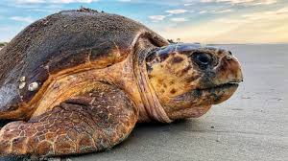
South African Turtles
South Africa has five of the seven kinds of sea turtles occurring in its coastal and off-shore waters
  Green turtle
  Hawksbill turtle
  Loggerhead turtle
  Olive ridley turtle
  Leatherback turtle
Loggerheads & Leatherbacks nest
on Maputoland Coast
All seven kinds of sea turtles in
the world are threatened;
harvesting of eggs, loss of nesting
beaches, trawling and longline fishing

Slide 3
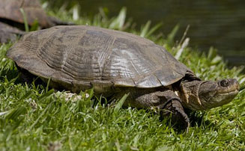
South African Terrapins
South Africa has six kinds of freshwater terrapins
  Cape terrapin
  Marsh terrapin
  Yellow-bellied hinged terrapin
  Variable hinged terrapin
  Serrated hinged terrapin
  Black-bellied hinged terrapin
All abundant and not considered
threatened,
Several cryptic (“hidden”) kinds
in hinged terrapins

Slide 4
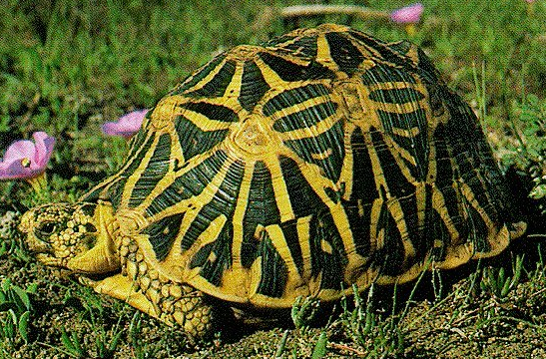
South African Tortoises
45 kinds of tortoises worldwide;
13 kinds in South Africa (30%)
8 kinds of tortoises in Western Cape; most anywhere in same area!
4 kinds threatened with extinction
  Geometric tortoise
  Speckled padloper
  Karoo padloper
  Tent tortoise

Slide 5
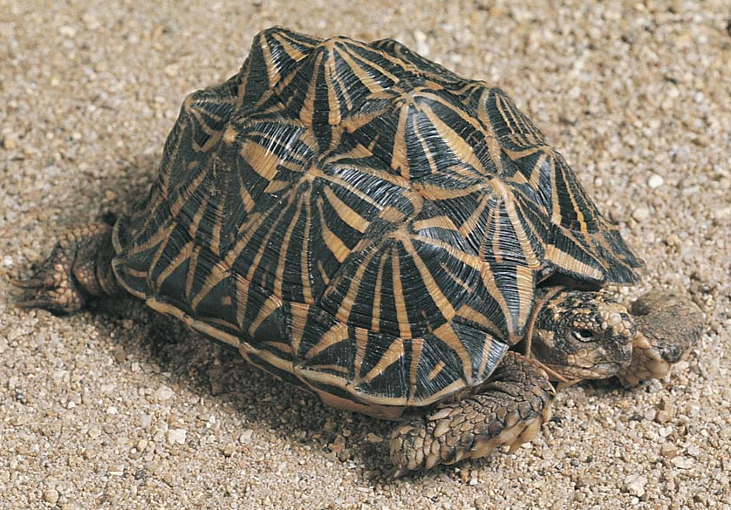
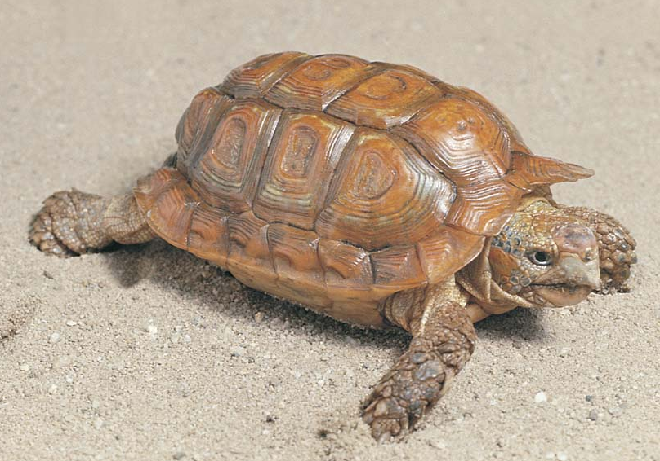
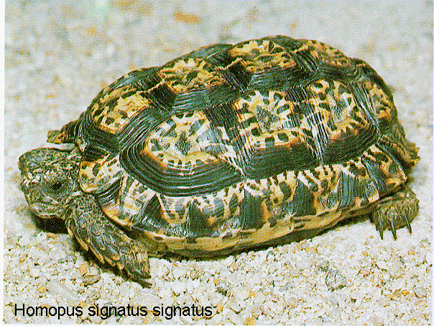
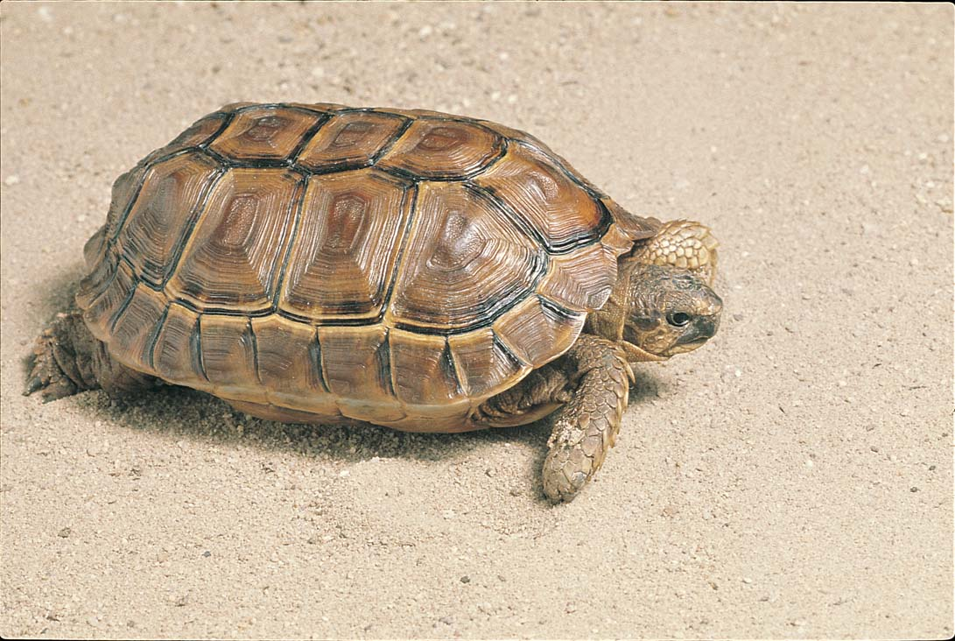
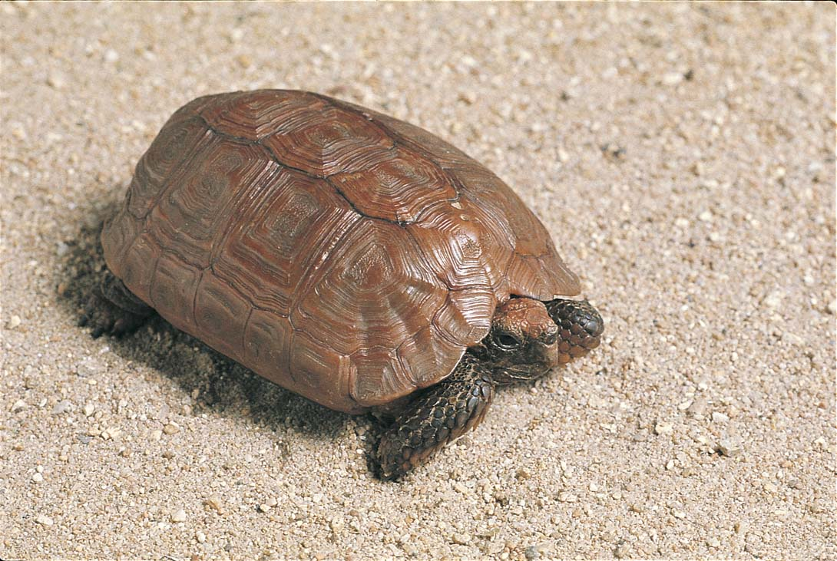
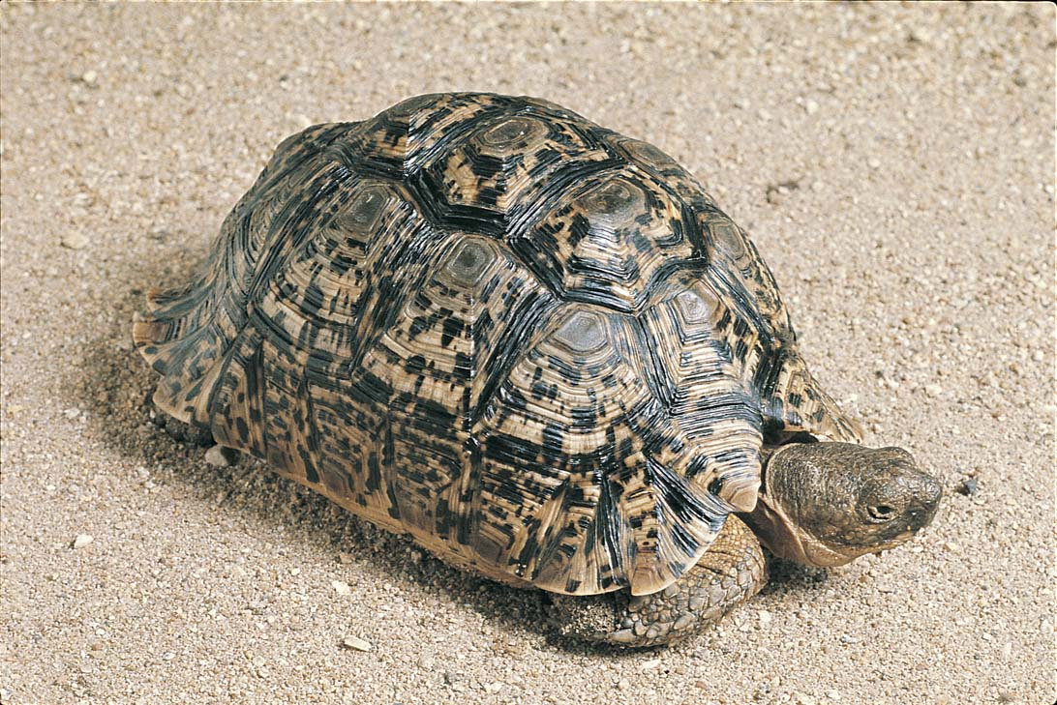
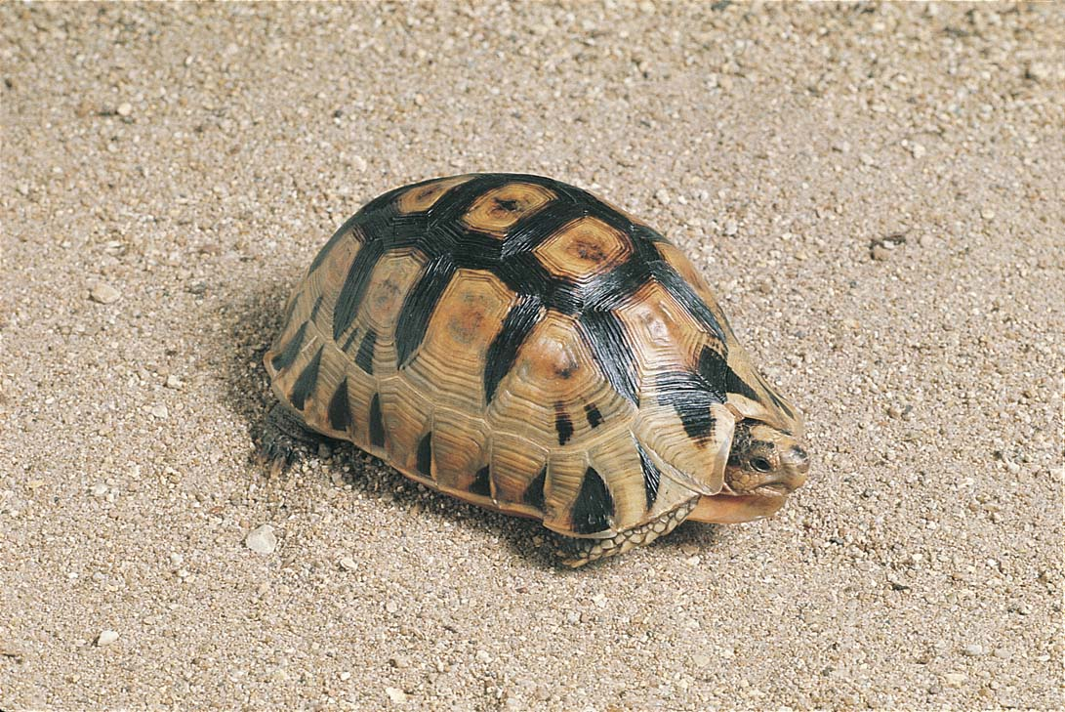
Geometric tortoise
Tent tortoise
Common padloper
Geometric tortoise
Speckled padloper
Greater padloper
Karoo padloper
Leopard tortoise
Angulate tortoise

Slide 6
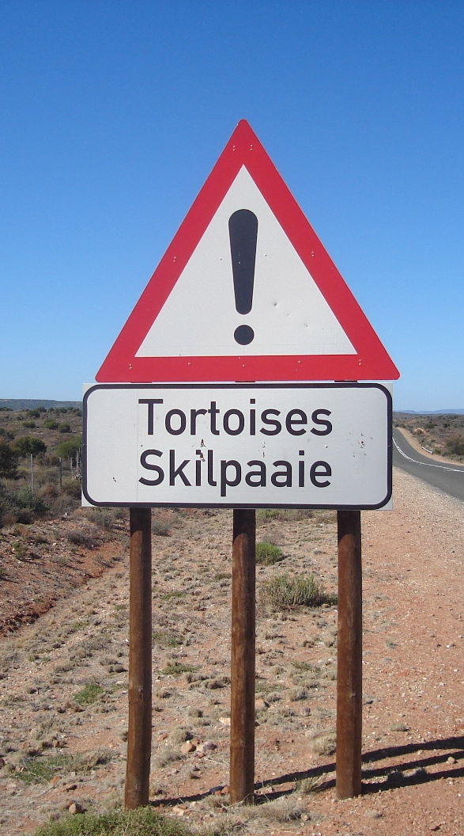
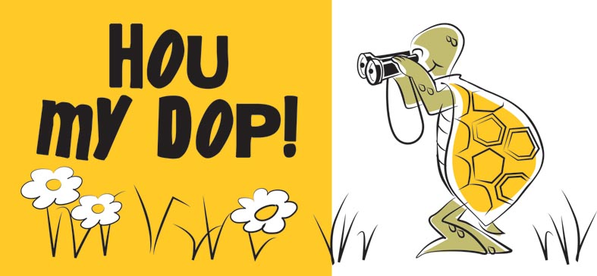
Watch out for our tortoises on the roads!!
They are not lonely! Do not take them home!

