Slide 1


Exploring Life Under Water:
Our Marine Biodiversity
12 June – ages 13 – 18
13h00 Session
LUSANDA GQAZA
Environmental Education Officer: CapeNature

Slide 2
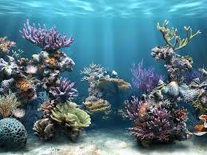
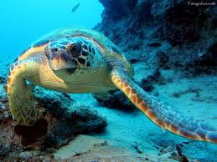
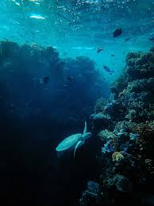
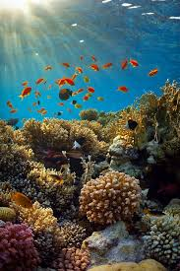
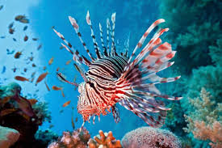
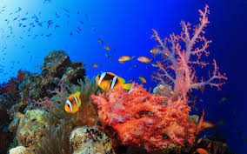
Introduction

Slide 3
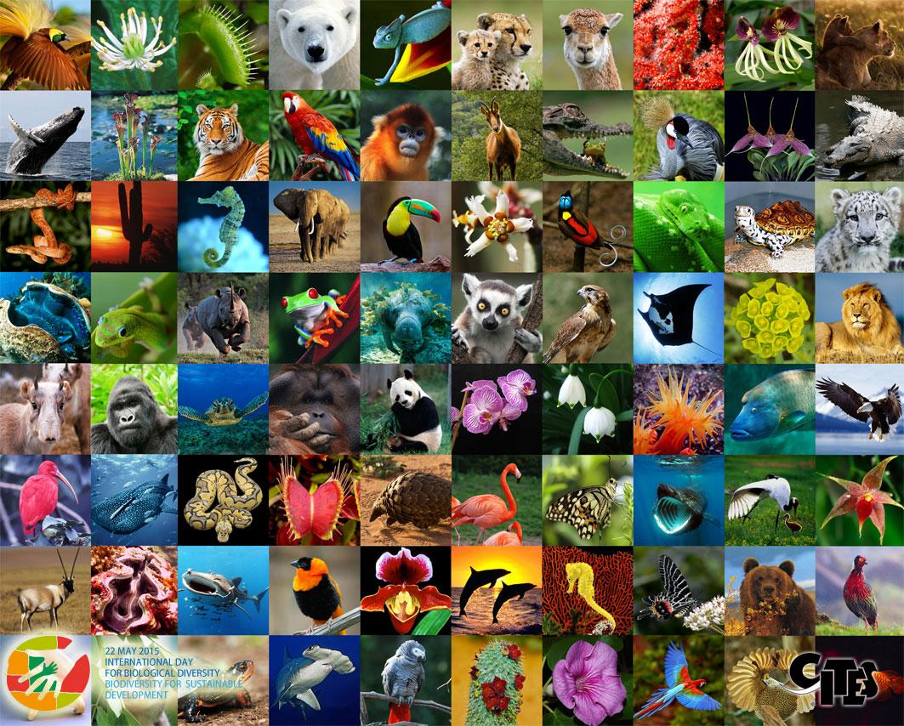
The world is made up of a variety of plants and animals – we call the variety of life on Earth…
B I O D I V E R S I T Y

Slide 4
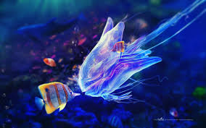
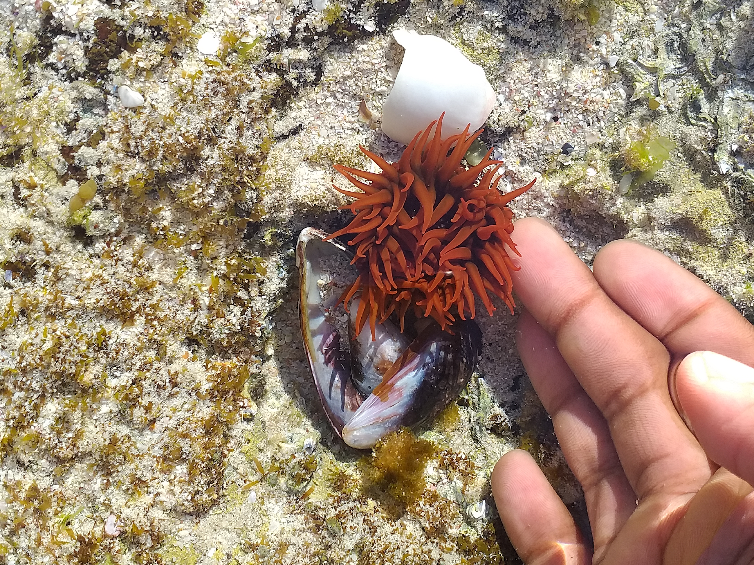
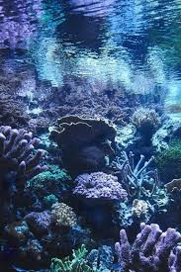
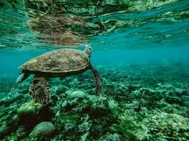
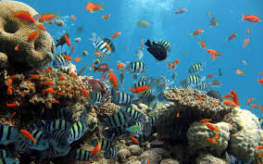
Marine biodiversity is the variety of plant and animal life that we find in the oceans and seas.

Slide 5
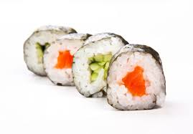
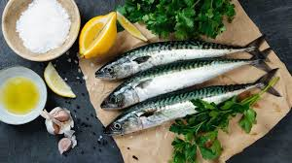
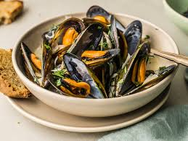
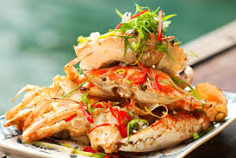
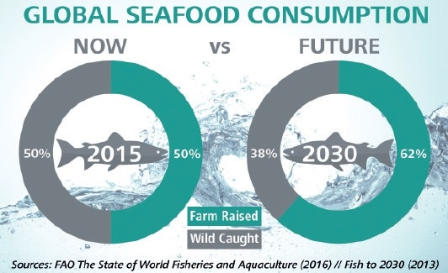
The marine environment is important because it provides:
Food for humans (and animals)…
0.97 to 2.7 trillion fish are caught from the wild every year. This doesn't include the billions of fish that are farmed.

Slide 6
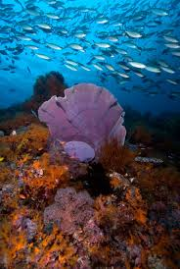

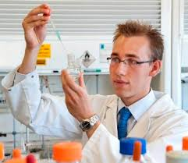
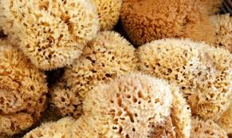
Raw materials for medicine
Did you know?
Although few representatives from sponges are approved as drugs, hundreds of new compounds are discovered from sponges every year.
Several sponge-derived compounds are already in clinical trials as agents against cancer, microbial infections, inflammation and other diseases.

Slide 7
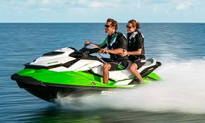

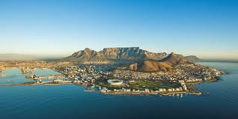
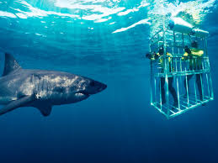
Recreational purposes - tourism
2019 – Almost 17 MILLION TOURISTS visited South Africa, a large number of those visited coastal towns such as Cape Town and Durban.
Tourism creates jobs.

Slide 8
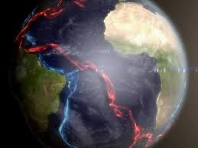
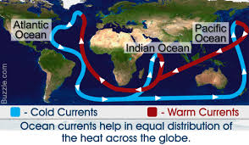
Regulates climate
Ocean currents act much like a conveyor belt, transporting warm water and precipitation from the equator toward the poles and cold water from the poles back to the tropics. Thus, ocean currents regulate global climate, helping to counteract the uneven distribution of solar radiation reaching Earth's surface.

Slide 9
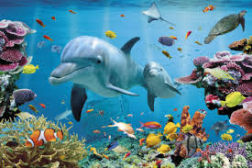
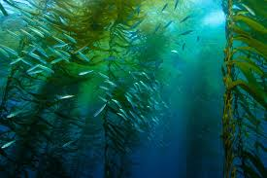
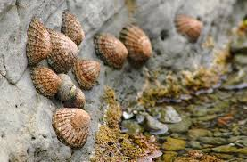
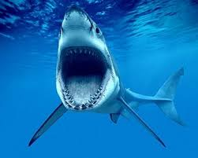
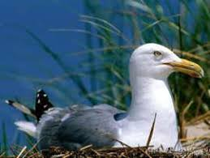
Diverse creatures depend on the ocean for life
There are over 200 000 known species in the ocean — and as many as 2 million more that remain a total mystery.
Scientists estimate that 91 % of ocean species have yet to be classified, and that 95 % of the ocean remains unexplored.

Slide 10
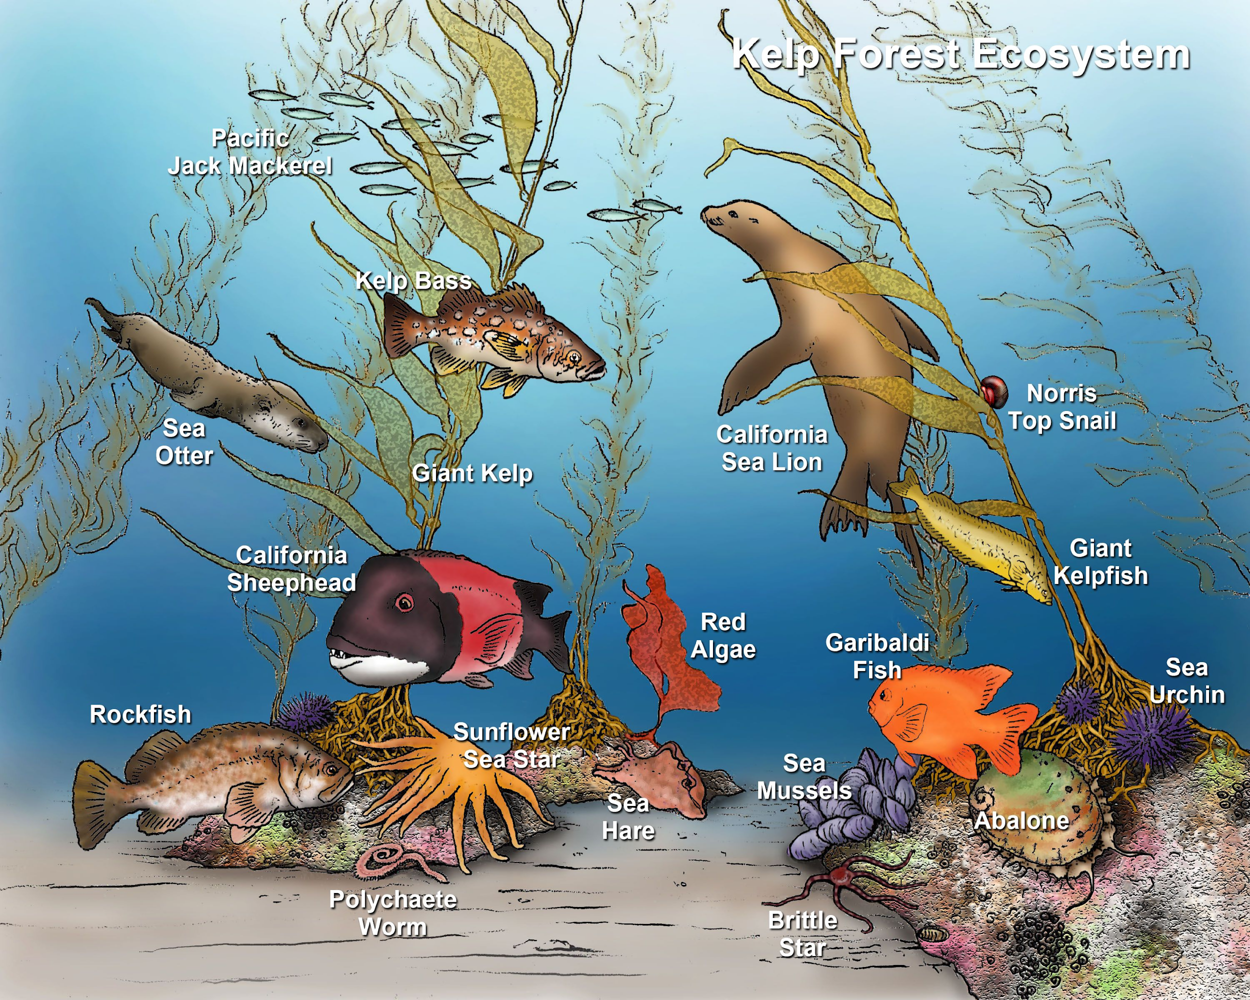
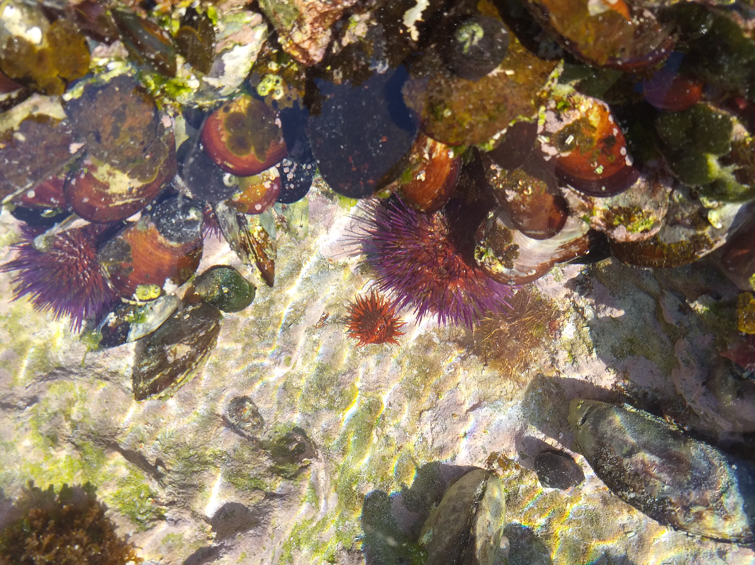
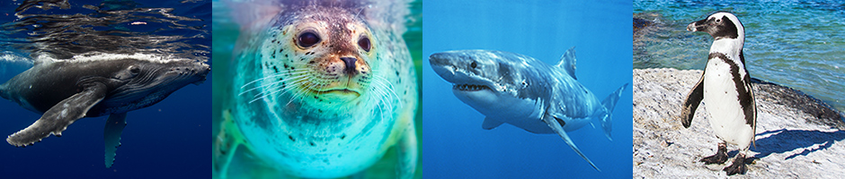
Life under water

Slide 11

Newsflash
According to the World Wildlife Fund (WWF), 80% of pollution in the ocean comes from land based activities. The plastic items we use and the sewage we create ends up in our oceans and harm the delicate ecosystems that lives in our waters ( WWF, 5 Jun,2018)

Slide 12
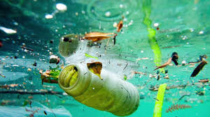
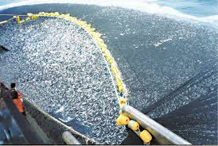
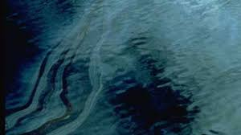
Threats
Pollution
Poaching
Overfishing
Oil spills
Toxic chemicals

Slide 13
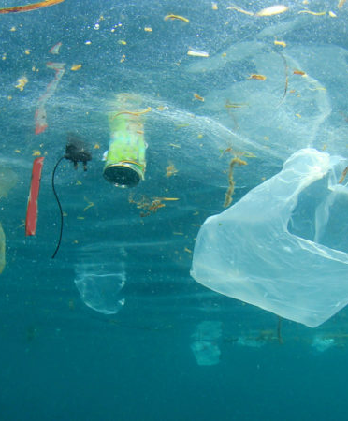
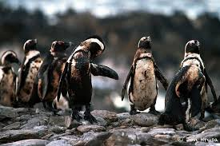

Slide 14
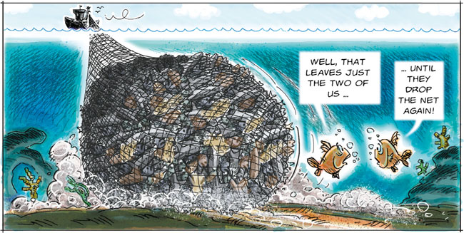
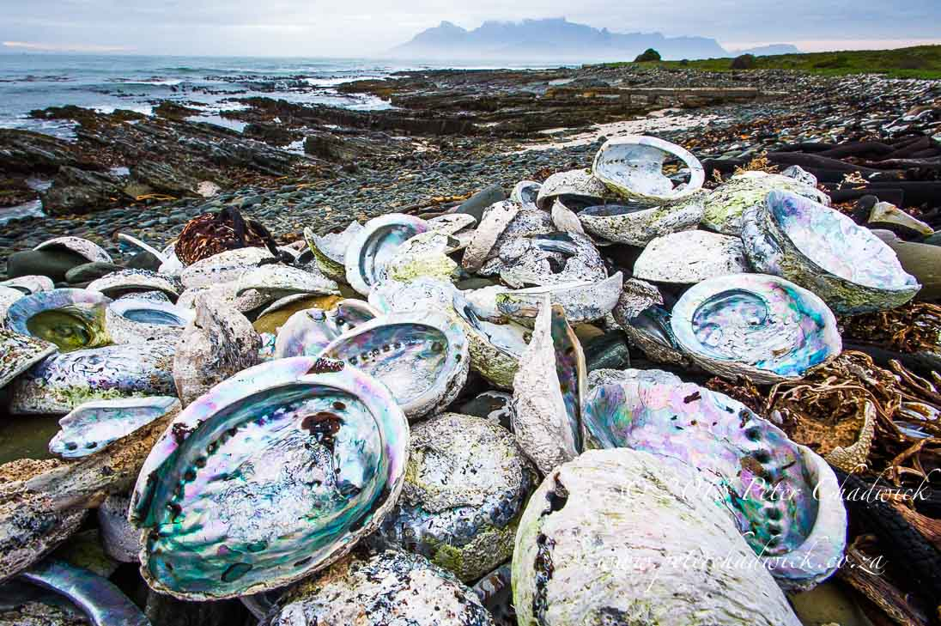

Slide 15
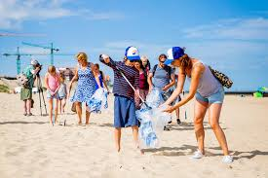
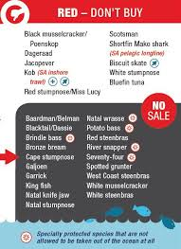
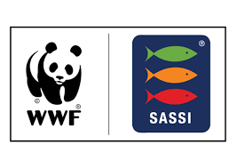
How can we help?
Raise awareness
Participate in beach clean ups
Recycle
Sustainable fishing
Educate yourself about the marine environment
Support organizations such as CapeNature
Make safe seafood choice
DO NOT LITTER

Slide 16
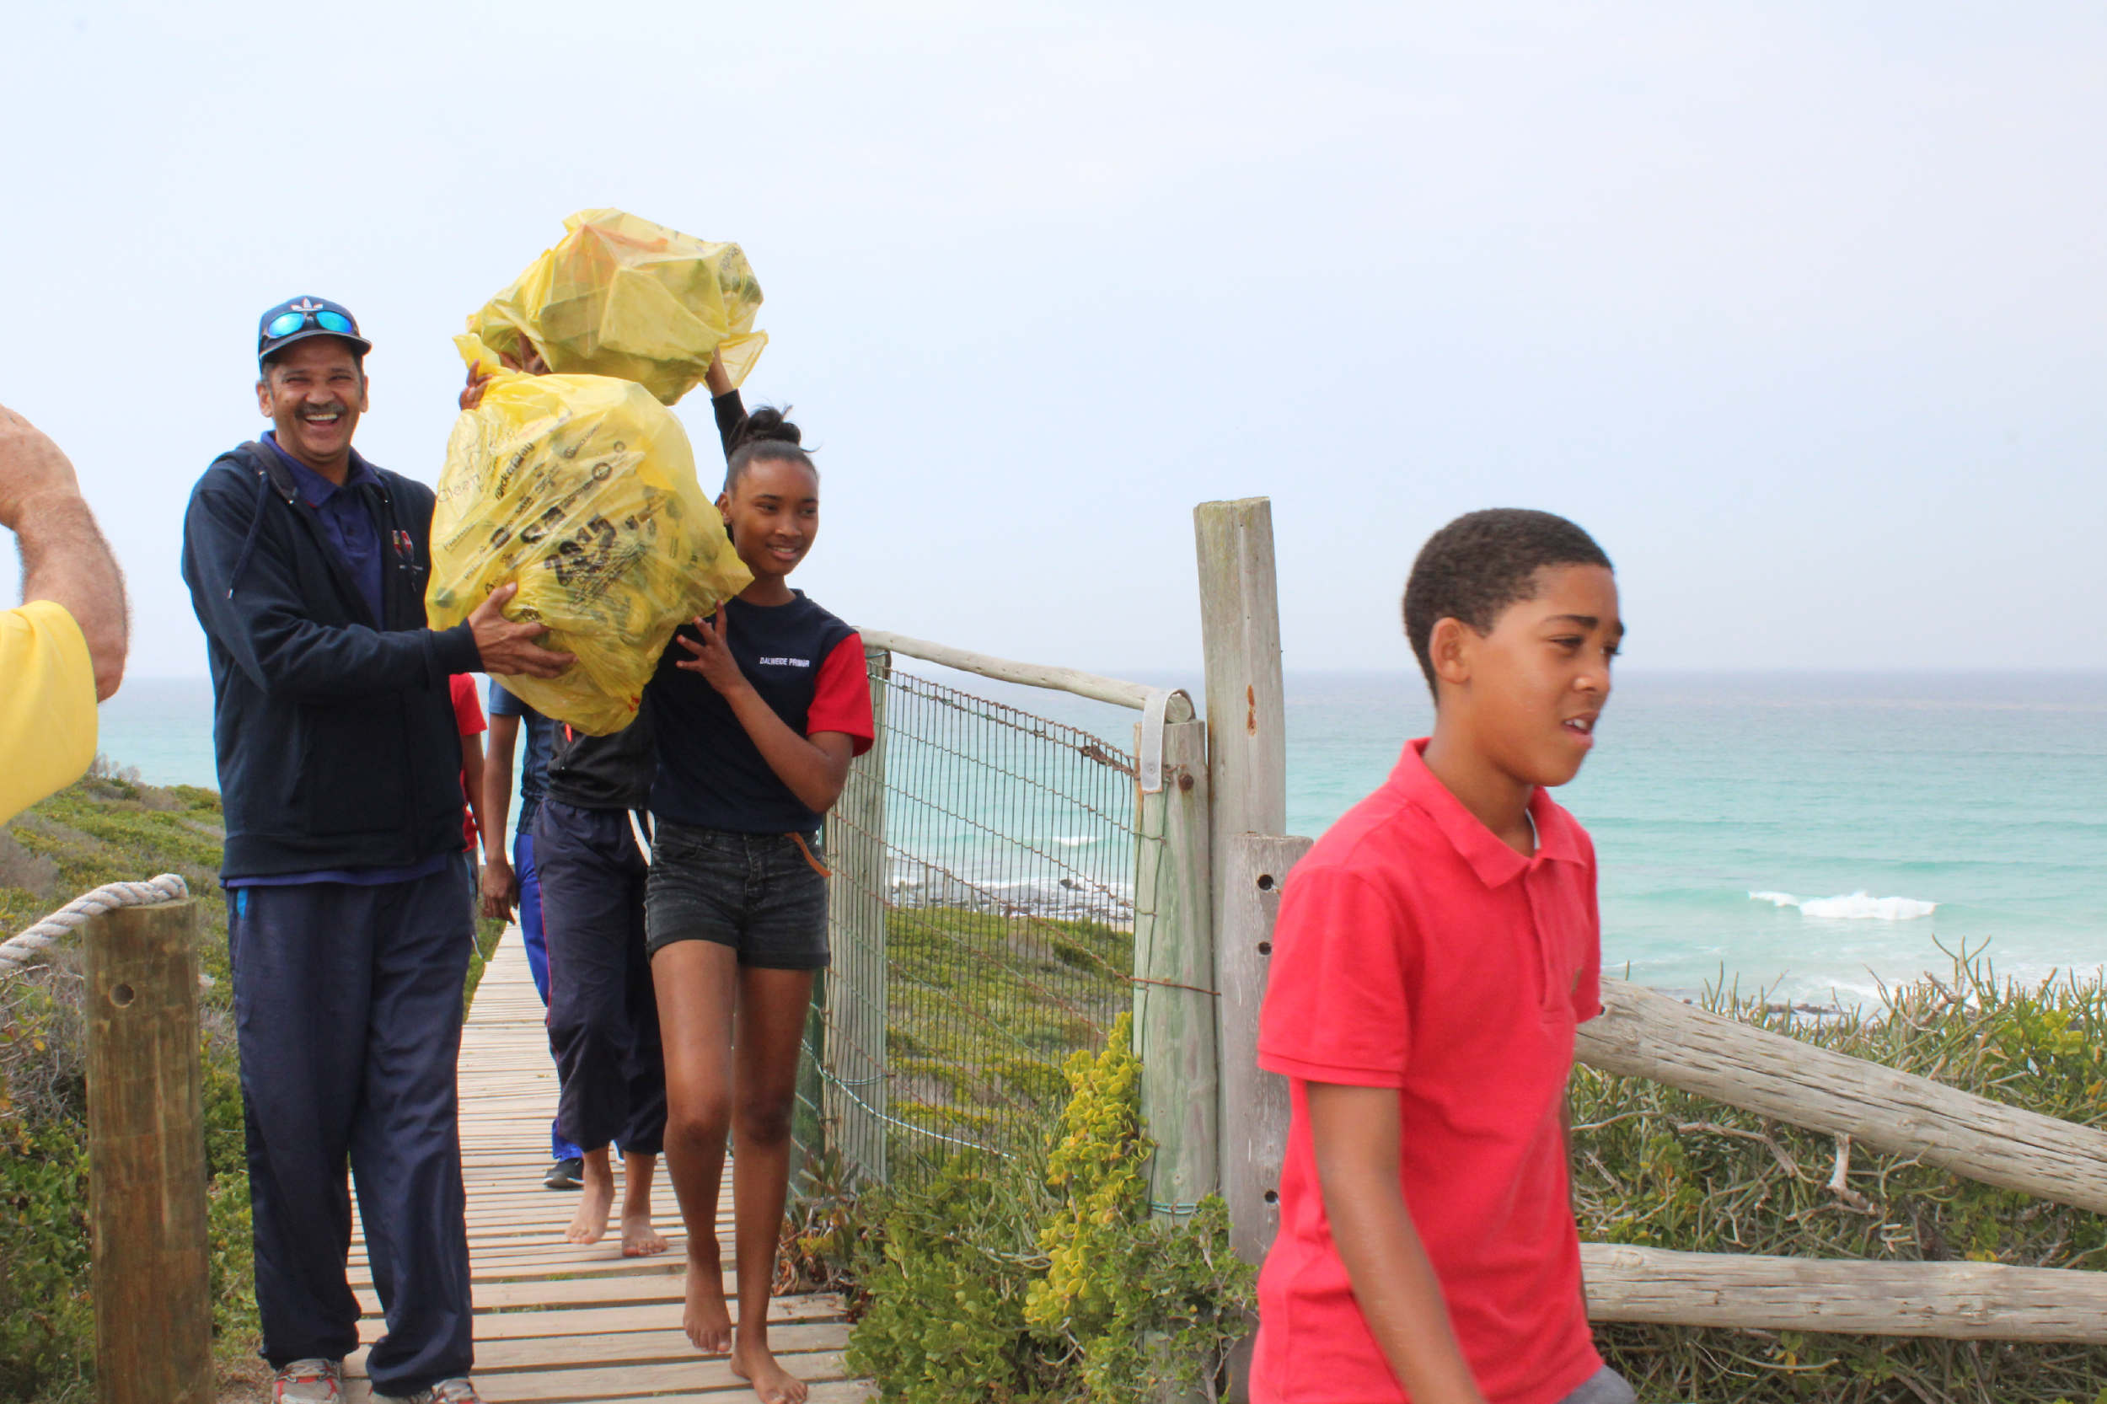
We are making a difference, what are you pledging to do to save our marine biodiversity?

