Slide 1
CELEBRATIING INTERNATIONAL FOREST DAY
XXX
ADD TITLE

Slide 2
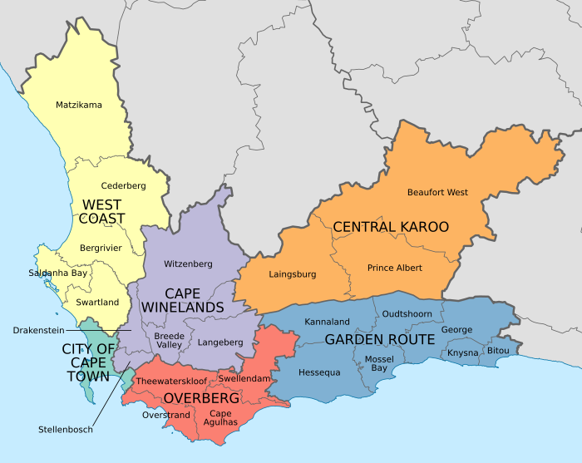
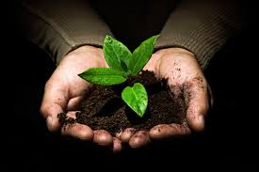
Who are we?
CapeNature is the part of government that protects natural occurring plant and animal life (biodiversity) in the Western Cape.
Quick activity: Do you know where there are forests in the Western Cape?
Forests – plantations and natural

Slide 3
What are we going to do today?
Guided Forest Hike
2.Role Play
3.Lunch

Slide 4
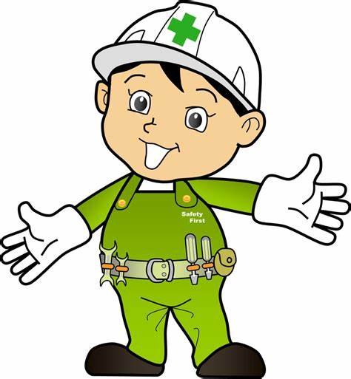
House rules
Safety
Bathrooms
Smoking
Refreshments
Other?

Slide 5
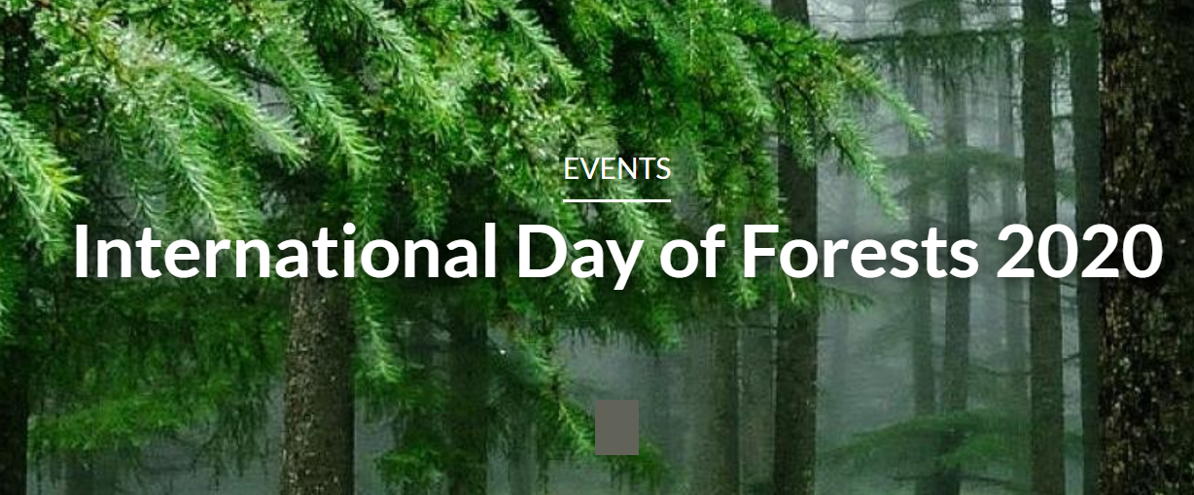
What is International Day of the Forest?
A special day to celebrate the importance of forests to people
Takes place on 21 March each year around the World
This years theme – Forests and Biodiversity

Slide 6
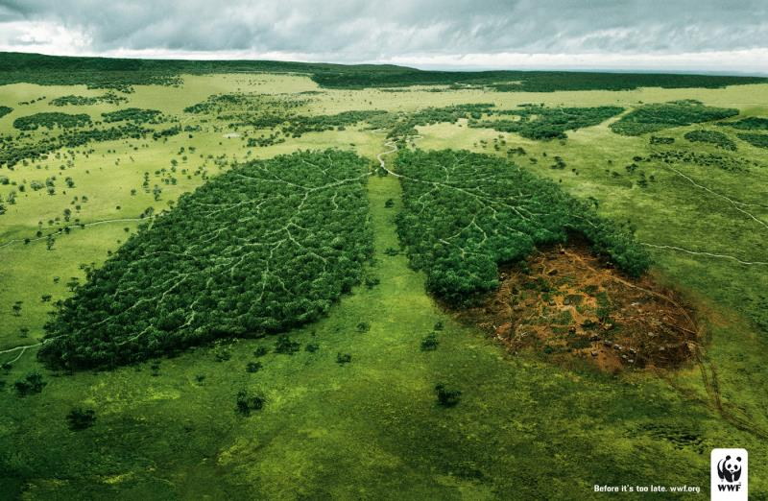
Why are trees and plants important to us ?
Cleans our air, provides our air

Slide 7
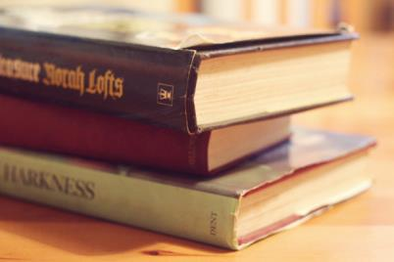
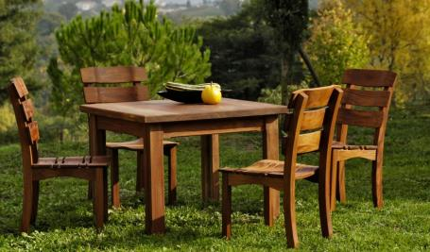
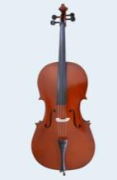
Provides wood we use

Slide 8
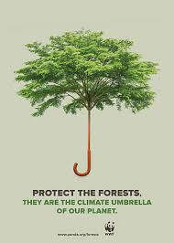
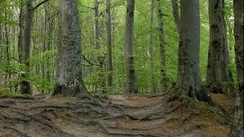
Mitigate climate change
Prevent soil erosion

Slide 9
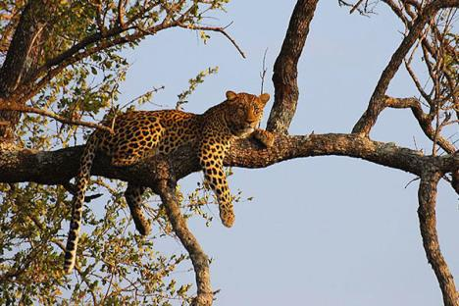
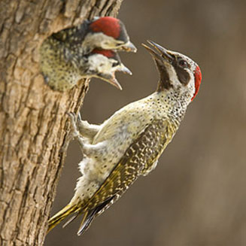
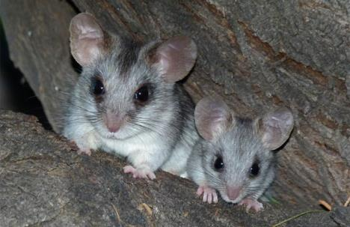
Habitat for animals and us

Slide 10
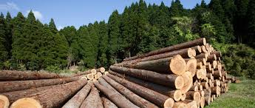
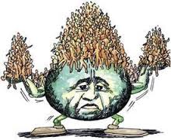
Why are forests under threat?
We are taking more than we are putting back
The worlds population is growing and we need more houses, paper, food etc.

Slide 11
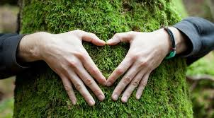
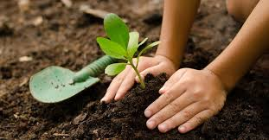
What YOU can do to protect trees and plants
LIVE IN A WAY THAT IS NOT HARMFUL TO THE ENVIRONMENT
PLANT TREES – check that it is indigenous first!
SPEAK UP - tell everyone about the importance of forests and biodiversity

Slide 12
