Slide 1
Living Fossils - Cycads
12 June – ages 13 – 18
13h30 Session
NOLOYISO DLAMINI
Stakeholder Engagement Officer

Slide 2
What is a cycad?
Cycad is an ancient woody cone bearing plant
They resemble a palm or fern but are not related
Adaptive to different climate conditions

Slide 3
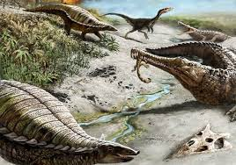
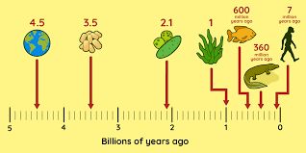
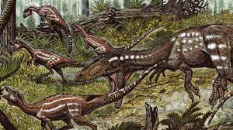
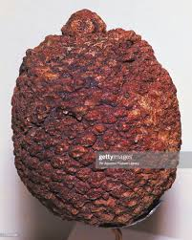
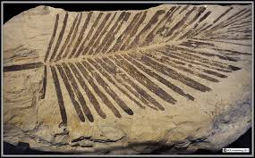
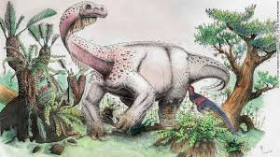
They are the oldest plants dated to 300-325 million years old – this plant shared its space with the dinosaurs!

Slide 4
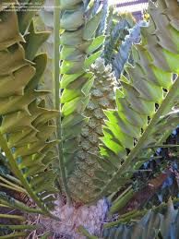
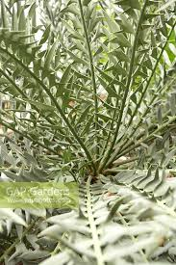
What makes a cycad unique?
Leaves – large , hard, tough and spikey

Slide 5
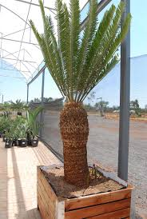
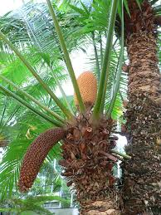
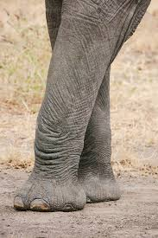
Stem - cylindrical , strong , woody thick like an elephant leg

Slide 6
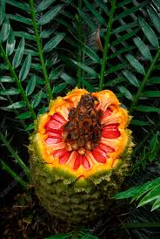
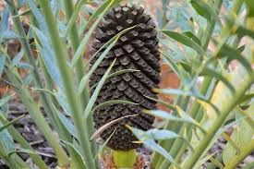
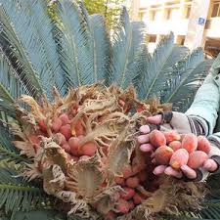
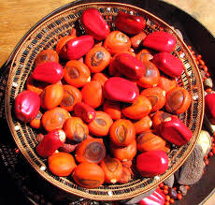
Seeds - often bright red , purple or yellow when matured

Slide 7
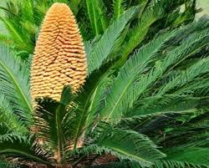
Interesting facts about cycads
How much do you know about earthworms?
Slow growing but can live hundreds of years

Slide 8
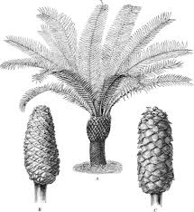
Male and female reproductive parts from separate plants

Slide 9
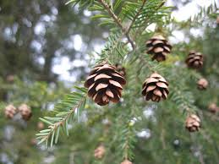
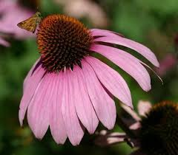
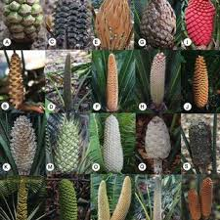
Produce cones instead of flowers

Slide 10
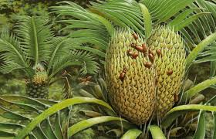
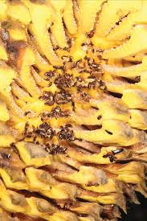
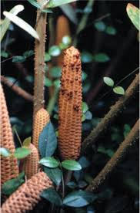
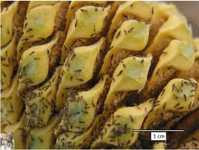
Some species produce heat or odour/ smell to attract pollinators

Slide 11
Important facts about cycads
How much do you know about earthworms?
Cycads are protected and require permits for :
Growing
Selling
Possession
Buying
Transporting

Slide 12
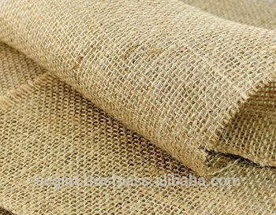
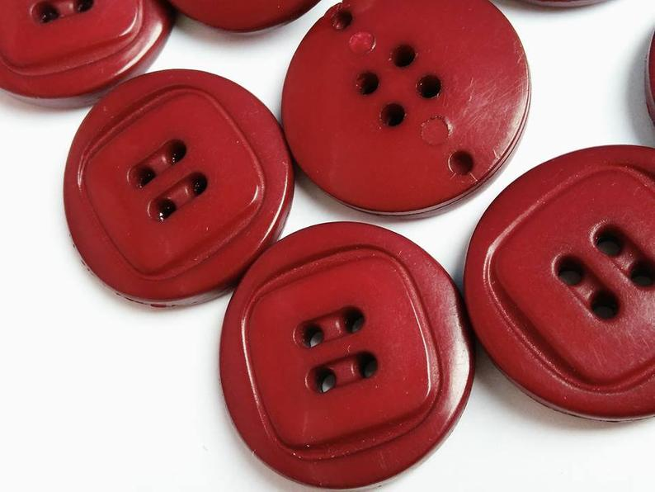
Activity – Create your own cycad model
WHAT DO YOU NEED ?
Stem- empty toilet paper roll or dried mealie cob
Rough bark – bark chips or hessian
Leaves – paper plate and green crayons for colouring
Cones – old pine cones ( green or dry )
Seeds – red middle size buttons or wool to create your seeds
Glue, or sticky tape and blunt nose scissor

Slide 13
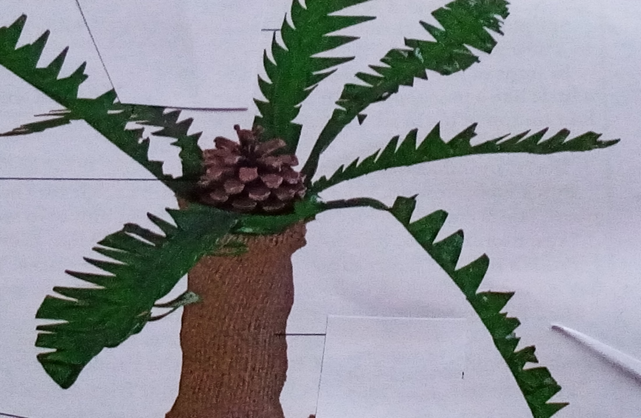
Cycad model
-

Slide 14
Pledging for plants
PLEDGE
I pledge to protect plants
I pledge not to pick plants from the wild unless permitted
I pledge to report the illegal trade or picking of fauna and flora

