Slide 1
Western Cape Protected Area Expansion Strategy 2021-2025
Philippa Huntly: Mainstream Specialist
Chanel Rampartab: Capability Manager Innovation
Anita Wheeler: Biodiversity Conservation Specialist
Newsflash prepared for
Biodiversity Planning Forum
3-5 August 2021

Slide 2
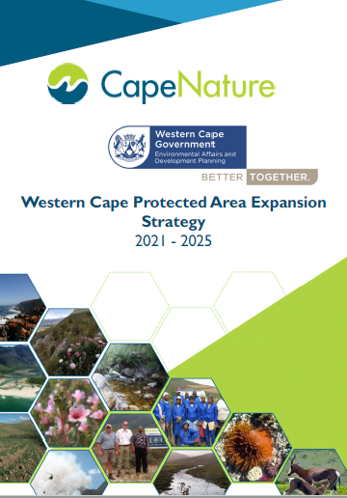
WCPAES
2021-2025
Aligned to & informed by:
National Protected Area Expansion Strategy
Protected Areas Act
CapeNature Strategic Plan 2021-2025
Western Cape Biodiversity Spatial Plan
Builds on the excellent foundation of the WCPAES of 2015.
Collective effort
Notes:
It is aligned to and informed by National Protected Area Expansion Strategy
The identification of priority areas for the protection of biodiversity is informed by the Western Cape Biodiversity Spatial Plan (WCBSP)
The new revised strategy builds on the excellent foundation of the 2015 Strategy and is very much the result of a collective effort.

Slide 3
Collective effort: thank you to all authors, contributors and reviewers !
Author: Garth Mortimer | Agency
Contributors: Alana Duffell-Canham, Alexis Olds, Chanel Rampartab, Cher-Lynn Petersen, Colin Fordham, Philippa Huntly, Therese Forsyth, Ruida Pool-Stanvliet Albert Ackhurst, Caren George, Frances Balayer, Leptieshaam Bekho, John Wilson, Marlene Laros | CapeNature Western Cape Department of Environmental Affairs and Development Planning (DEA&DP)
Partners: Andre Rossouw, Clifford Dorse, Jacques van der Merwe, Julia Wood Kerry Maree Kevin McCann Giselle Murison, Melissa Whitecross Odette Curtis Sean Privett Gareth Boothway, Jan Coetzee, Katherine Forsythe, Onkemetse Nteta, Shelly Fuller | City of Cape Town (CCT) Table Mountain Fund (TMF) Conservation Outcomes Birdlife SA Overberg Renosterveld Conservation Trust Grootbos Foundation WWF-SA
External Reviewers: Deshni Pillay, Andrew Skowno, Mthobisi Nzimande | South African National Biodiversity Institute (SANBI)
Notes:
Stewardship is a collective effort and CapeNature would like to acknowledge and thank all contributors and partner organisations and individuals in this space.
The emphasis of the revised PAES has moved away from protected area-centric conservation to bridging divisions between geographies, jurisdictions, sectors, and cultures to safeguard ecological, cultural, and economic benefits for all. This approach enables stronger focus on strategic partnerships with key stakeholders such as local municipalities, provincial and national departments, NGOs, other conservation agencies, landowners, and communities. We would like to thank all our partners.

Slide 4
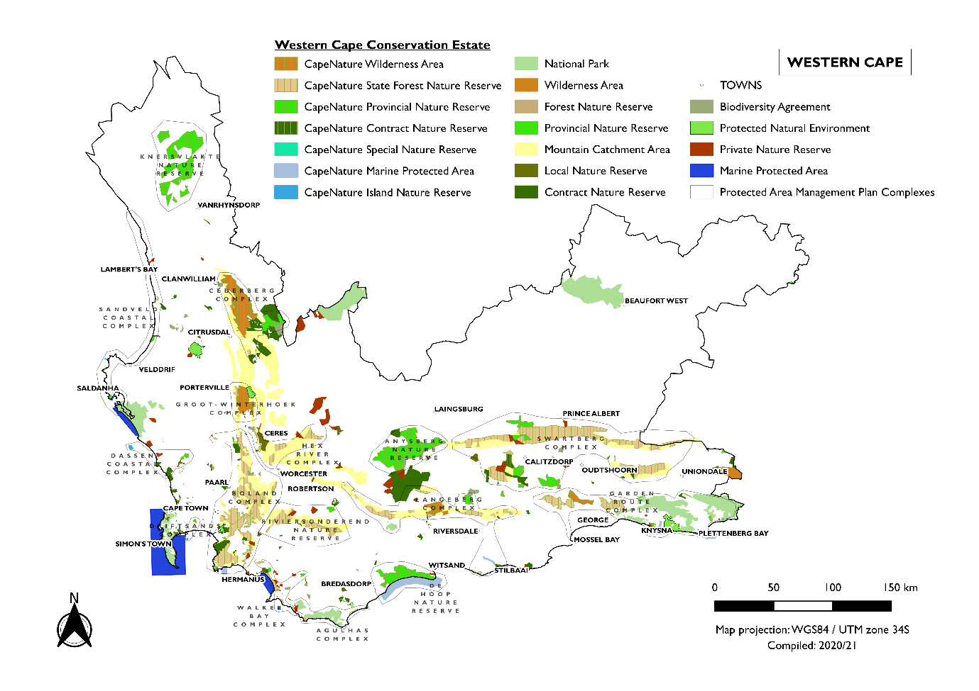
Notes:
The existing protected area network provides extensive protection to mountain catchments and encompasses over 60% of South Africa’s Strategic Water Source Areas which are located within the province.
However, the historic focus on mountains has left lowland areas under-protected, with 20% of lowland vegetation types not protected at all.
The updated strategy addresses the need to urgently protect priority threatened ecosystems.

Slide 5
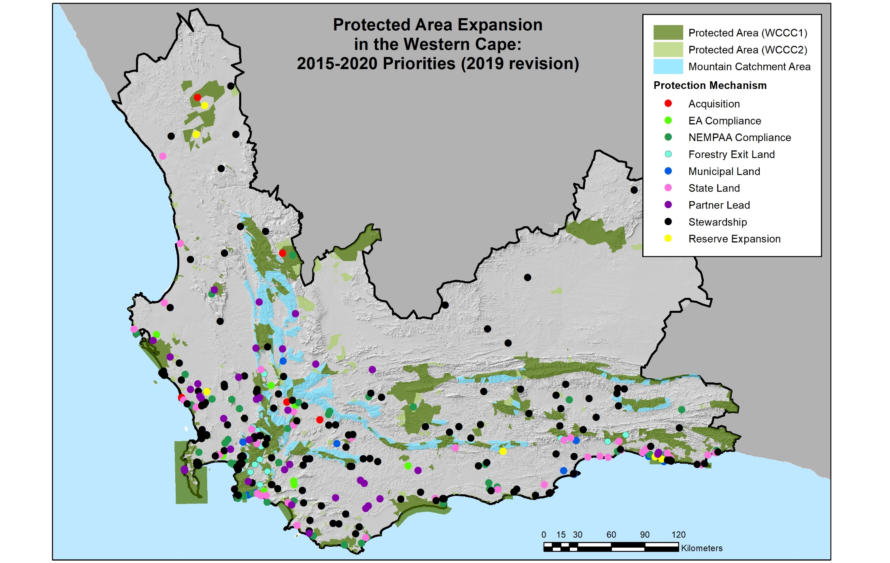
CAP Map
Notes:
Priority areas are identified in the updated Conservation Action Priorities Map.
The CAP Map, is underpinned by a comprehensive database, indicates specific cadastres targeted for protected area expansion according to objective, mechanism, organisation, and urgency.

Slide 6
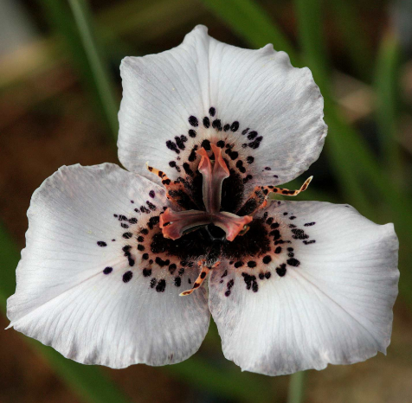
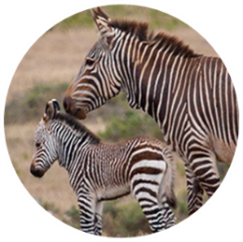
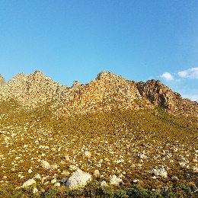
WCPAES objectives
Gains made 2015-2020
Critically endangered ecosystems
Key species
Under-protected and strategic landscapes
Coastal, marine and estuarine ecosystems
Freshwater ecosystems
Secured sites in 12 of 15 critically endangered ecosystems
Secured habitat of Cape Mountain Zebra, riverine rabbit, endemic fish and butterflies, bird congregation sites and plant hotspots
Met full protection level targets for two under-protected ecosystems and one strategic landscape
CapeNature manages six Marine Protected Areas: ~43000 ha and 116km coastline
Secured 14 freshwater ecosystems across five District Municipalities
Notes:
The objectives are to protected: Critically endangered ecosystems; Key Species; Under-protected and strategic landscapes; Coastal, marine and estuarine ecosystems and freshwater ecosystems.

Slide 7
Mechanisms to achieve goals
Increasing support from CapeNature
and commitment to conservation
Nature Reserve
Declared as per S23 of NEM:PAA
Stewardship
Regularisation
State land
Purchase/donation
Biodiversity Agreement
between CapeNature and landowner
Protected Environment
Declared as per S28 of NEM:PAA
Biodiversity Partnerships
Single area, property or multiple properties. Incl. Natural Heritage Sites and Conservancies
Notes:
Of the various mechanisms to achieve protected area goals, formal Stewardship is the most effective

Slide 8
Stewardship process
Desktop screening
Site visit
Status assigned for biodiversity value
Present to WCPAES Review Committee
Administrative and legal process
Official declaration
CapeNature audits regularly
Agreement subject to change

Slide 9
The 2021 Annual Provincial Target of 5000ha already reached:
Lettas Kraal Nature Reserve 6900ha
Silflay Nature Reserve 1280ha
Notes:
The 2021 Annual Target of 5000ha reached with the declaration of a number of sites earlier this year, the largest being Lettas Kraal Nature Reserve 6900ha and Silflay Nature Reserve 1280ha

Slide 10
Thank you

