Slide 1
The structure of plants
NAME OF PRESENTER
Date:
Venue:

Slide 2
Introduction

Slide 3
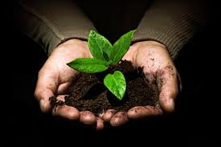
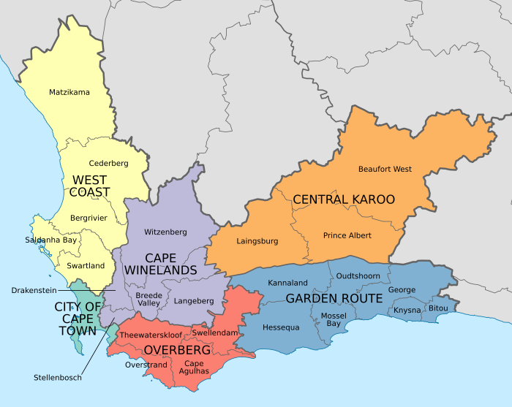
Who are we?
Quick activity: Can you spot where we are right now on this map of the Western Cape?
CapeNature is the part of government that protects natural occurring plant and animal life (biodiversity) in the Western Cape.
NOW - Introducing our incredible staff…

Slide 4
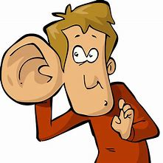
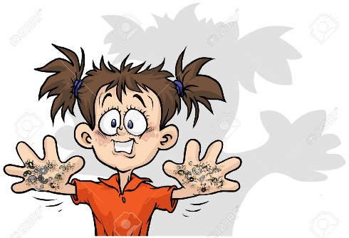
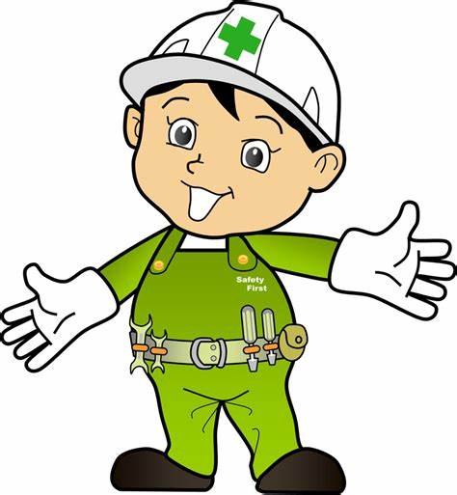
What are the rules for today?
RULES OF ENGEGEMENT
Listen to the speaker
Respect your teacher and classmates
Be safe
What else?
Take part in all the activities!
Have fun!

Slide 5
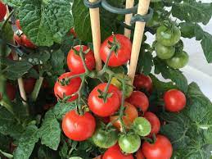
What are we going to do today?
Learn all about the structure of plants
Learn about what plants need to survive
Interview a plant
Promise to do one thing to look after plants

Slide 6
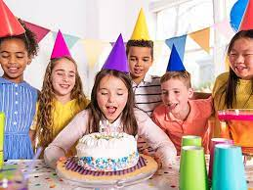
What is Plant Appreciation Day?
A special day for celebrating plants – like a birthday !!!
This special day takes place on 13 April every year (annually)

Slide 7
Tuning in

Slide 8
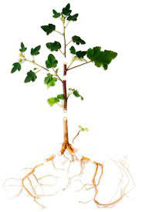
The structure of plants
Plants are living things and have a basic structure with different parts.
Can you see some of the different parts in this picture?

Slide 9
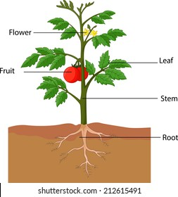
Plants have different parts like leaves, flowers, seeds, stems, fruit and roots.

Slide 10
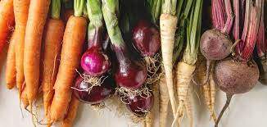
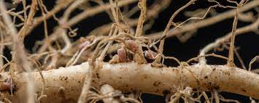
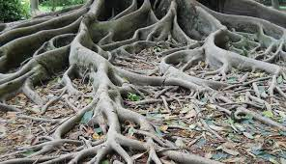
Each plant part has a job that helps them carry out their life processes
Roots – suck up water from the soil and anchor the plant in the soil.

Slide 11
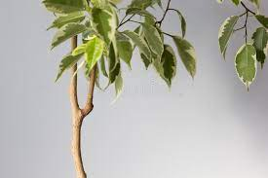
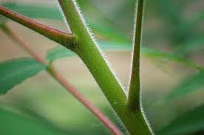
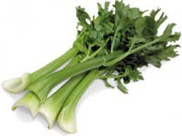
Stems hold the leaves in a way so that they can catch sunlight.

Slide 12
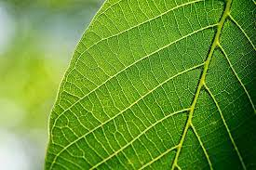
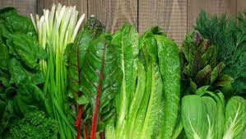
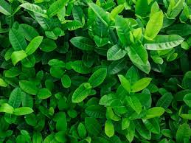
Leaves catch sunlight energy to make the plants food.

Slide 13
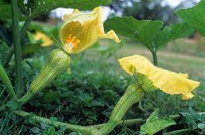
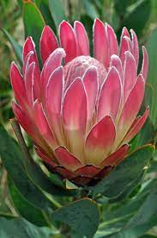
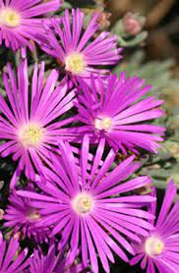
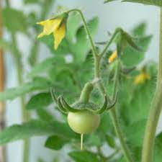
Flowers make seeds.

Slide 14
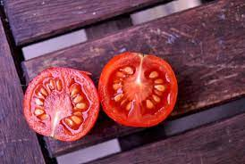
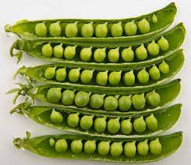
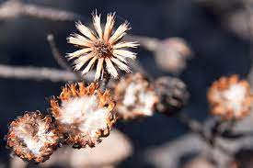
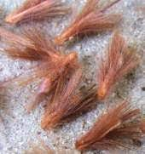
Seeds make more plants of the same kind. What does the fruit do?

Slide 15
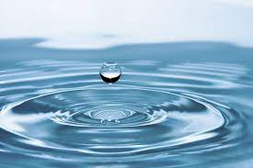
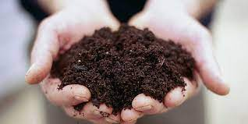
Plants also NEED certain things to survive…
Sun, nutrients in the soil, air, water, a place to live and even other plants!

Slide 16
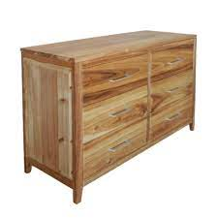
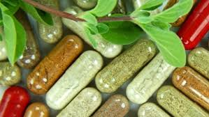
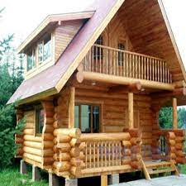
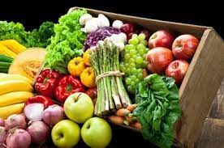
And just like plants need things to survive…we need plants to survive!
Can you think why we need plants?

Slide 17
Interview with a plant
ACTIVITY
Learners must:
• Draw their plant (in real life or off the screen)
• Label all the plant parts that they can
• Measure their plant and record it on the drawing (how high, how wide) - optional
• Ask them to ask the plant the following questions and answer on the drawing:
- What do you need to live?
- What part of you makes your food?
What part of you holds you upright?
How tall are you?
What do your flowers look like?
Note for teachers – you can ask any questions about plant
structure, the function of plant parts or things that plants
need to survive.

Slide 18
Consolidation

Slide 19
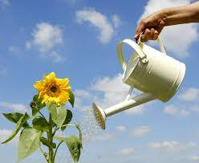
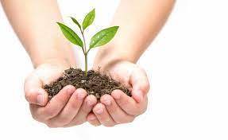
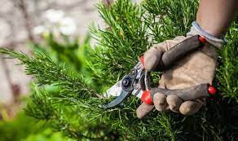
What did you learn today?
Let’s look at one or two interviews:.
Remember that we need to look after plants as they are very important to us. What can you do to look after and protect plants at school or at home?

Slide 20
Acknowledgements: Primary Science Programme – information source

