Slide 1

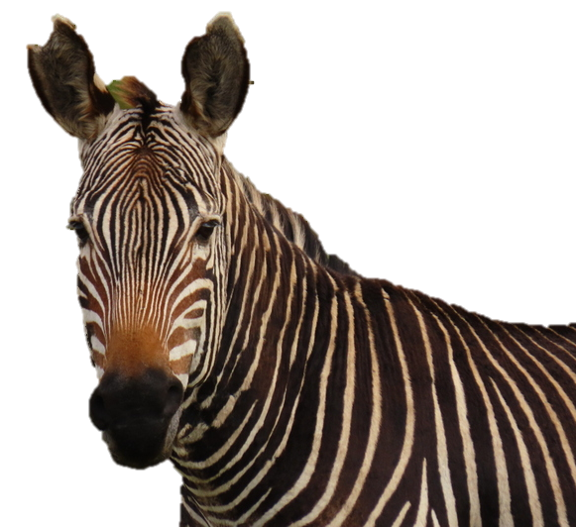

In the mix:
Cape mountain zebra conservation
Marienne de Villiers
for the CapeNature CMZ Working group
Ecologist Fauna: CapeNature

Slide 2
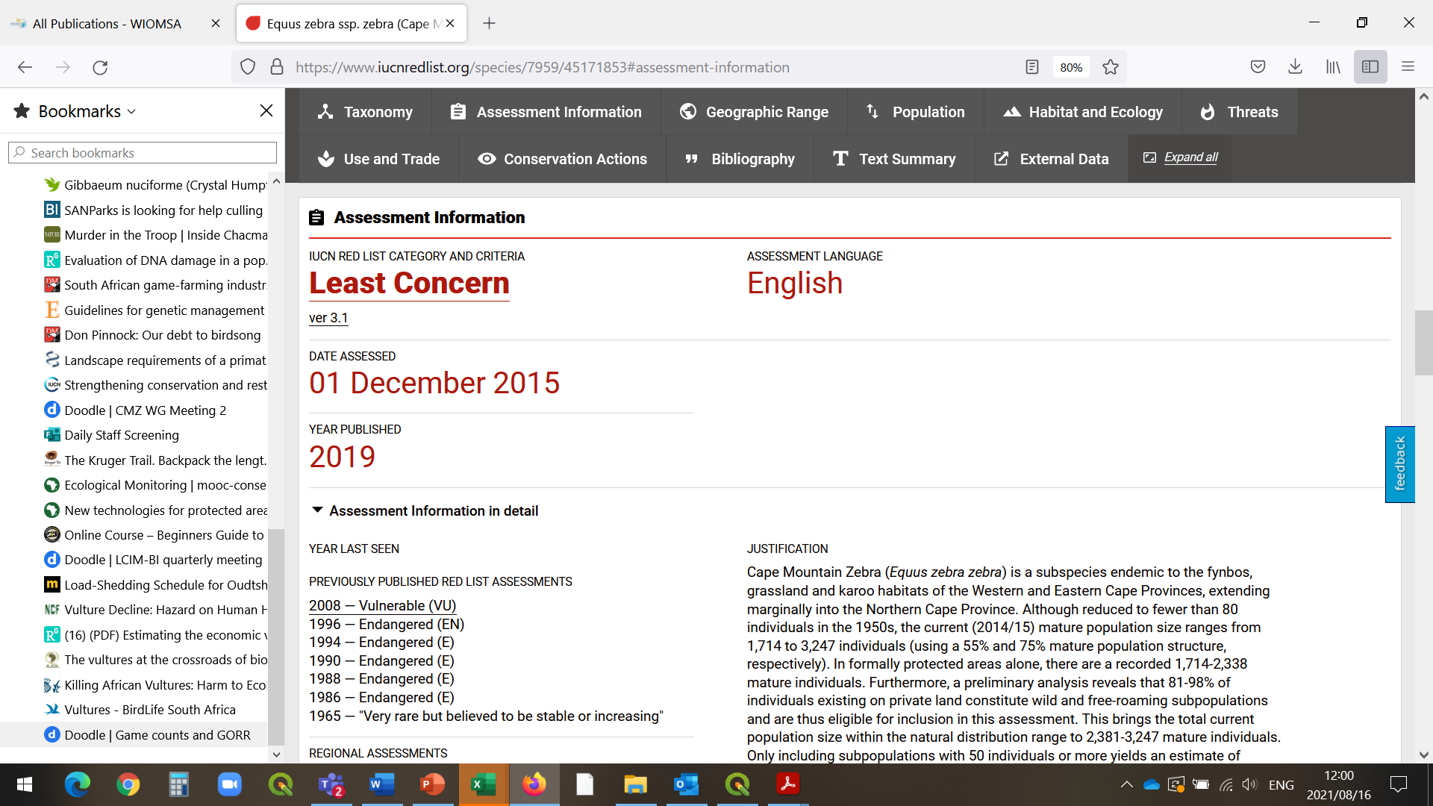
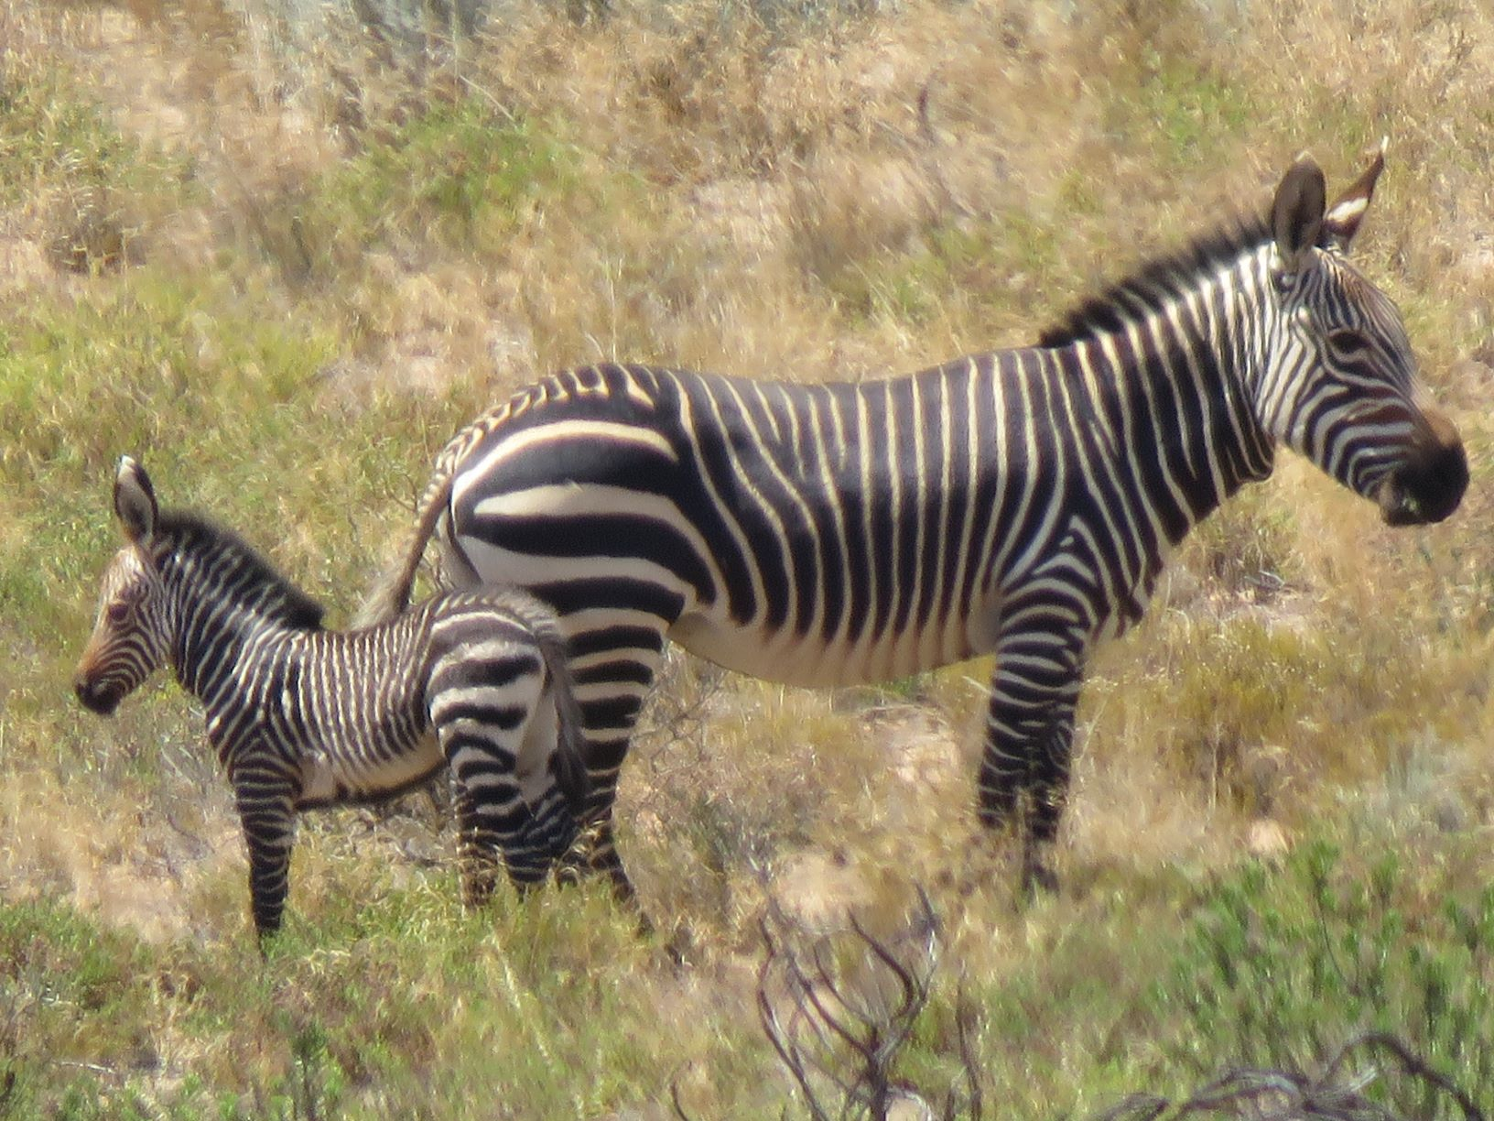
3000
60

Slide 3
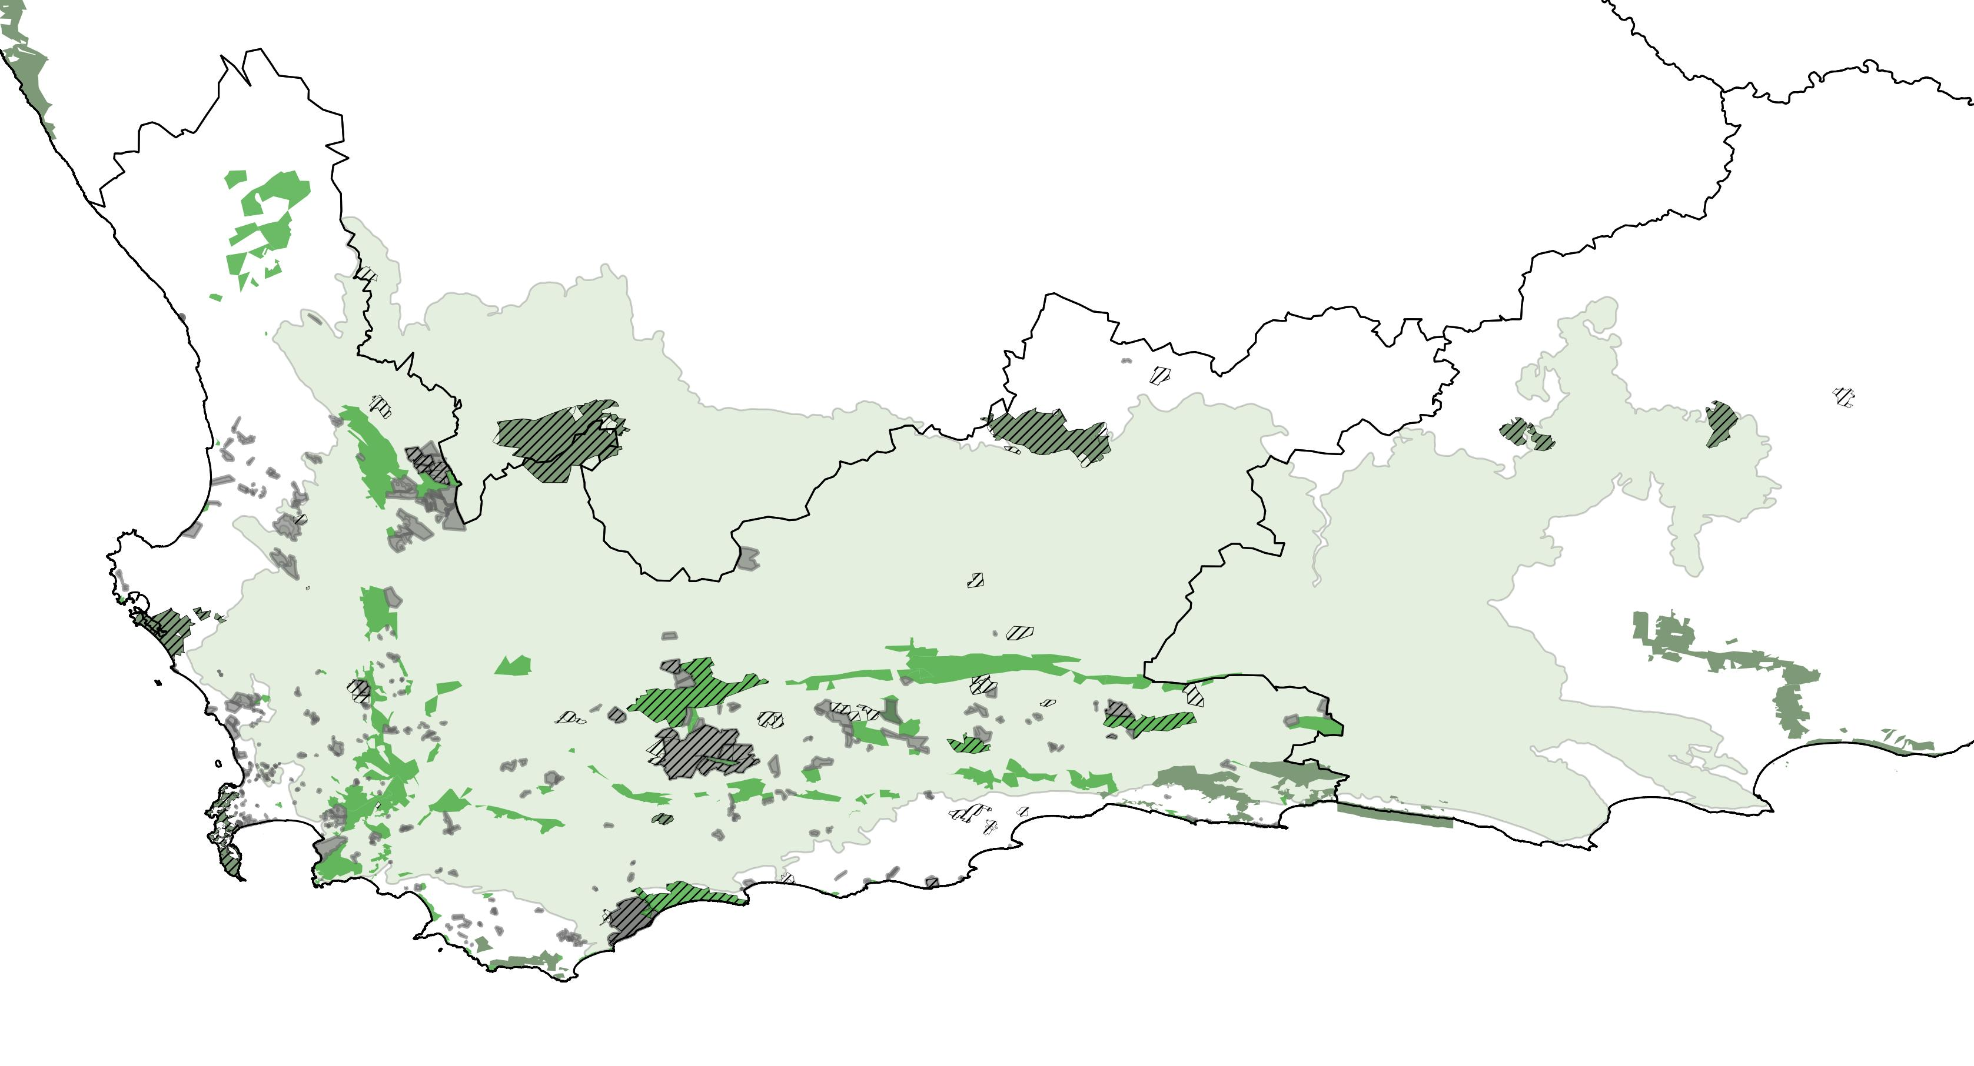
Notes:
Light green: Natural (historical distribution range).
Dark green: CapeNature reserves

Slide 4
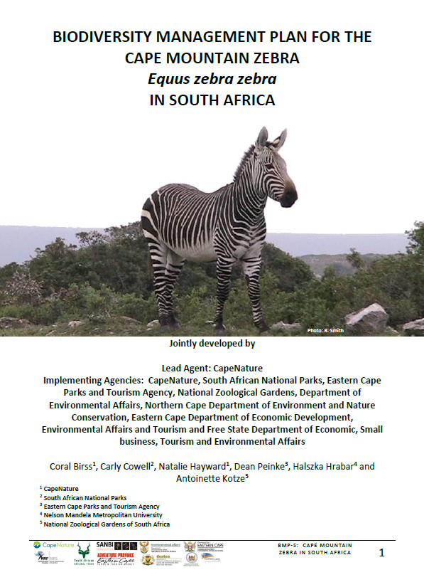
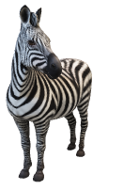
BMP
Hybridization
Inbreeding
Habitat

Slide 5
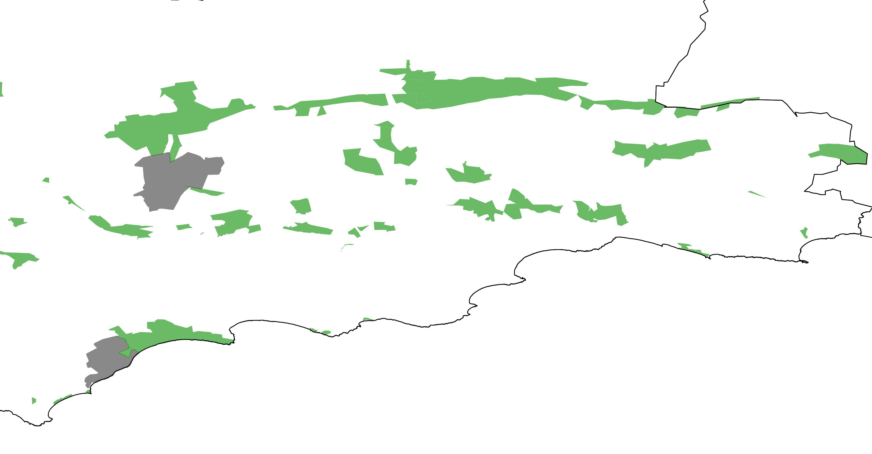
issues
Small populations: inbreeding
Male-bias: social stress, poor reproduction
Isolation: Social stress, inbreeding
lack of prime habitat: Health, reproduction
fencing: hybridization, injury, death
ANYSBERG
±26
Oudtshoorn
KAMMANASSIE
GAMKABERG
≥30
±64
SANBONA
32
Swellendam
OVERBERG
TEST
RANGE
Mossel Bay
DE HOOP
25
±40

Slide 6
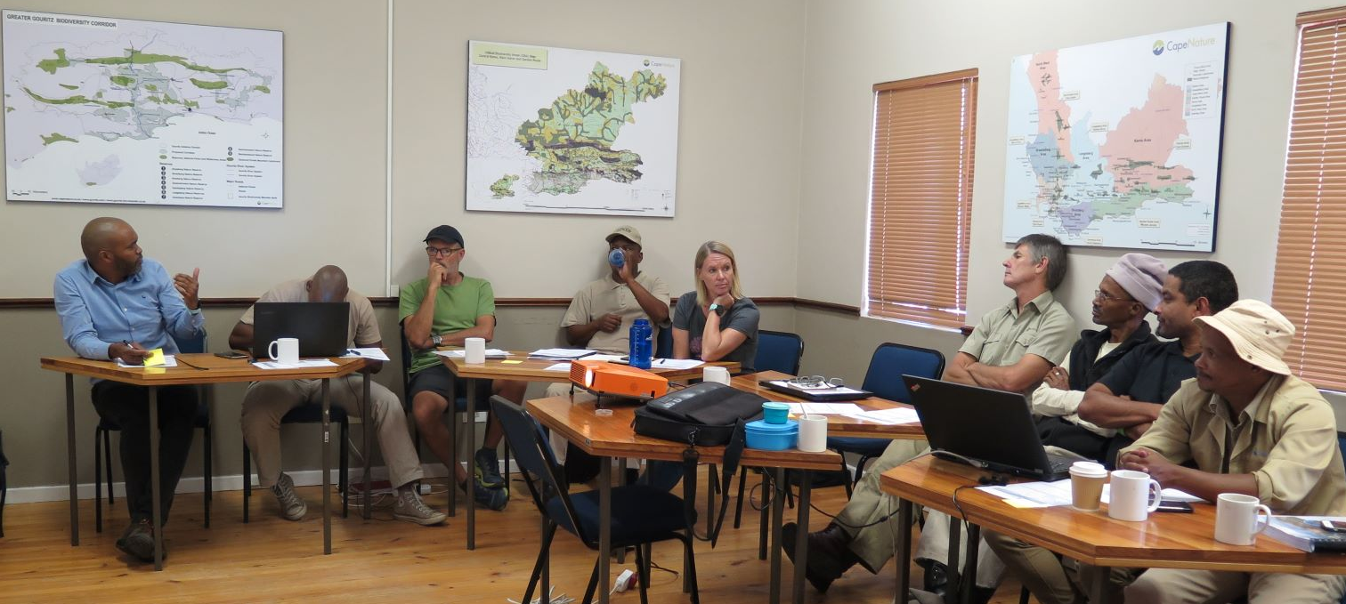
No. | Item
1 | Opening
2 | Apologies
3 | Minutes of the last meeting
4 | Matters arising Genetic mixing Game removal Protected area expansion Monitoring protocols, SOGs BMP-s steering committee Funding
5 | Standard item: Reserve feedback Popn size, sex ratio, herd composition Animal health Distrib and veld condition Waterpoints Fences, escapees, hybrid risk Monitoring issues Awareness
6 | New items
7 | Date of next meeting
8 | Closure
Ah, the good old days…
CMZ Working Group
(managers, rangers, ecologists, etc)
Task team: Escapees
Task team: Genetics
+ Univen,
Sanbi

Slide 7
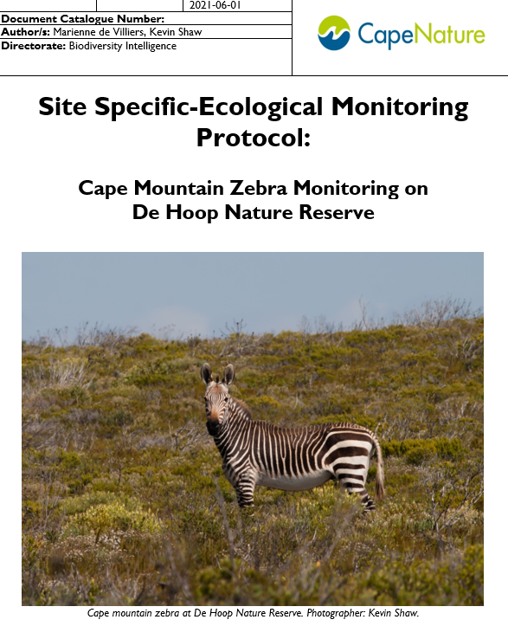
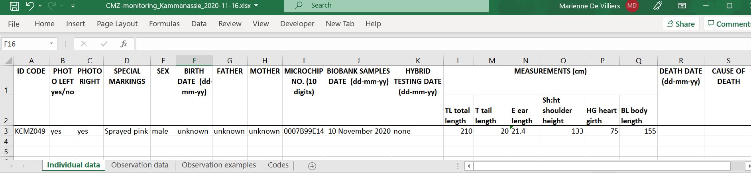
BMP
Hybridization
Habitat expansion
Genetic diversity
Monitoring

Slide 8
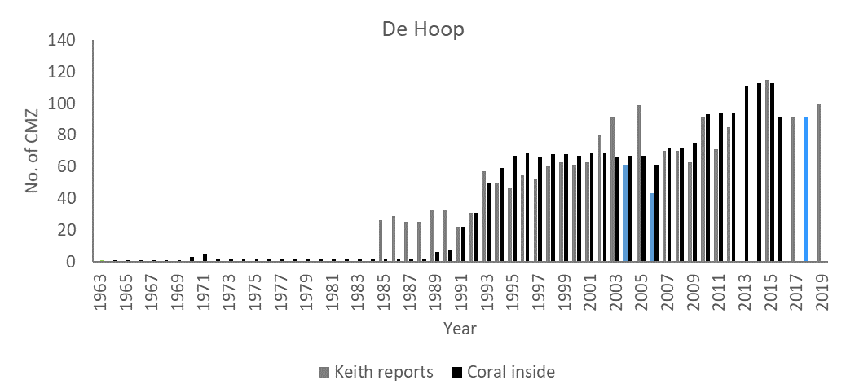
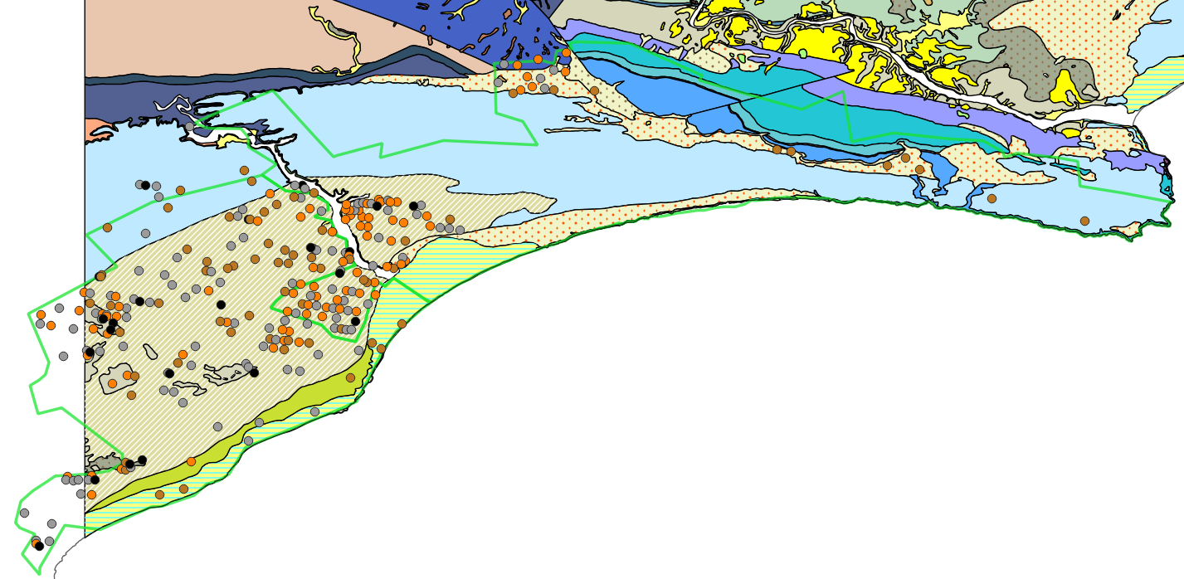
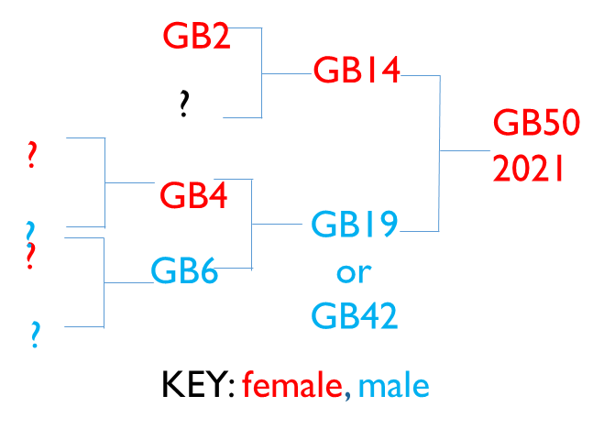

Waenhuiskrans Limestone Fynbos
(grassy depressions)

Slide 9
BMP
Hybridization
Inbreeding
Habitat

Slide 10
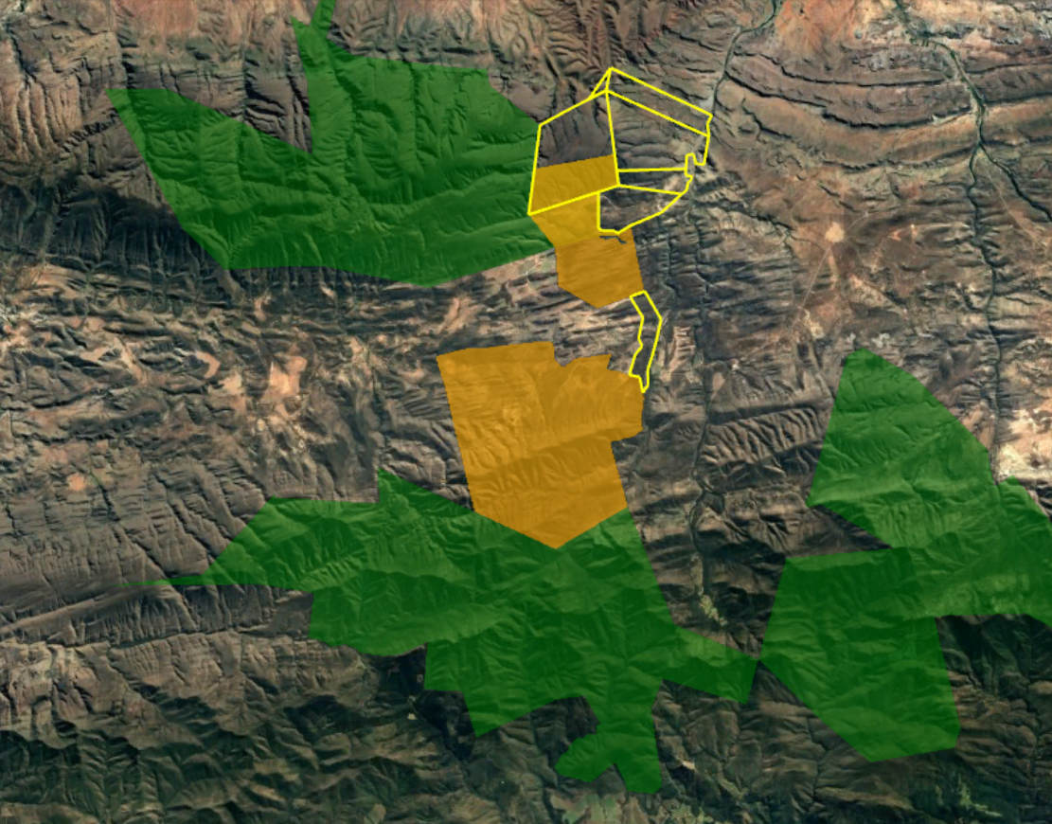
Gamkaberg
1500 ha
2071 ha
Attakwaskloof

Slide 11
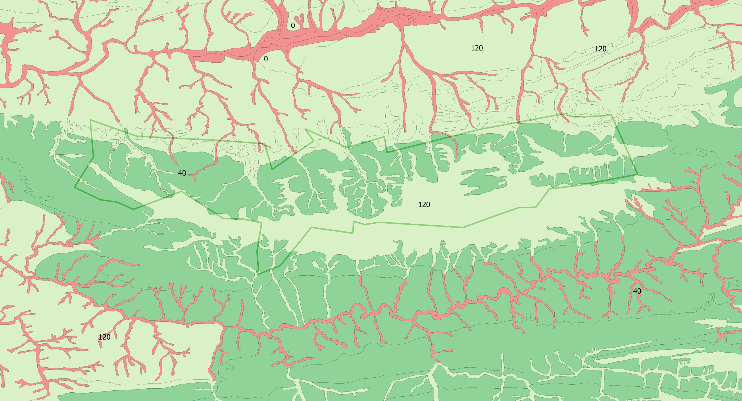
Kammanassie NR

Slide 12
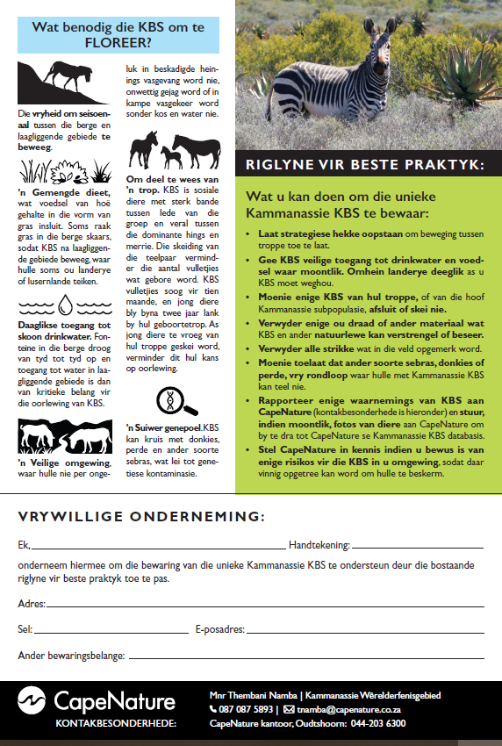

Slide 13
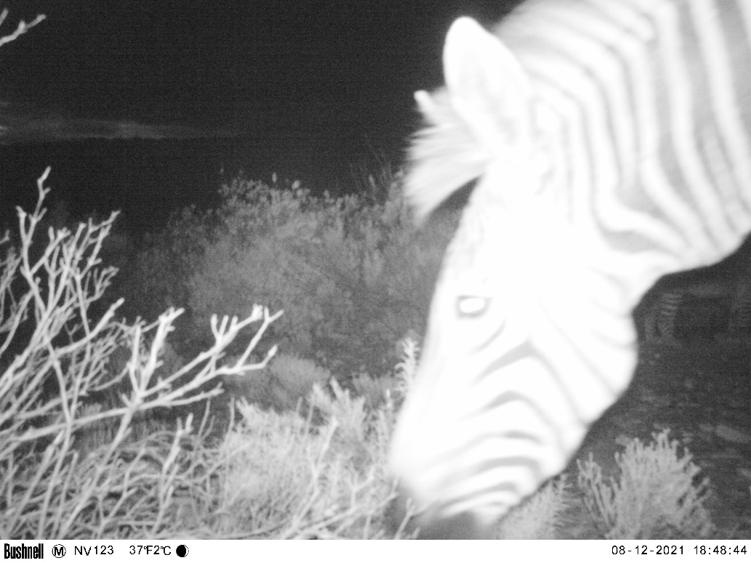
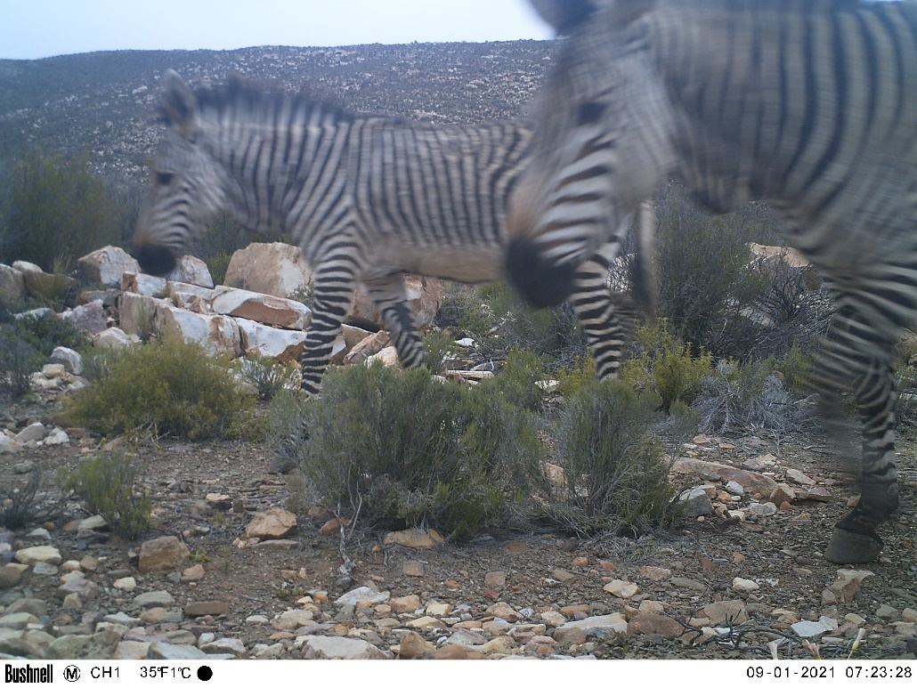
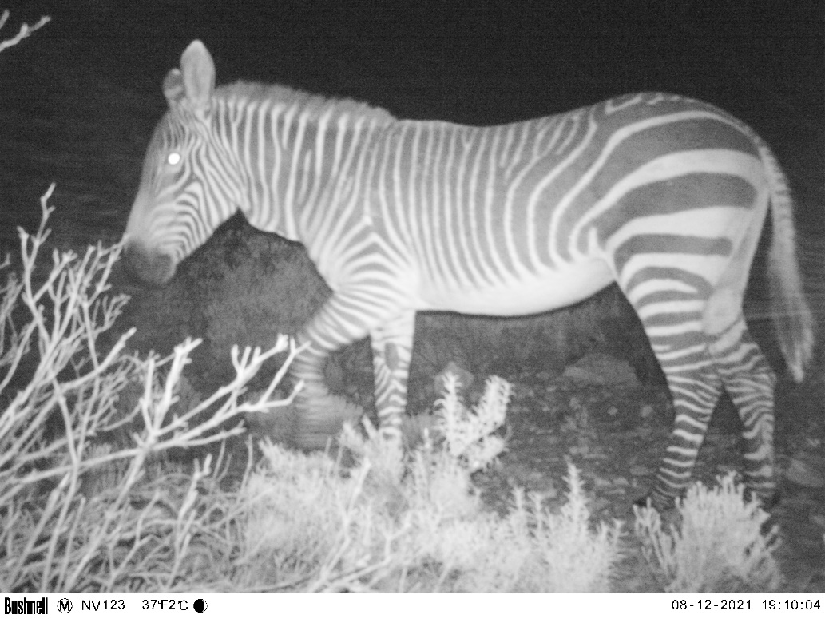
BMP
Hybridization
Inbreeding
Habitat
ANYSBERG
Oudtshoorn
KAMMANASSIE
GAMKABERG
Swellendam

Slide 15
BMP
Hybridization
Inbreeding
Habitat
CMZ STOCKS
CRADOCK – C
GAMKABERG – G
KAMMANASSIE – K
ANYSBERG
C
KAMMANASSIE
GAMKABERG
Oudtshoorn
K
SANBONA
K-C
G
Swellendam
OVERBERG
TEST
RANGE
DE HOOP
K-C

Slide 16

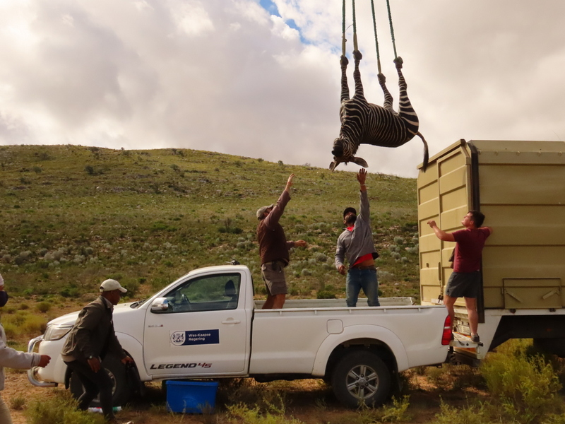
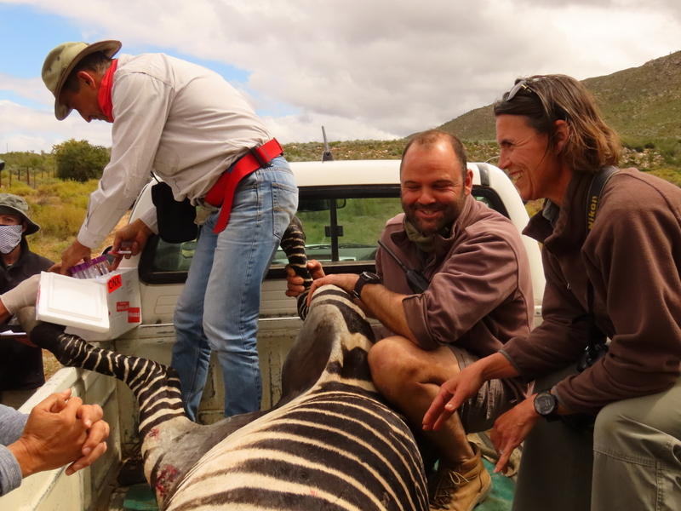
GAMKABERG
SANBONA
G
G-K-C
K-C

Slide 17
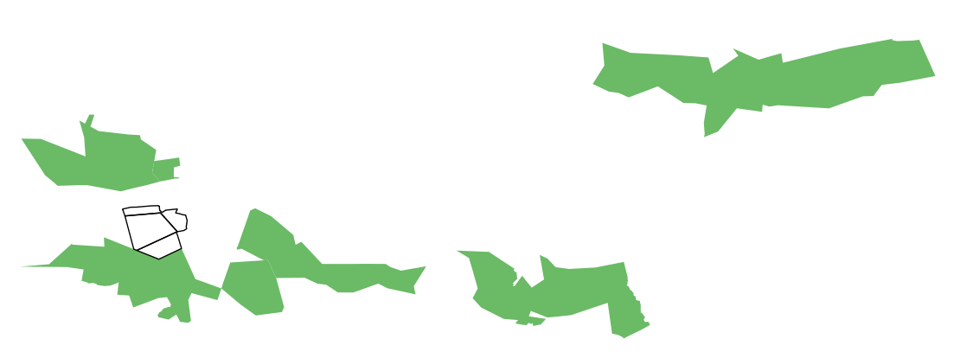
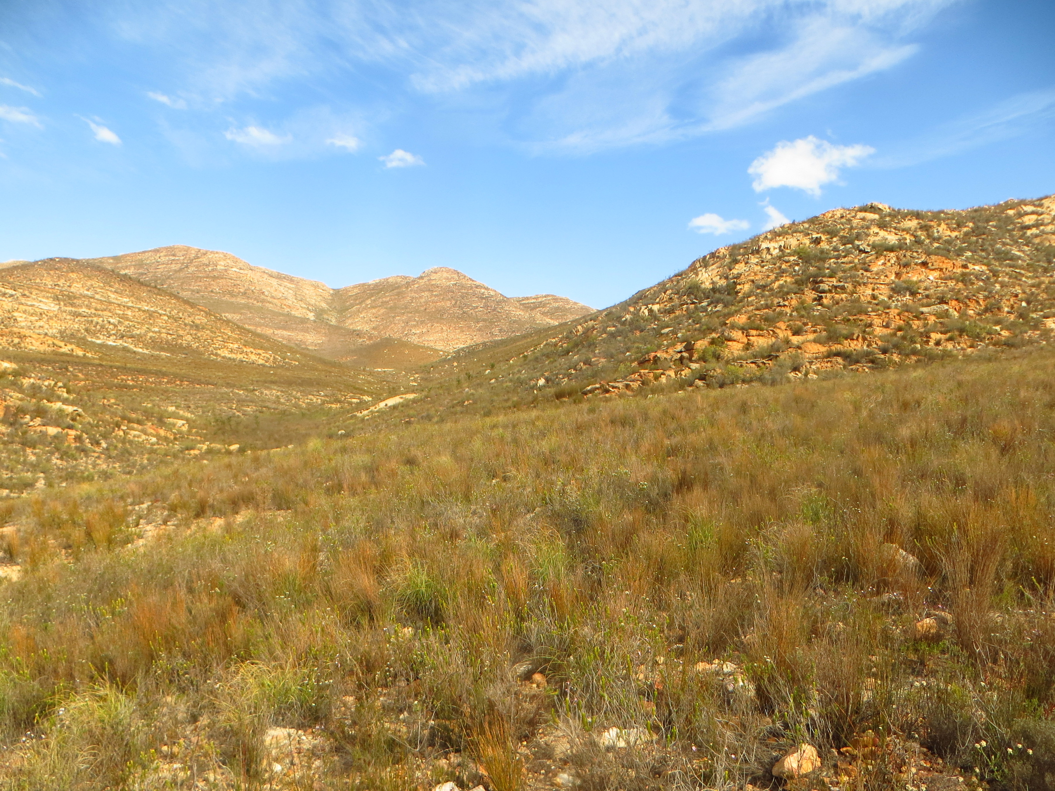
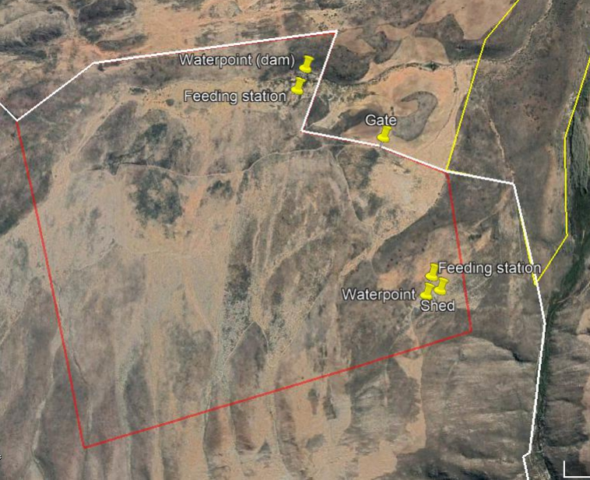
KAMMANASSIE
GAMKABERG
K
G
G-K

Slide 18
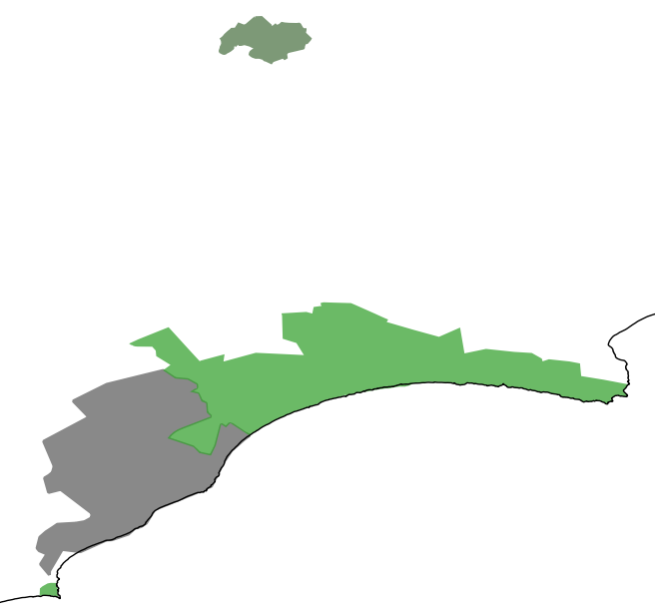
C
C-K
BONTEBOK NP
X
K-C
DE HOOP
OTR

Slide 19
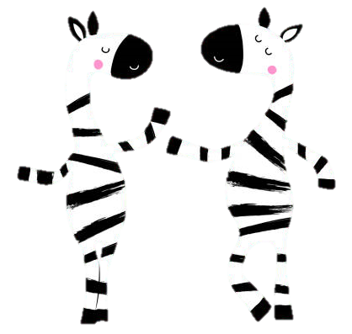
In the mix: Cape mountain zebra conservation
Together we can do so much more!
Thank you!

