Slide 1


The Fabulous Forms of Fish
12 June – ages 13 – 18
14h00 Session
ALEXIS OLDS
Ecologist: Marine & Coasts

Slide 2
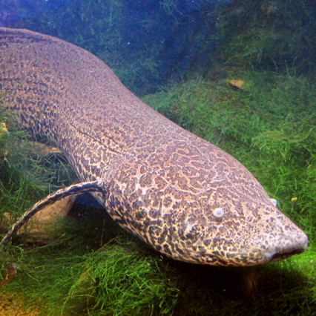
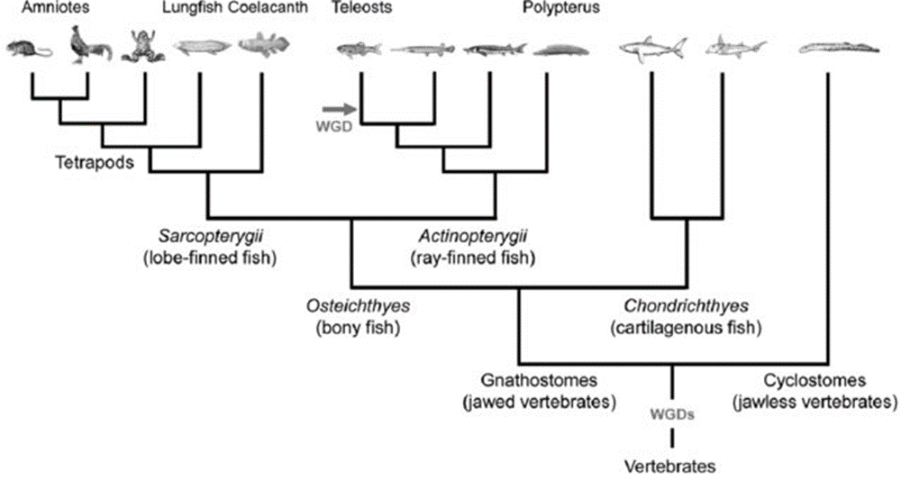
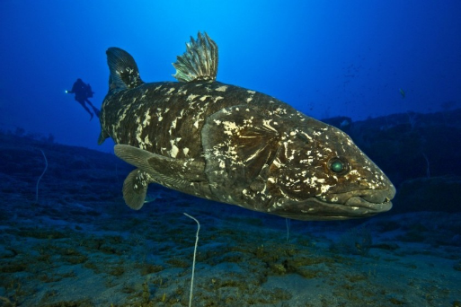
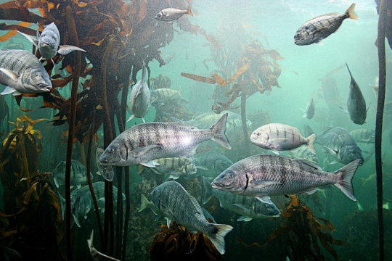
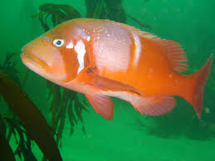
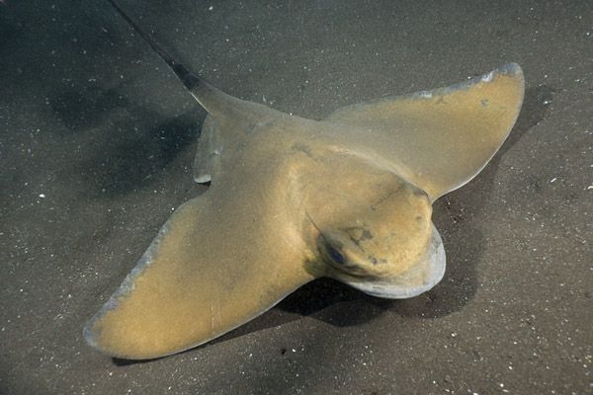
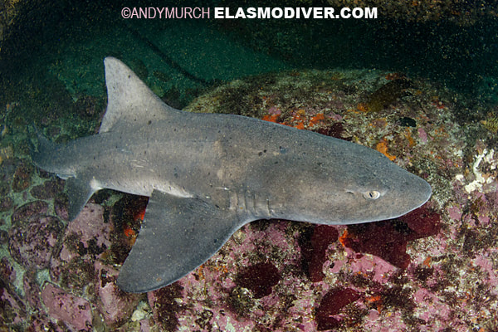
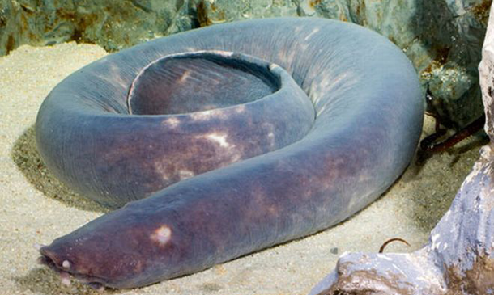
The phylogeny of fishes

Slide 3
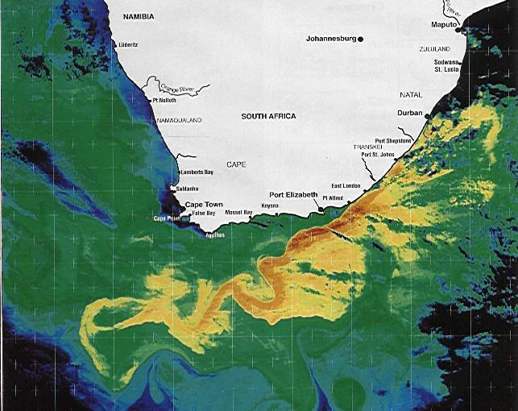
South Africa’s coastline
Approximately 2800 km long
Two major currents – cold Benguela & warm Agulhas

Slide 4
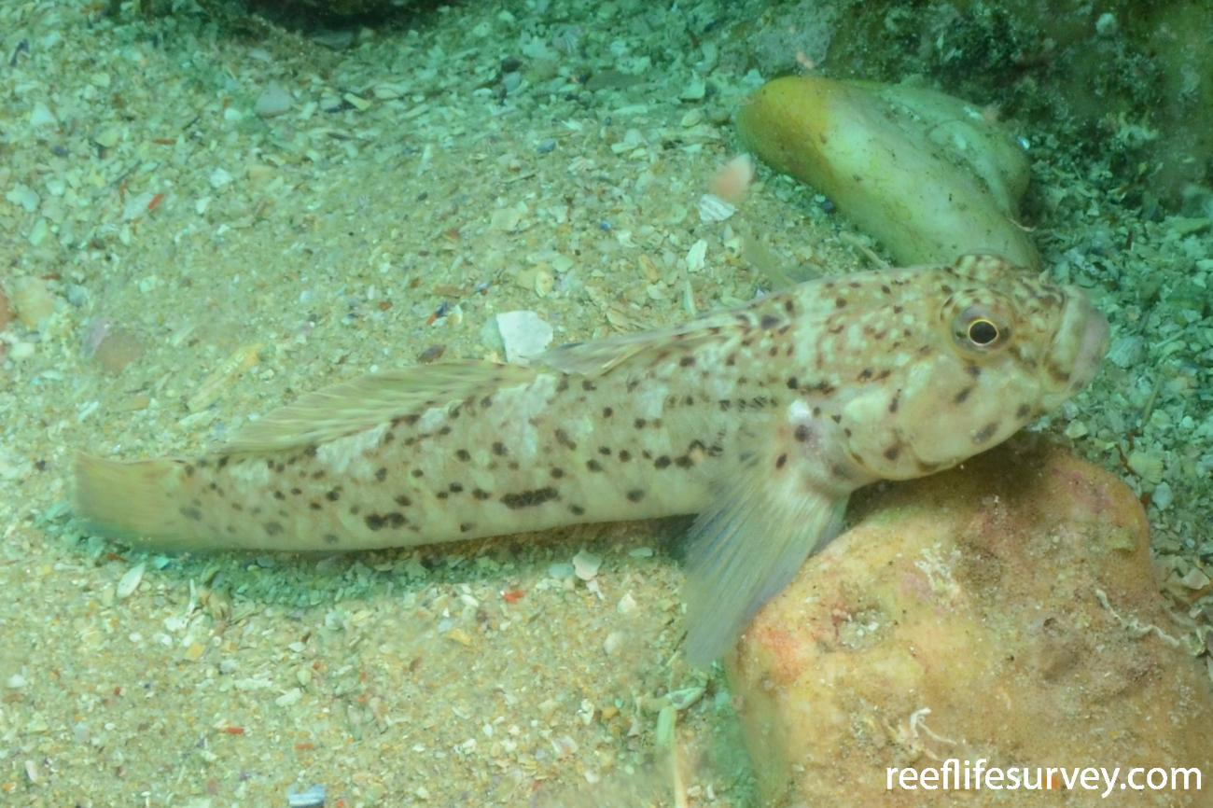
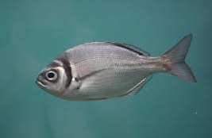
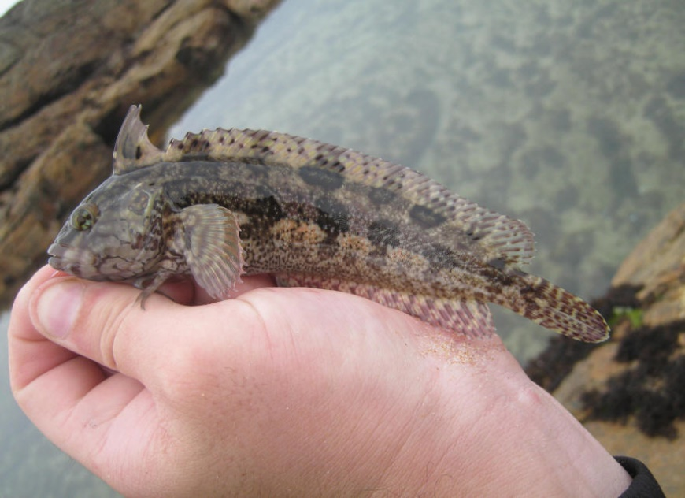
South Africa’s endemic fish and sharks
± 2600 Species recorded in SA
13% Endemic to Southern Africa
Families typically South African
Klipvis
Gobies
Seabreams
Notes:
There are some 2 600 species of fish in our seas
There are 270 families of fishes represented in South Africa, equivalent to 83% of all marine fish families known.
Strikingly, up to 13% are endemic, ranking amongst the highest anywhere.
338 species endemic

Slide 5
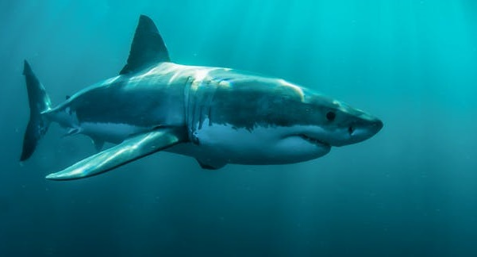
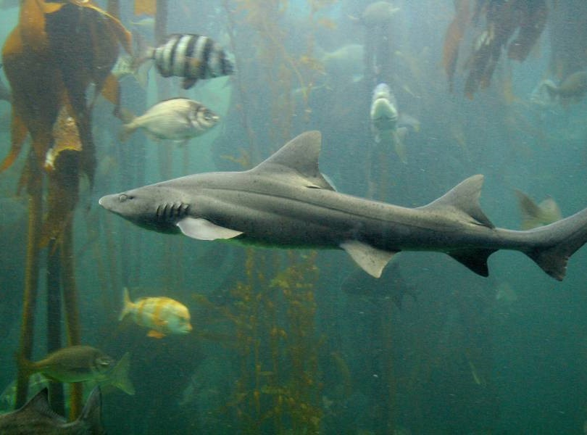
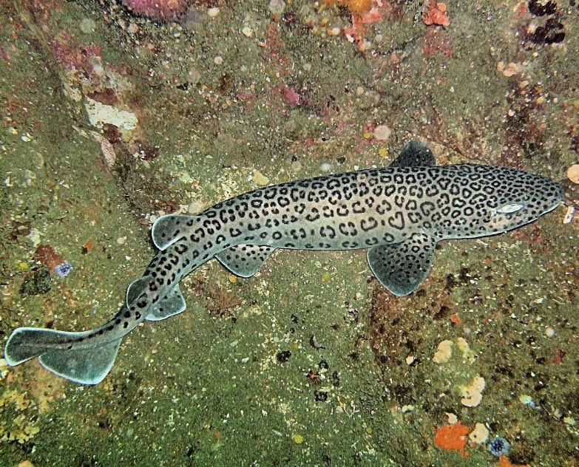
South Africa’s endemic fish and sharks
185 Species recorded in South Africa
34 Endemic to Southern Africa
15 Endemic to SA

Slide 6
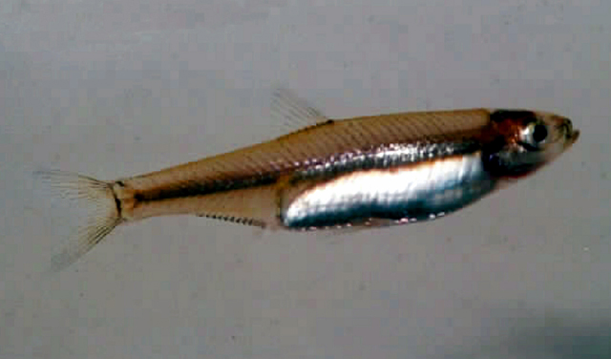
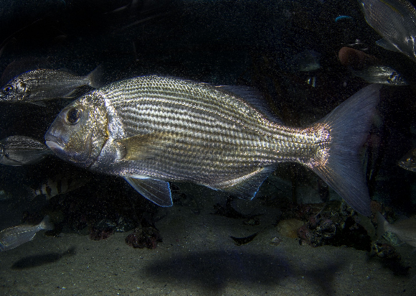
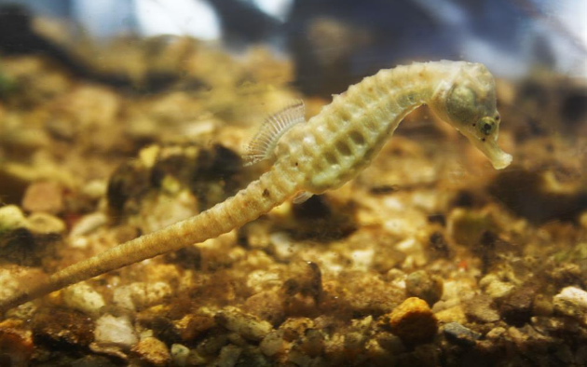
Life history strategies in fish
It’s all about growth, survival and reproduction
Opportunistic
Short generation times, small bodies
Produce lots of eggs, no parental care
Unstable environments
Periodic
Long-lived, large bodies
Produce lots of eggs, no parental care
Stable environments
Most fish species
Equilibrium
Fairly long-lived, varying body size
Few offspring but provide parental care
Most stressful and density dependent environments

Slide 7
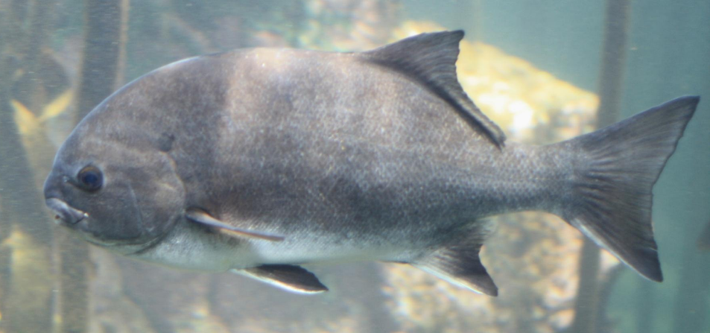
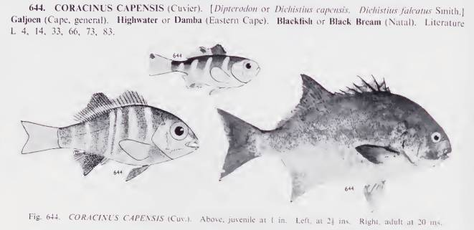
Our National fish
Galjoen – Dichistius capensis
The suggestion to make it the national fish came from Margaret Smith, wife of the ichthyologist J. L. B. Smith, to find a marine equivalent to the Springbok
Angola to South Africa (near endemic)
Part of the Sparid family
Highly resident
Max age – Males: 12 yrs Females: 21 yrs
Max size: Males: 47 cm Females: 74 cm
Vulnerable to overfishing
Two Oceans Aquarium

Slide 8
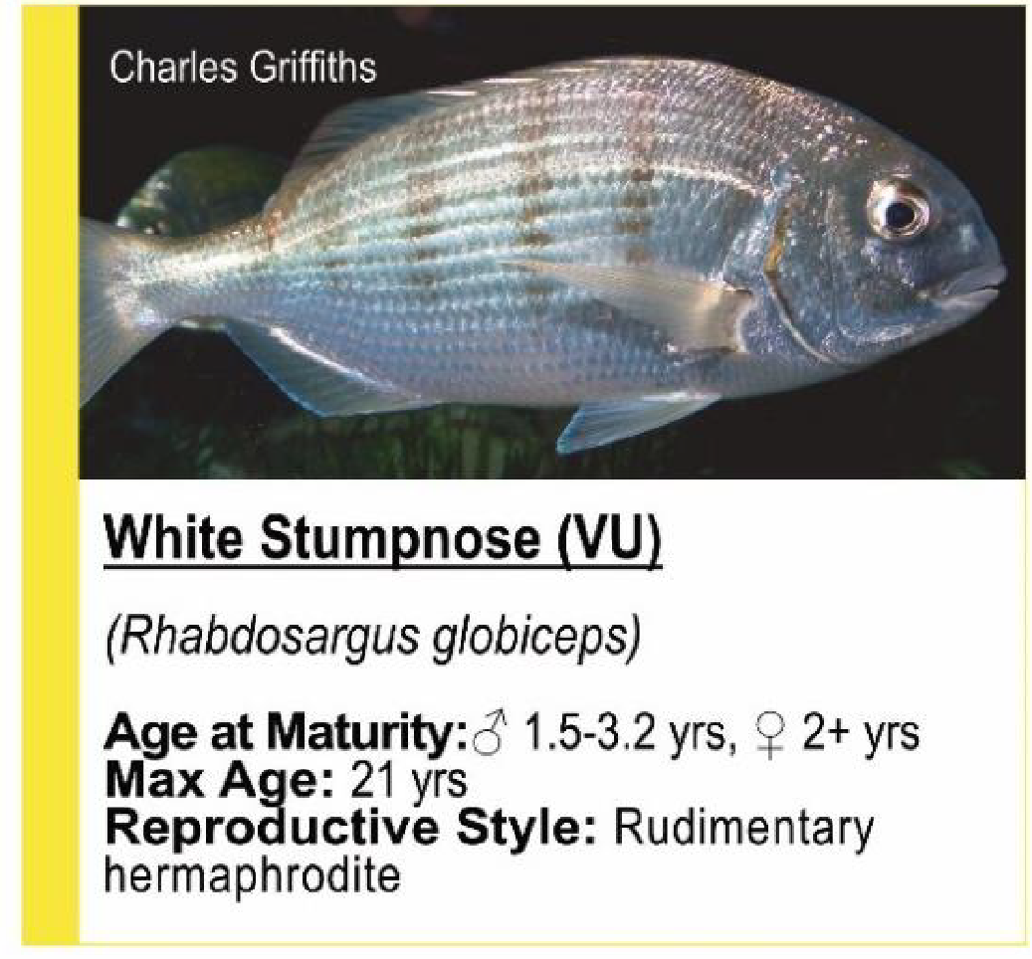
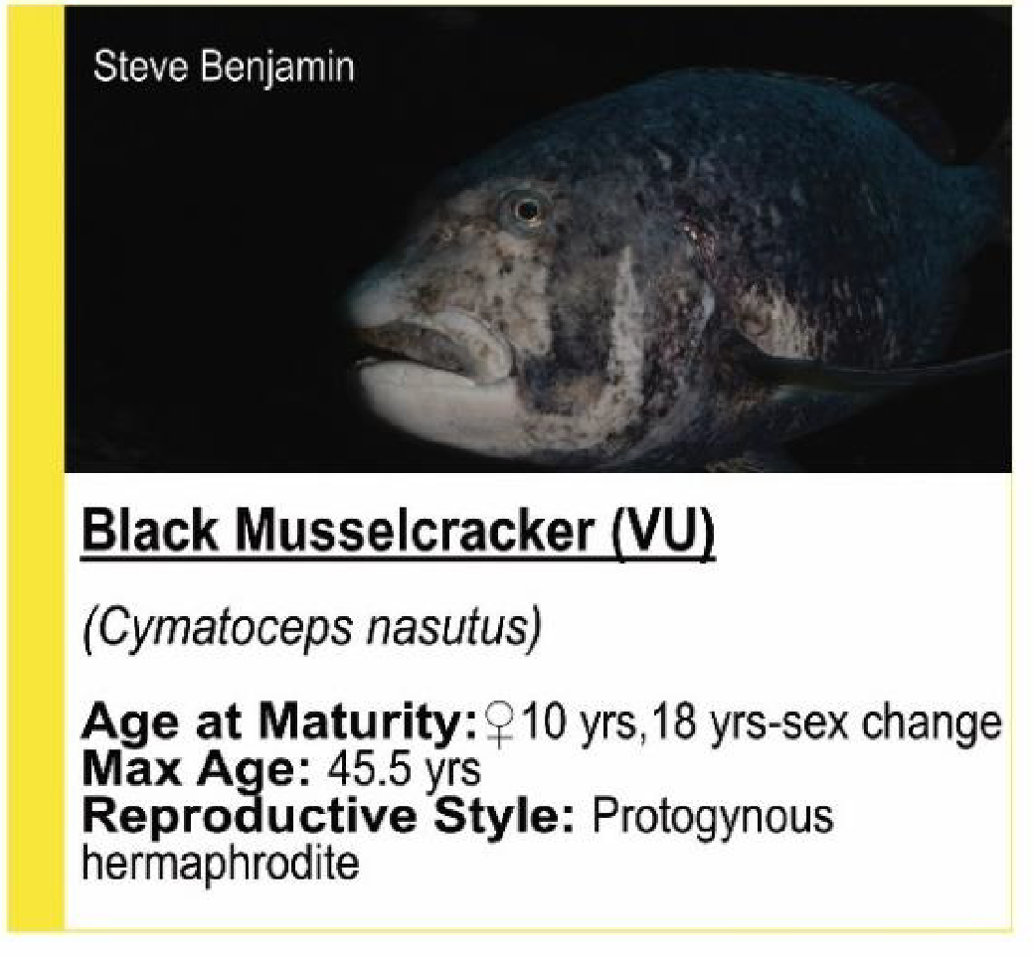
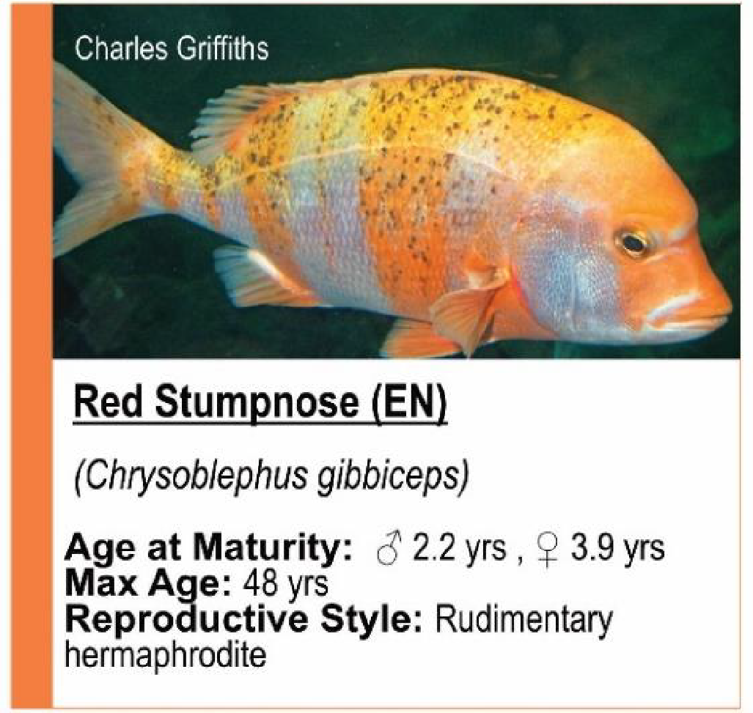
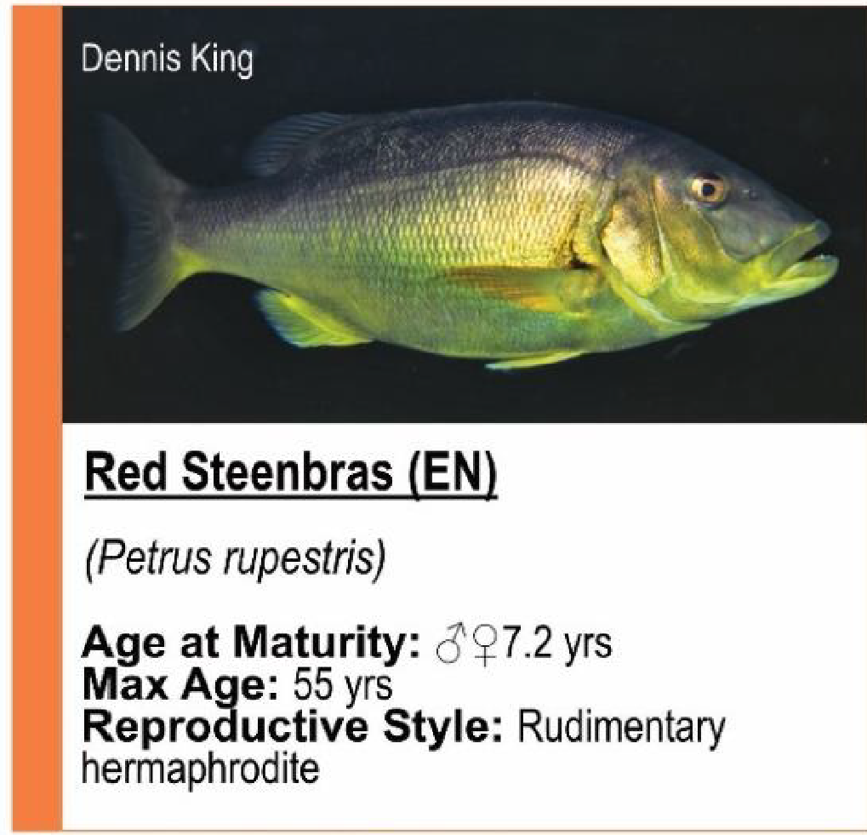
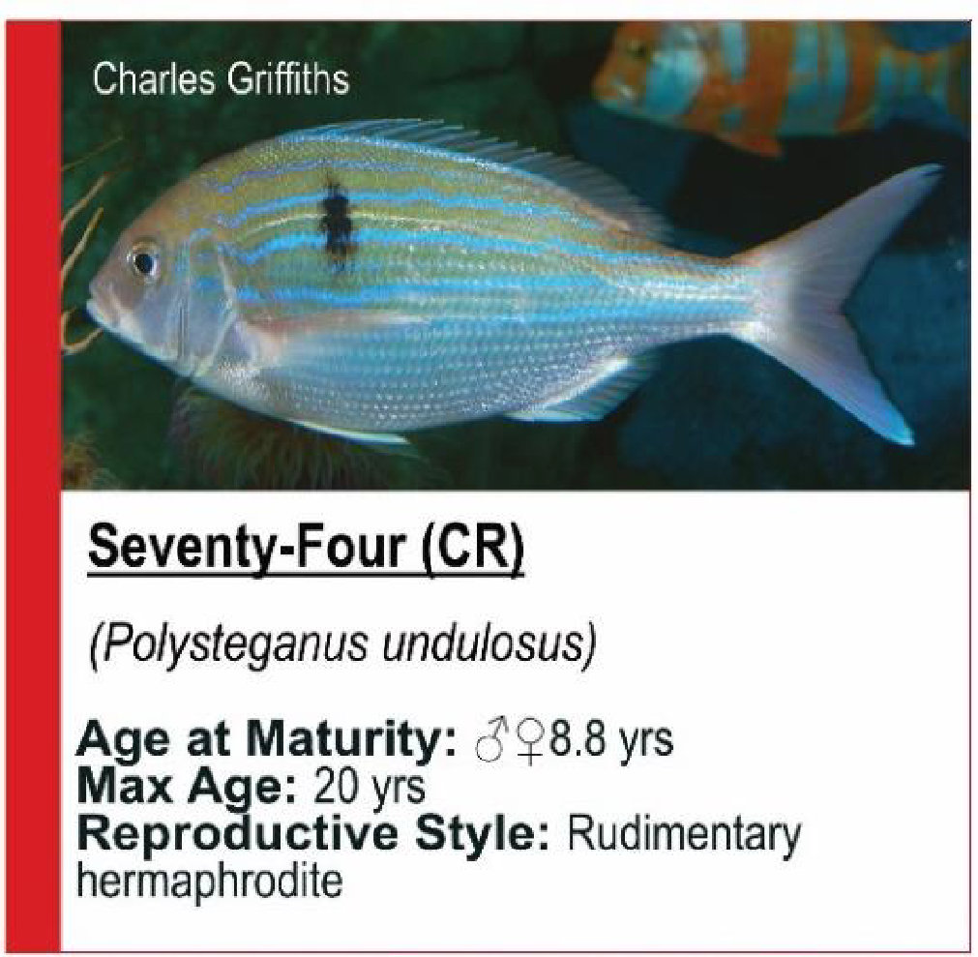
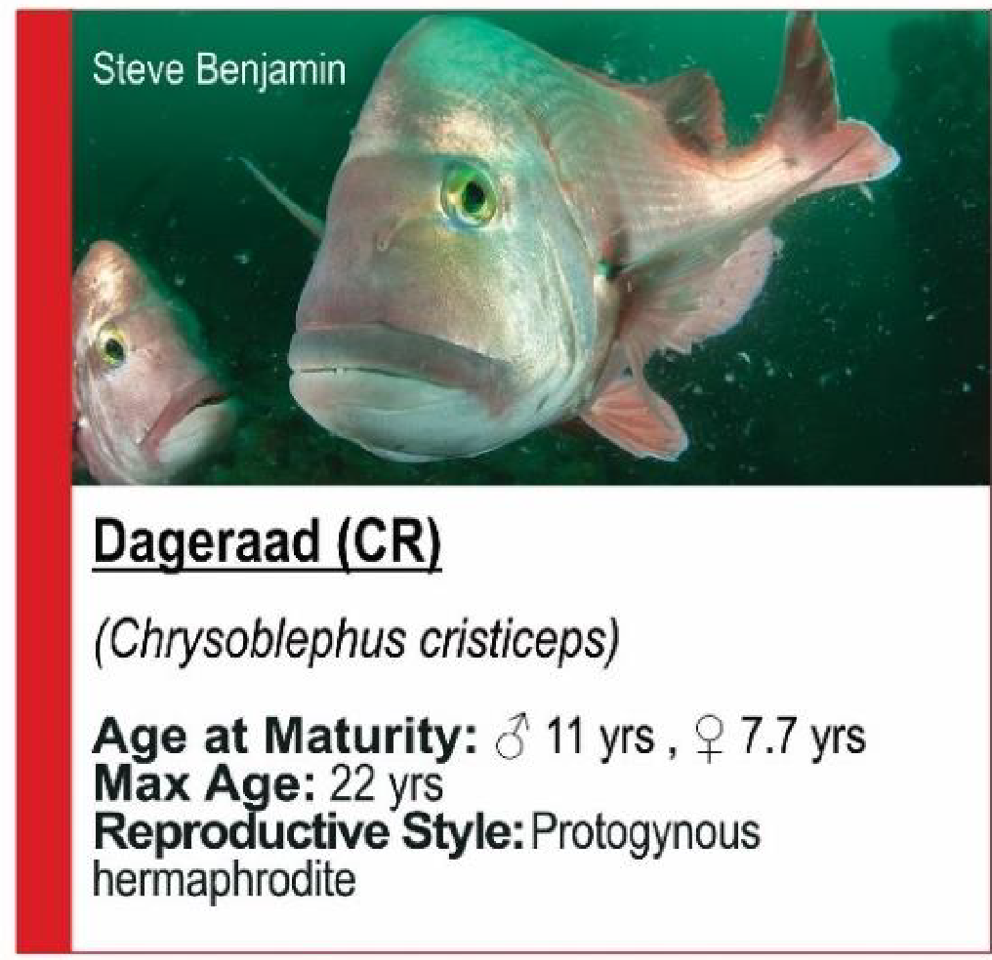
The seabreams (Sparidae)
42 FOUND IN SA, 15 ENDEMIC
National Biodiversity Assessment 2018
Notes:
Protogynous hermaphrodite – change sex from female to male
Rudimentary hermaphrodite - intersexual immature gonads but single-sex mature ones. Most appear to be female but male gonads develop just prior to sexual maturity

Slide 9
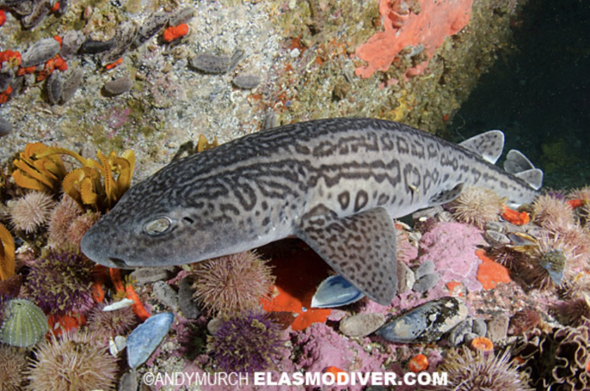
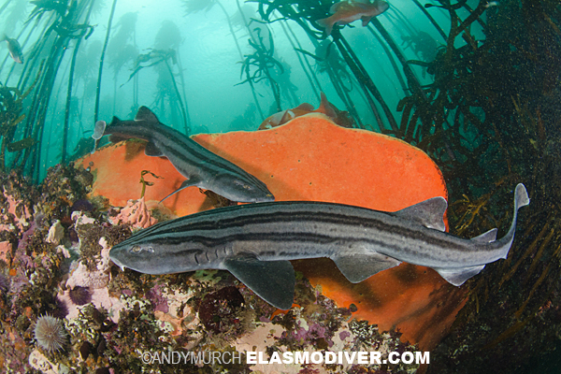
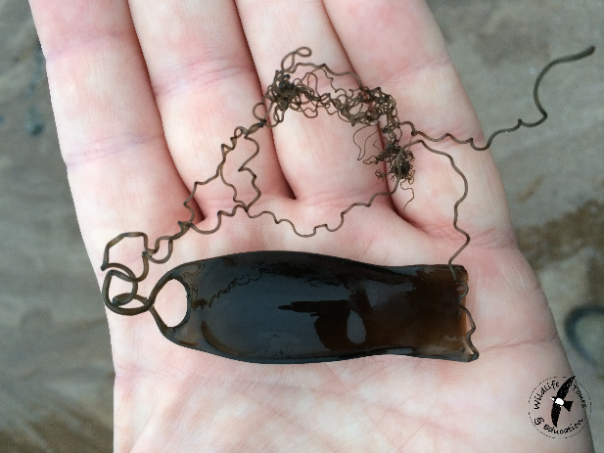
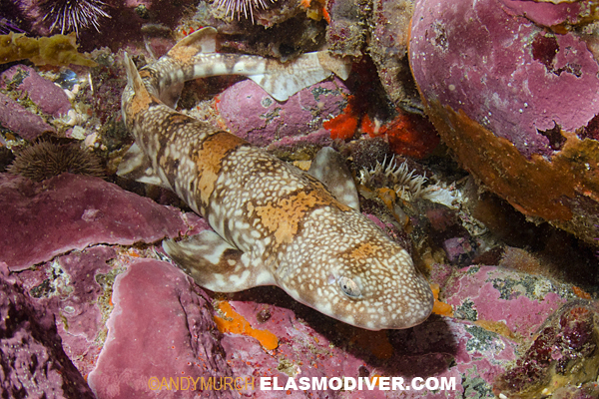
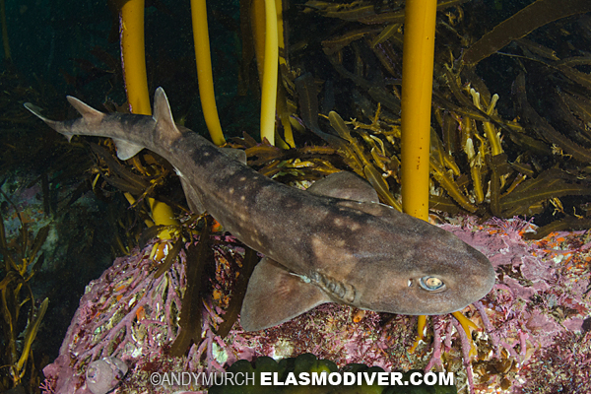
The catsharks
Poroderma africanum
Pyjama shark
Poroderma pantherinum
Leopard catshark
Haploblepharus edwardsii
Puffadder shyshark
Haploblepharus pictus
Dark shy shark

Slide 10
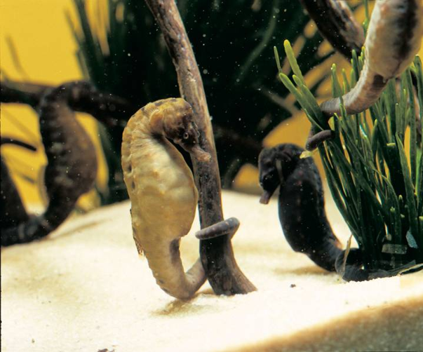
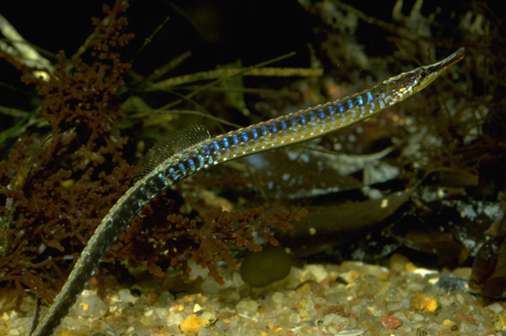
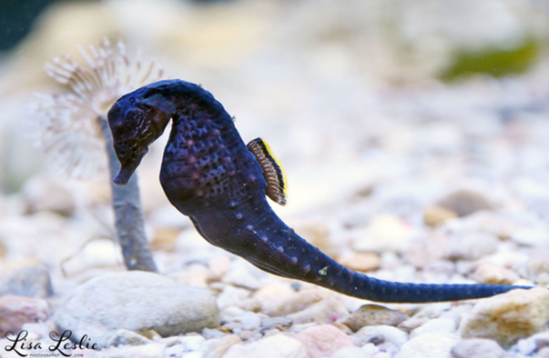
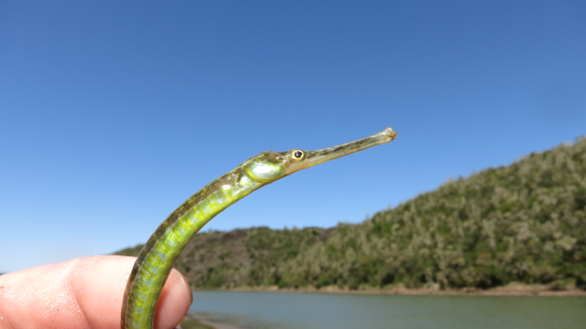
The seahorses & pipefish
Two Oceans Aquarium

Slide 11
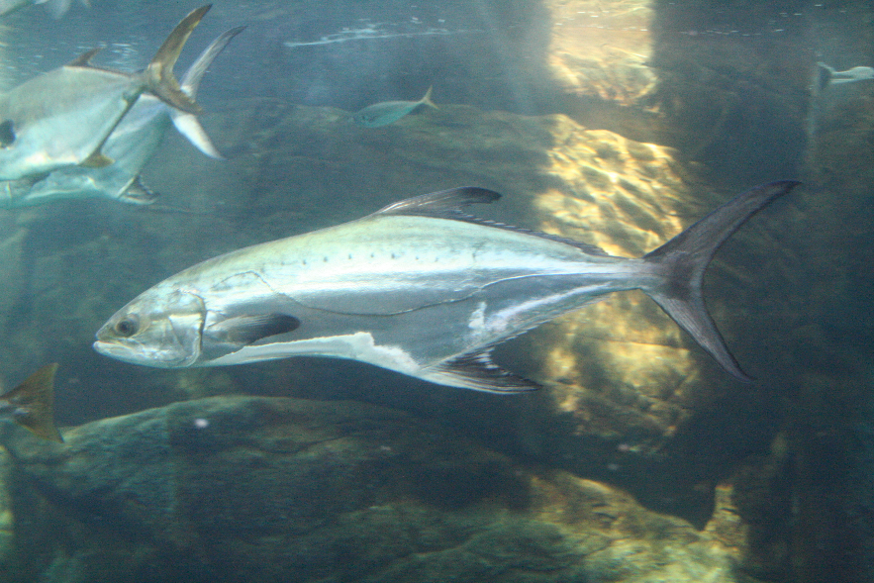
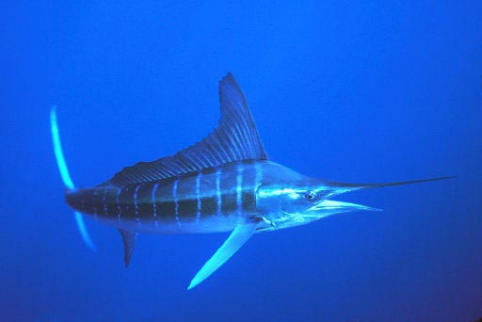
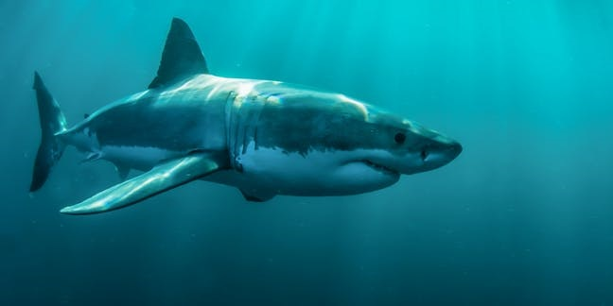
The hunters
Very long, sleek bodies
Very fine scales to reduce drag
Caudal fins shaped for speed
Highly developed sensory organs, lateral line, ampullae of lorenzini

Slide 12
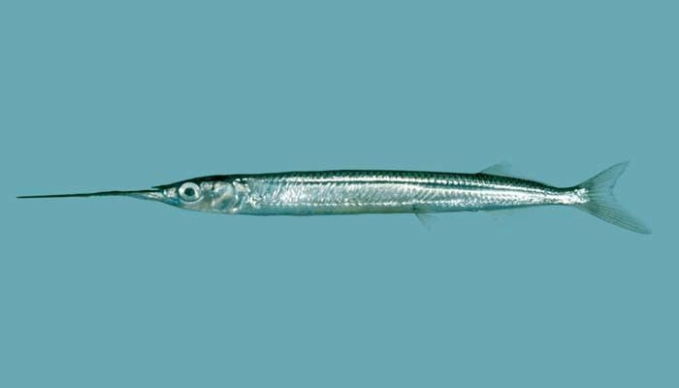
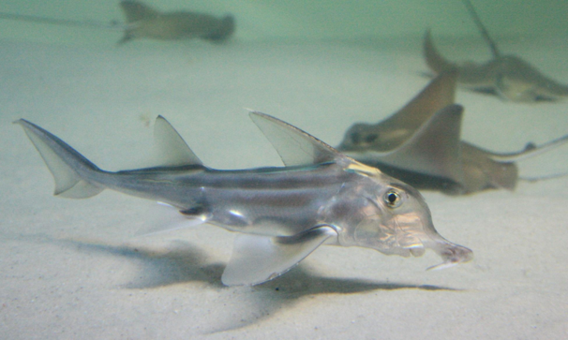
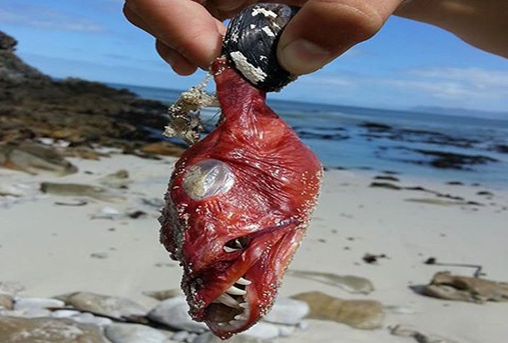
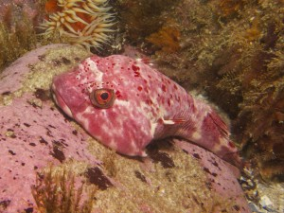
The weirdos
Halfbeak
St Josef shark
Rocksucker

Slide 13
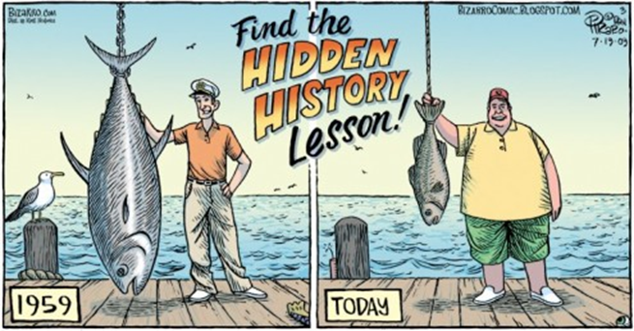
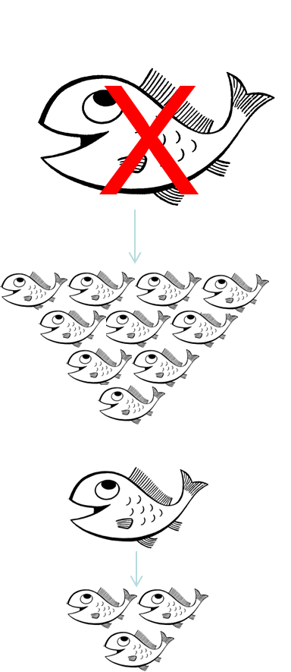
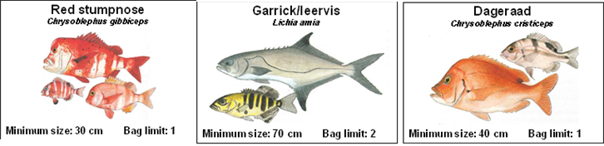
Major threats our fish face
Overfishing
What can I do?
Catch and release fishing (or better yet, catch, tag, release)
Stick to the daily size and bag limits
SASSI fish list

Slide 14
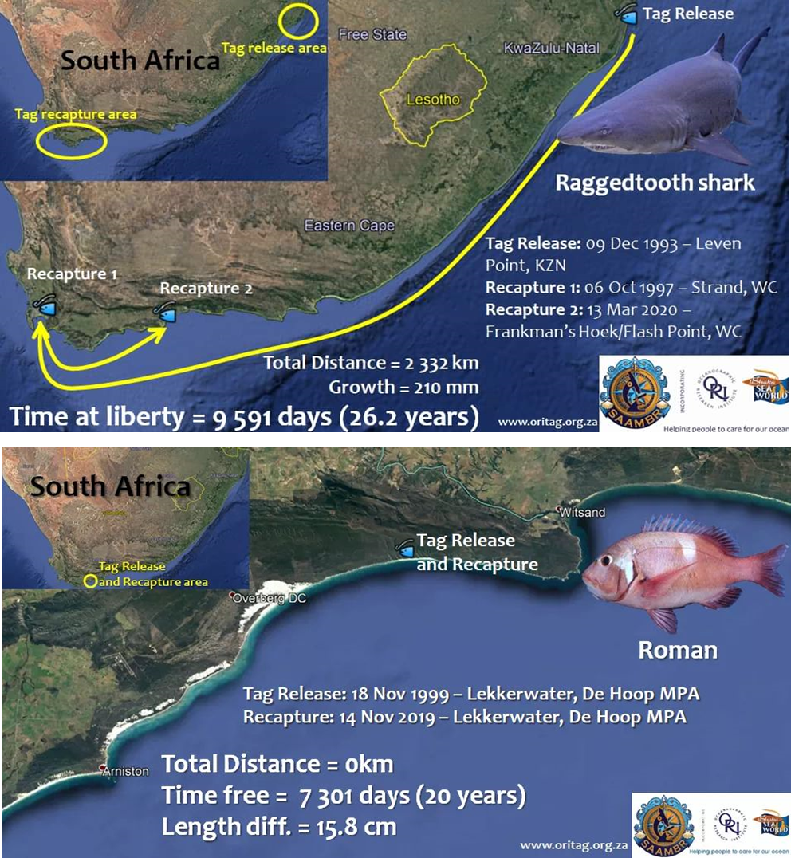

Slide 15
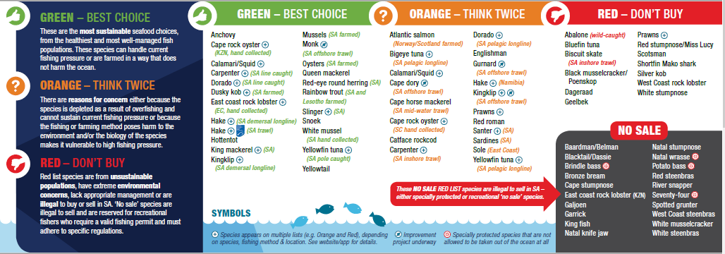
Major threats our fish face
Overfishing
What can I do?
Catch and release fishing (or better yet, catch, tag, release)
Stick to the daily size and bag limits
SASSI fish list

Slide 16
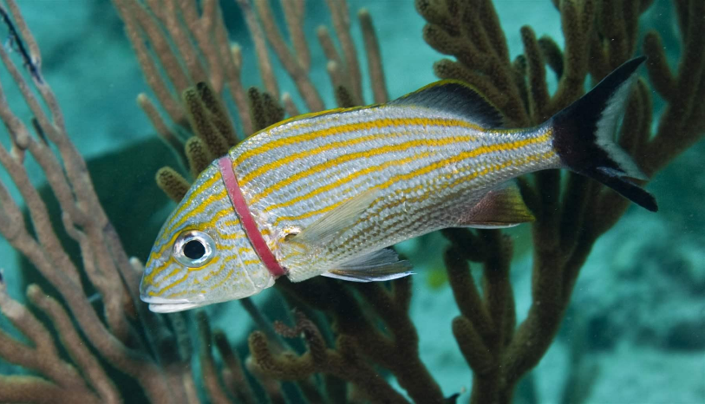
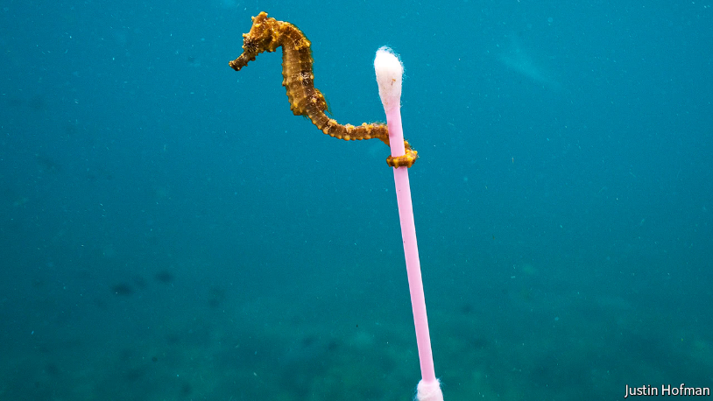


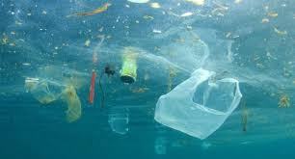

Major threats our fish face
Pollution
What can I do?
Reduce, reuse, recycle
Pick up litter
Use less plastic

Slide 17

Thank you ! Please ask questions ☺

