Slide 1


The Web of Life –
All about Interdependence
11 June – ages 8 – 12
13h30 Session
Edward adonis
Stakeholder Engagement Officer

Slide 2
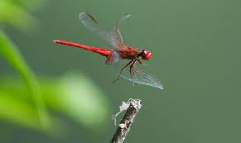
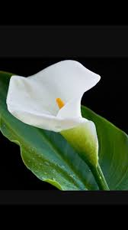
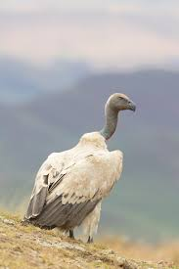
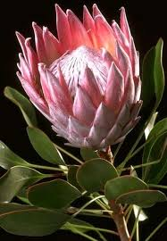
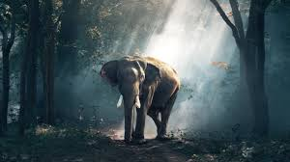
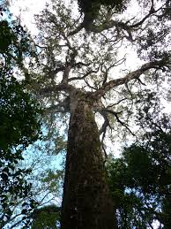
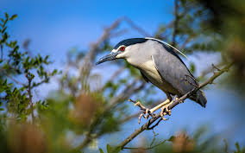
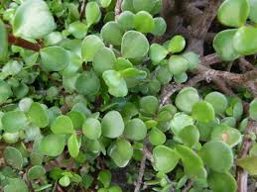
Introduction

Slide 3
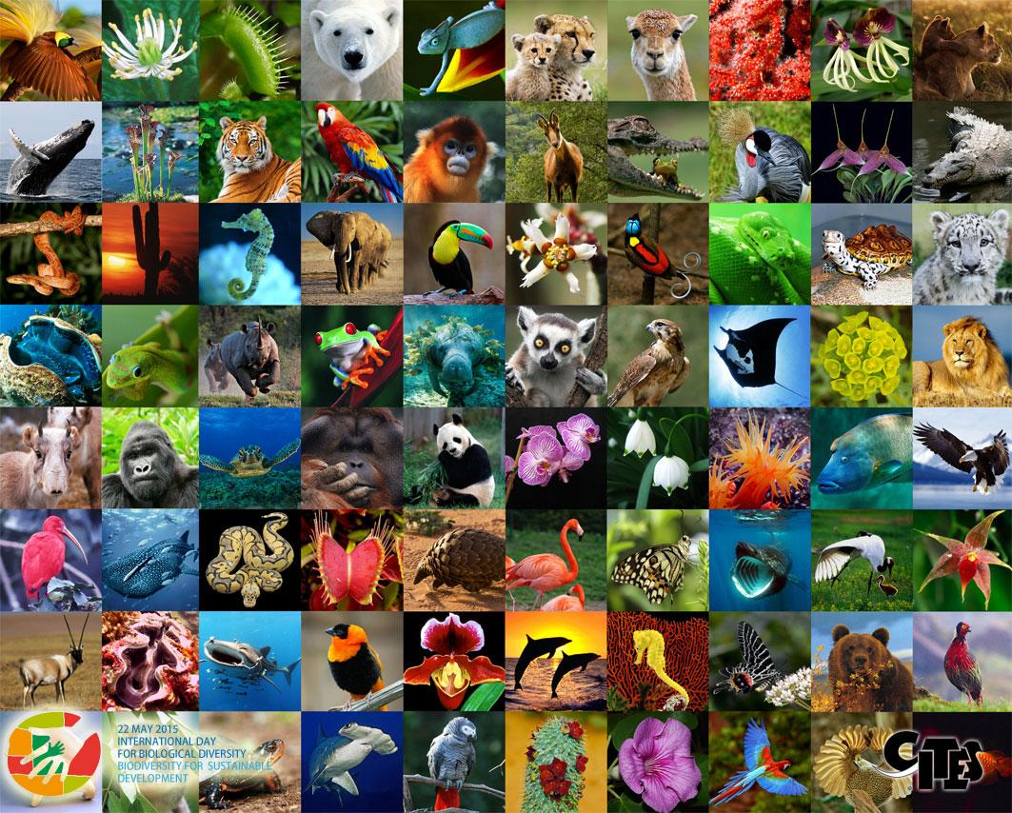
The world is made up of a variety of plants and animals – we call the variety of life on Earth…
B I O D I V E R S I T Y

Slide 4



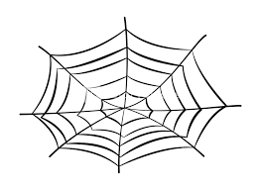




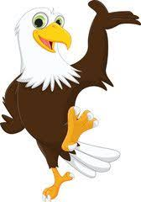
…these make up the web of life, where each living thing depends on the other for survival.
Use the text box to tell us what your favorite animal is…
What does your favorite animal eat?
How would your favorite animal use plants (not for food)?

Slide 5
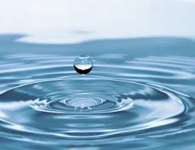
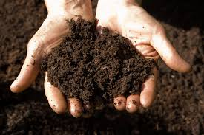
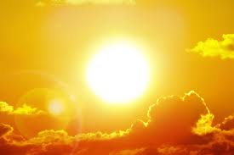
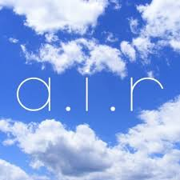
There are also non-living things that living things depend on.

Slide 6
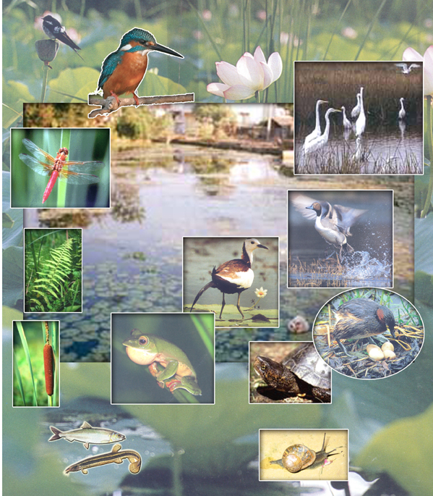
Interdependence

Slide 7
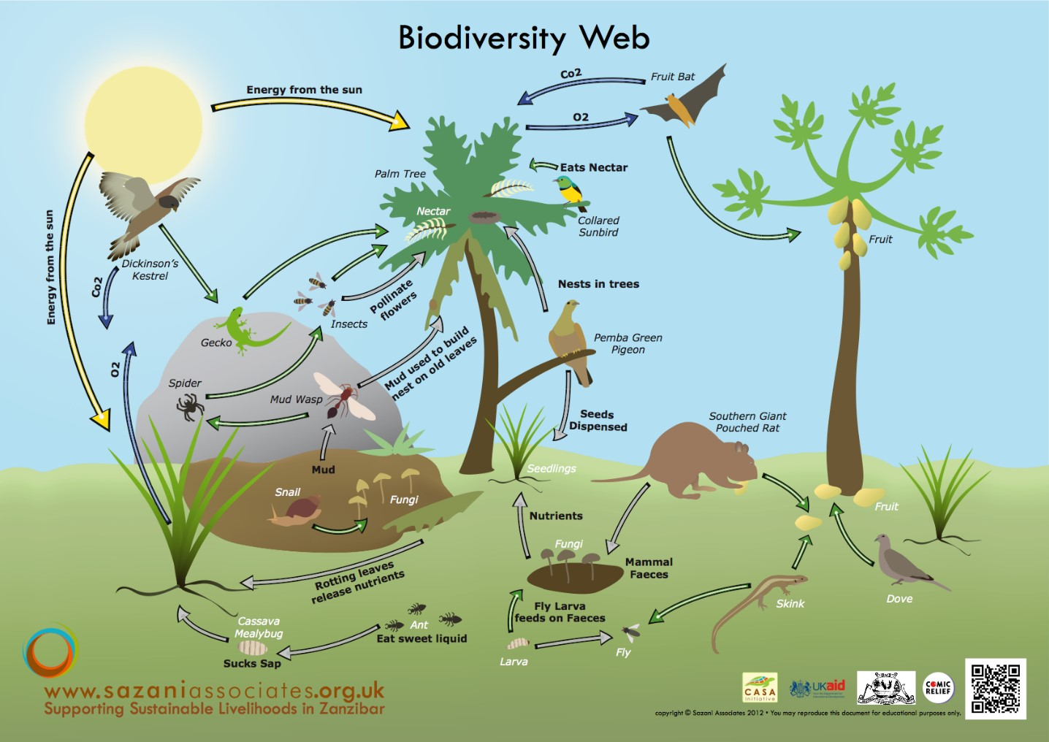

Slide 8
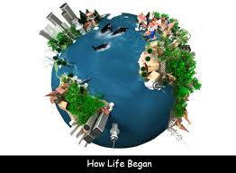
We need the Earth to live and survive.

Slide 9
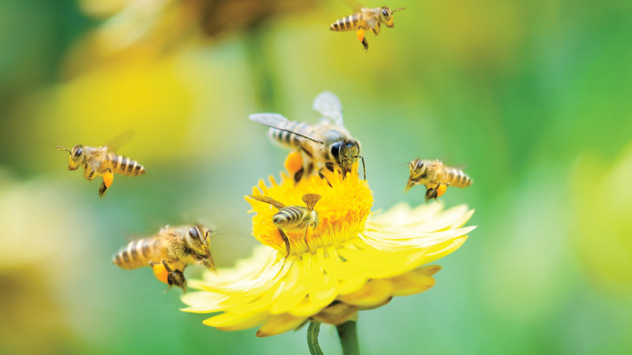
Bees depend on flowers for nectar.
Flowers depend on bees for pollination.

Slide 10
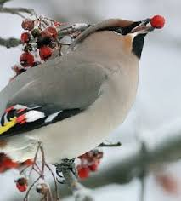
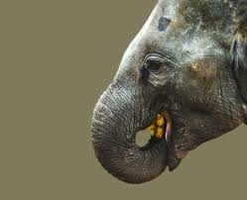
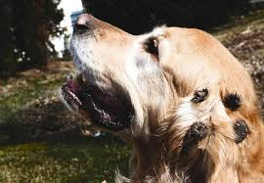
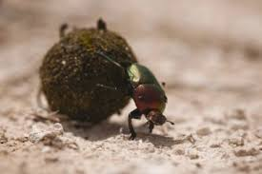
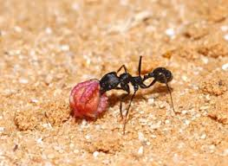
Some seeds are eaten and dispersed as animals move around.
“Hitchhiking” – attaching to animal fur/skin/clothing to help disperse seeds.

Slide 11
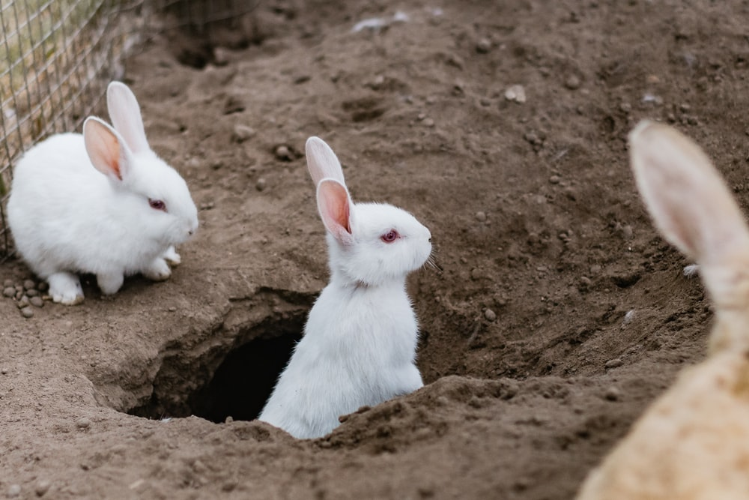
Rabbits rely on burrows to be safe underground.

Slide 12
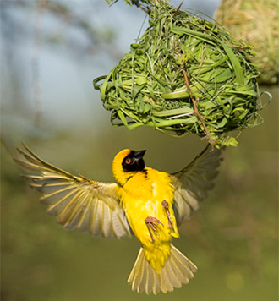
Weavers use grass and other materials to build their nests.
The nests need trees to be attached to.

Slide 13
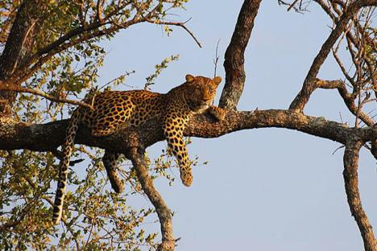
Leopards need trees to eat, sleep and for safety.

Slide 14
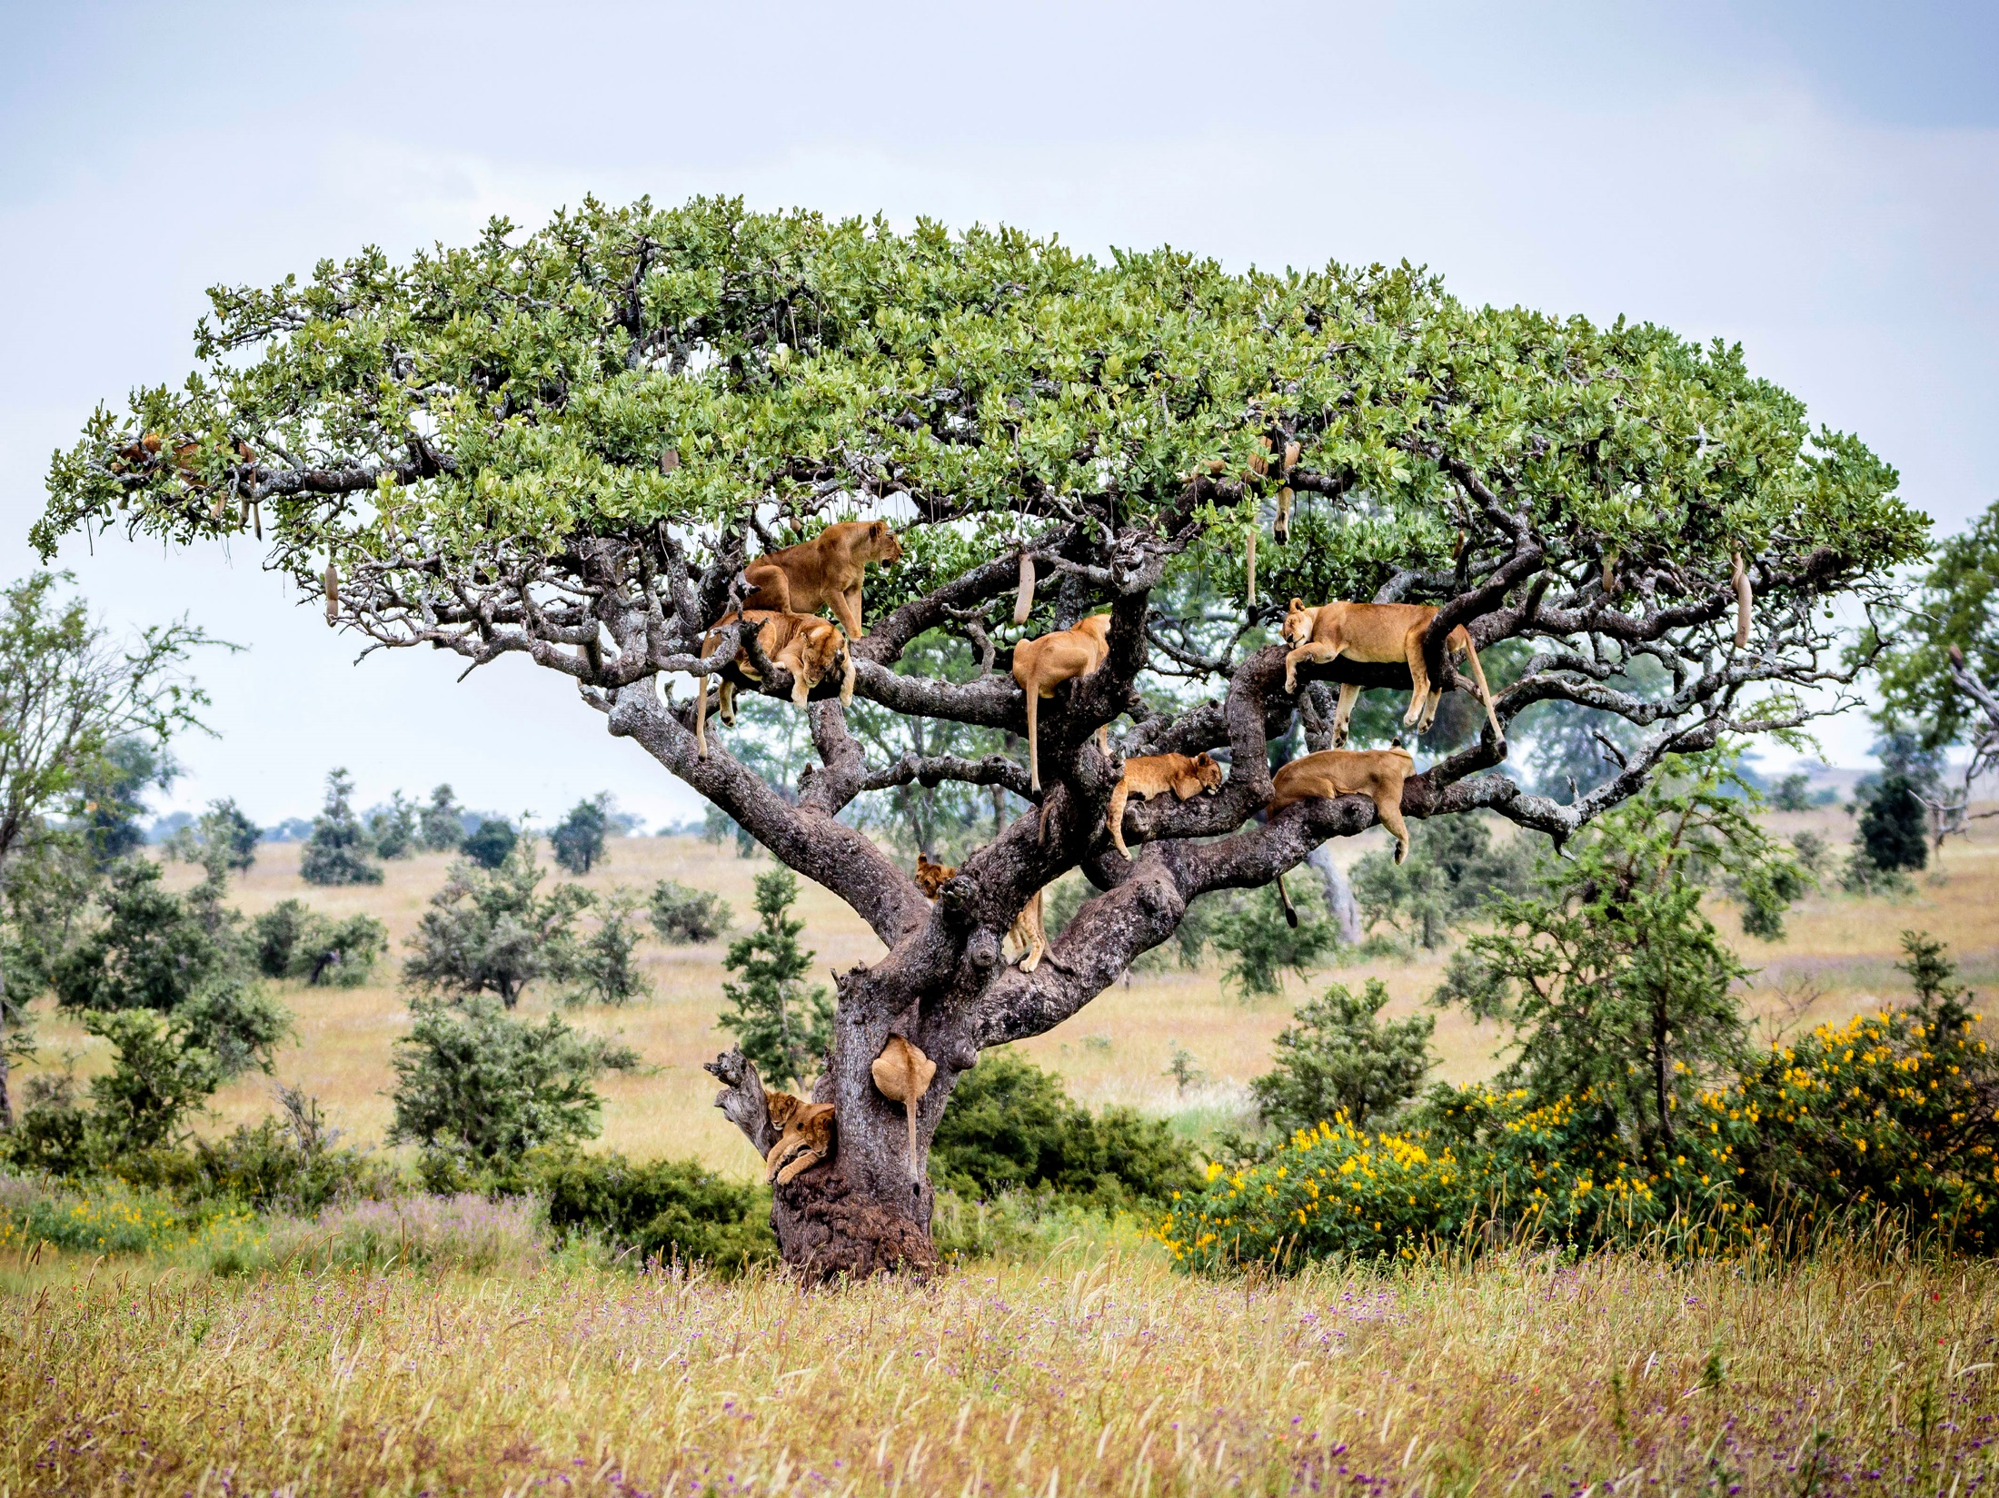
These lions needed a tree to escape the heat and flies.

Slide 15
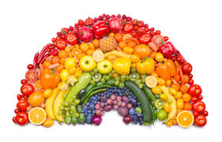
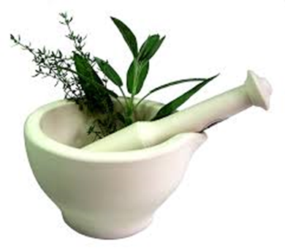
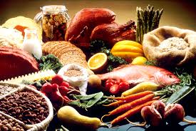
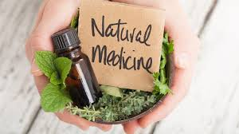
Humans depend on plants for medicine.
Humans depend on plants and animals for food.
Imagine if we didn’t have biodiversity and variety and there was only broccoli to eat…

Slide 16
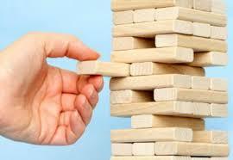
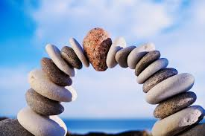
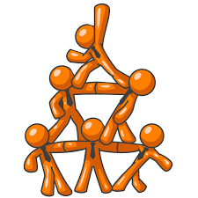
Ecosystems and interdependence

Slide 17
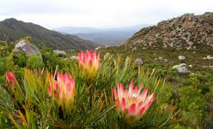
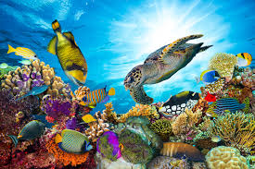
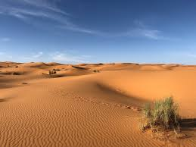
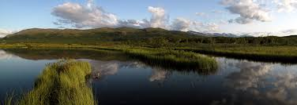
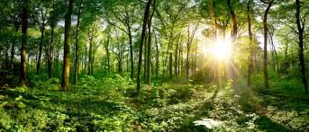
Humans, plants and animals are dependent on entire ecosystems. Just like species have variety, so to do ecosystems - there are many different types.
Aquatic (water)
Terrestrial (land)

Slide 18

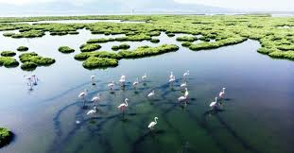
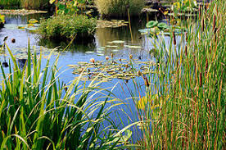
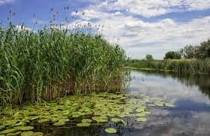
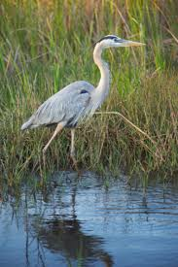
Wetlands are unique areas that are covered with water all year round or part of the year.

Slide 19
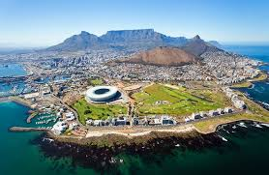
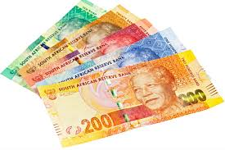
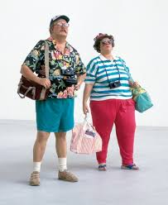
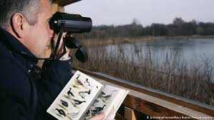
Wetlands attract tourists and in turn provide jobs
=

Slide 20
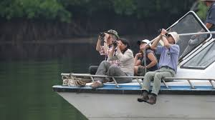
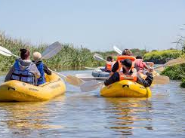


Wetlands provide space for recreation

Slide 21





Wetlands protect and provide a home for plants and animals…
…they provide protection for juvenile (young) fish

Slide 22

Wetlands provide food and water for livestock…
…and protect against erosion.

Slide 23

Putting the pieces together

Slide 24

Bottom line ... We need biodiversity for EVERYTHING

Slide 25

Everything is dependent on everything else. If one part of the web collapses….. the rest does too.
No plants = no animals = no food
No bees = no pollination = no plants
No wetlands = no tourists = no money

Slide 26



What can you do to protect our biodiversity?
Educate others
Get involved in protecting our environment
Can you think of anything else?

Slide 27

Biodiversity RAP song
Biodiversity is really cool!
We learned about it today in school.
The ecosystem – that's where it's at.
And where organisms live, that's their habitat.
Now to have an ecosystem that is so fine,
you gotta have variety down the line.
You need lots of animals. And plants, too.
Usually more is better than just a few.
To keep biodiversity in days to come,
we can't keep the animals on the run.
But if I do my part and you do yours,
we can ALL protect the great outdoors.
Swamps and wetlands and tall cool forests,
can use our help, and I'm all for it.
Cause if habitats are there for lots of critters,
they'll be there for me, and that's all the better.
So now that you've heard my diversity song,
I hope on the next round that you'll sing along.
So teach it to others, and our feet we'll all tap,
as EVERYONE does the Biodiversity Rap.

Slide 28
Edward Adonis
Cell: 078 498 6691
Email: eadonis@capenature.co.za

