Slide 1

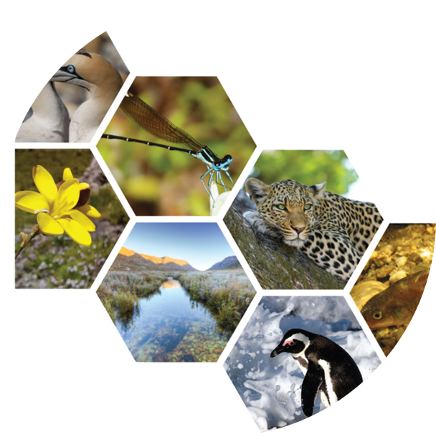


Department of Environmental Affairs and Development Planning
Western Cape Biodiversity Act
Development of Regulations
Venue: Virtual
Date: 13th September 2023
Time: 6pm to 7pm
Marlene Laros and Coral Birss
03 May 2023

Slide 2
Agenda
Welcome
WCBA & the process of drafting regulations
Stakeholder Feedback

Slide 3
Western Cape Biodiversity Act
Developing regulations to implement the Western Cape Biodiversity Act, 6 of 2021
The Western Cape Biodiversity Act was signed into law in 2021. It marks a key milestone in the rationalisation and modernisation of the regulatory framework for biodiversity governance in the Western Cape Province and supports alignment with national and international policy and strategic frameworks.
On 15 November 2022 several chapters and sections of the Western Cape Biodiversity Act came into operation, including the critical governance, planning and reporting sections.
The next phase is to the enable key conservation and sustainable use of biodiversity through the development of appropriate regulation.
Once promulgated by the Provincial Minister, this will repeal and replace the Nature Conservation Ordinance and its regulations.
Notes:
(Information consistent with information on the website and in the media) to introduce the requirement for regulations to give effect to and bring into operation certain sections of the Western Cape Biodiversity Act – which will ultimately result in the repeal of the Nature Conservation Ordinance.
National Legislations referred to – e.g NEMA, NEMBA, NEMPAA
International policies and strategic frameworks eg CITES, Convention on Biological Diversity

Slide 4
Process of Drafting Regulations
Through a series of stakeholder engagements, CapeNature and the Department of Environmental Affairs and Development Planning invite your participation:
To provide inputs;
To raise concerns;
To voice expectations, and
To engage with CapeNature
on the development of regulations, primarily focused on giving effect to and bringing into operation Sections 49 to 76 of the Act. These sections largely relate to plant and animal species in need of protection, or which pose a threat to the environment and related activities.
Why are you here?
Input on drafting regulations
Raise concerns
Notes:
Why are you here?
Input on drafting regulations
Raise concerns
Provide direction to CapeNature

Slide 5

Background
The Western Cape Nature Conservation Board is established as a juristic entity in terms of the Western Cape Biodiversity Act, 6 of 2021
CapeNature is governed by this Board, which is CapeNature's accounting authority
One of CapeNature's primary functions is the management of nature conservation, not only within protected areas but within the entire Western Cape Province
CapeNature and its staff carry out the day-to-day operation of nature conservation in the Western Cape Province
The Nature Conservation Ordinance, and its regulations, is essentially the enabling legislation creating the legal framework, processes and structures necessary to carry out the above-mentioned nature conservation functions
The Nature Conservation Ordinance prescribes the law relating to the protection and sustainable utilization of, amongst other aspects of biodiversity, wild flora and fauna

Slide 6
Background
The Nature Conservation Ordinance contains schedules of endangered and protected indigenous animals and plants and provides certain legal protections for the scheduled species to assist conservation officials in the protection of biodiversity
The Nature Conservation Ordinance also deals with professional hunting and non-indigenous species and sets out a system of permitting for certain activities
The Nature Conservation Ordinance also designates the powers of conservation officials and provides for the appointment of officers
Until such time as new regulations necessary to supplement the Western Cape Biodiversity Act, 2021, are finalized, which is the stakeholder process we are busy with right now, the relevant administrative and law enforcement provisions are still dealt with by the current Nature Conservation Ordinance (1974) and regulations (1975)
Once the Western Cape Biodiversity Act, 2021, and its regulations are fully put into operation the Nature Conservation Ordinance (and its regulations) and will be entirely repealed
Naturally, before we can repeal the current Ordinance and regulations, we need to have new regulations in place. And that is why we are all here

Slide 7
The new Regulations and the blank slate, multiphase approach
Regulations (i.e. subordinate or secondary legislation) are made by the Provincial Minister in terms of section 81 of the Western Cape Biodiversity Act (i.e. the original legislation)
Ordinarily, and generally, during the drafting of regulations, a draft set of regulations is written inhouse (i.e. by CapeNature and DEA&DP), and then formally published for comment and stakeholder consultation (i.e. a single phase)
A publication (in the Gazette and newspapers) and consultative process in terms of section 84 of the Act is followed
To ensure greater inclusivity and engagement with ALL stakeholders to identify and address ALL issues, that a draft set of regulations should address, CapeNature and Department of Environmental Affairs and Development Planning are taking a tabula rasa (blank / clean slate) approach to drafting the regulations
We are literally starting with an empty page which you, the stakeholders, will help populate, which will ultimately form a set of draft Regulations for formal publication

Slide 8
The new Regulations and the blank slate, multiphase approach
We have chosen a multiphase approach to engage with stakeholders on the drafting of the regulations from the outset and before the draft regulations enter the formal publication and consultation phase, as highlighted above
The first phase is a series of stakeholder engagements facilitated by CapeNature and the Department of Environmental Affairs and Development Planning to gauge what it is that stakeholders in the Western Cape want from a set of biodiversity regulations (and what they don’t want) as they relate to certain sections of the Act relating primarily to matters regarding animals, plants and permits
Once feedback from this first round / phase of stakeholder engagements have been captured, a formal / official draft set of regulations will be written in terms of section 81 and published in terms of section 84 of the Act, as mentioned above, for formal comment and consultation and further focused rounds of stakeholder engagements will be held as part of this formal consultative process (second phase)
It is envisaged that the final regulations will be promulgated towards the end of 2024 (final phase) and further sections (mainly sections 47 – 76) of the Act will then (also) come into operation
It is envisaged that the Western Cape Biodiversity Act and its implementation through these regulations will enable a transformed biodiversity economy focusing on enabling access to critical resources in an equitable and sustainable manner

Slide 9
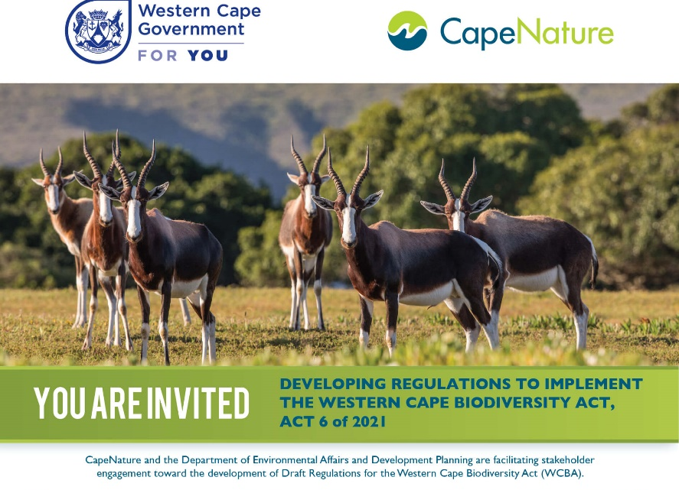
Stakeholder Engagements, Round One
Notes:
Further engagements – based on expression of interest, could be considered

Slide 10
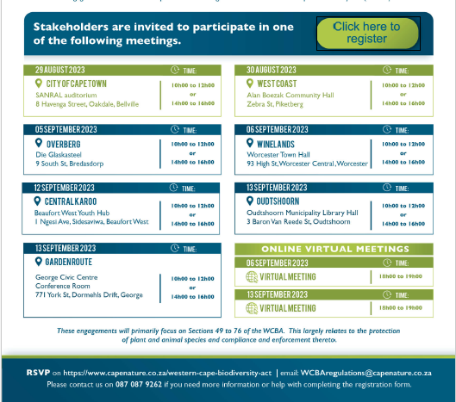
Stakeholder Engagements Round One

Slide 11
The new Regulations, what is expected?
These regulations should ultimately reflect what YOU want and how they impact on YOU/YOUR industry/sector
This is NOT a rewrite / redo / rehash of the old / current regulations (Provincial Notice 955 / 1975)
We welcome all questions and concerns
Identify what works for YOU
Identify what doesn’t work for YOU
What can CapeNature do better / more of / less of for YOU and YOUR sector
What species need more protection (regulation)
Identify areas of / for self-administration (i.e., less permits and red-tape reduction)
Comments / questions / concerns can be raised during any of the live stakeholder sessions, and can be submitted online or via email to: WCBAregulations@capenature.co.za
At the end of these stakeholder engagements, all input acquired will be analyzed and used to inform the draft a set of regulations that will eventually be published for public comments and consultation
YOU WILL HAVE ANOTHER OPPORTUNITY TO COMMENT ON THE DRAFT REGULATIONS BEFORE THEY COME INTO OPERATION
Notes:
These are YOUR regulations and will ultimately reflect what YOU want and how they impact on YOU/YOUR industry
This is NOT a rewrite / redo / rehash of the old / current regulations (955 / 1975)
During the stakeholder engagements, all questions and issues are welcomed (there are no silly or irrelevant questions or issues)
During the stakeholder engagements we want to identify what works for YOU (so that we can incorporate them into the regulations)
Identify what doesn’t work for YOU (so that they don’t end up in the regulations)
What can CapeNature do better / more of / less of for YOU and YOUR industry
What species need more protection (regulation)
Identify areas of / for self-administration (i.e. less permits and red-tape reduction)
Comments / questions / issues can be raised during any of the live stakeholder sessions, are can be submitted online or via email to: WCBAregulations@capenature.co.za
At the end of this current round / phase of stakeholder engagements, all input acquired will be analyzed and used to draft a set of regulations that will eventually be published for another round or comments and consultation
Note that YOU WILL HAVE ANOTHER OPPORTUNITY TO COMMENT ON THE DRAFT REGULATIONS BEFORE THEY COME INTO OPERATION

Slide 12
Regulations, which sections of the WC Biodiversity Act, 2021, will we be looking at for purposes of drafting these regulations?

Slide 13
Primary focus for this session of stakeholder engagements
CHAPTER 7: PROTECTION OF ECOSYSTEMS, ECOLOGICAL INFRASTRUCTURE AND SPECIES
47. Ecosystems or ecological infrastructure in need of special protection
48. Biodiversity offsets and other mitigation measures
49. Species in need of protection or posing threat to the environment
Notes:
The primary focus being on those sections which are currently dealt with by the Nature Conservation Ordinance relates to species in need of protection or posing a threat to the environment and related matters, which include activities, compliance and enforcement.
Section 47 to 76 have not yet come into effect – as they will be impacted on by the draft regulations that will give effect to Section 49.
(the drafting of regulations to give effect to sections 47 and 48 are planned for a later phase)

Slide 14
Primary focus for this session of stakeholder engagements
EXISTING PROVISION IN THE ACT
Species in need of protection or posing threat to environment
49. (1) The Provincial Minister may, by notice in the Provincial Gazette, publish a list of restricted activities or restricted methods in respect of any species or any category of species listed in terms of subsection (2).
(2) The Provincial Minister may, by notice in the Provincial Gazette, publish lists of the following species or categories of species:
(a) species which are extinct in the wild;
(b) critically endangered species;
(c) endangered species;
(d) vulnerable species;
(e) species that require protection and are not listed in terms of paragraph (a), (b), (c) or (d), including species listed—
(i) by the IUCN as Near Threatened, Data Deficient or Not Evaluated; or
(ii) in appendices I, II and III of CITES;
(f) any other indigenous species not listed in terms of paragraph (a), (b), (c), (d) or (e);
(g) extra-limital species;
(h) alien species other than extra-limital species;
(i) species that require special management measures; and
(j) domesticated species.
(3) The Provincial Minister must at least every five years review the lists contemplated in subsections (1), (2) and (7).
(4) The Provincial Minister must prescribe the special management measures required for species listed in terms of subsection (2)(i).
(5) No person may carry out a restricted activity or restricted method involving a species listed in terms of subsection (2), unless authorised to do so in terms of section 51(1)(a).
(6) Subsection (5) does not apply to a listed species conveyed from outside the Province in transit through the Province to a destination outside the Province, provided that the transit through the Province takes place in terms of an applicable authorization in terms of any law.
(7) The Provincial Minister may, by notice in the Provincial Gazette, publish—
(a) a list of species; and
(b) the list of restricted activities or restricted methods contemplated in subsection (1) involving a species contemplated in paragraph (a), in respect of which an authorisation may not be issued in terms of this Act.
(8) No person may carry out a restricted activity or restricted method involving a species listed in terms of subsection (7).
Notes:
Note the provision of the act – to guide the drafting of regulations.

Slide 15
Secondary focus for this session of stakeholder engagements
CHAPTER 8: AUTHORISATION
50. Application for authorisation
51. Decision on application for authorisation
52. Risk assessments and expert evidence
53. Proof of legal possession
54. Integrated authorisation
55. Review, suspension, withdrawal and amendment of authorisation
CHAPTER 9: COMPLIANCE AND ENFORCEMENT
Part 1 Compliance and enforcement officials and judicial matters
56. Designation of nature conservation officers, nature conservation rangers and honorary nature conservation officers
57. Declaration of nature conservation officers and nature conservation rangers as peace officers
58. Mandate of nature conservation officers and nature conservation rangers
59. Honorary nature conservation officers
60. Functions of nature conservation officers and nature conservation rangers
61. Identity card and letter of designation
62. General powers of nature conservation officers and nature conservation rangers
63. Routine inspections
64. Warrants
65. Powers to stop, enter and search vehicles, vessels, aircraft and other conveyance
66. Duty to produce documents
67. Treatment of seized specimen or item
68. Security for release of vehicles, vessels, aircraft or other conveyance
Part 2 Administrative enforcement mechanisms and penalties
69. Administrative enforcement
70. Failure to comply with directive
71. Administrative penalties
CHAPTER 10: OFFENCES AND PENALTIES
72. Offences
73. Penalties
74. Cancellation of authorisations
75. Award of costs
76. Forfeiture
Notes:
Section 47 to 76 have not yet come into effect (come into operation) – as they will be impacted on by the draft regulations that will give effect to Section 49.

Slide 16
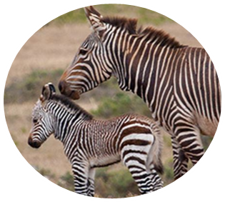
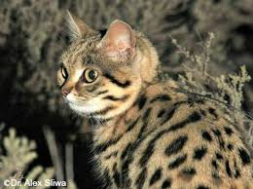
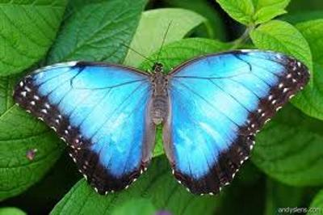
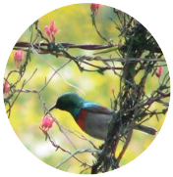
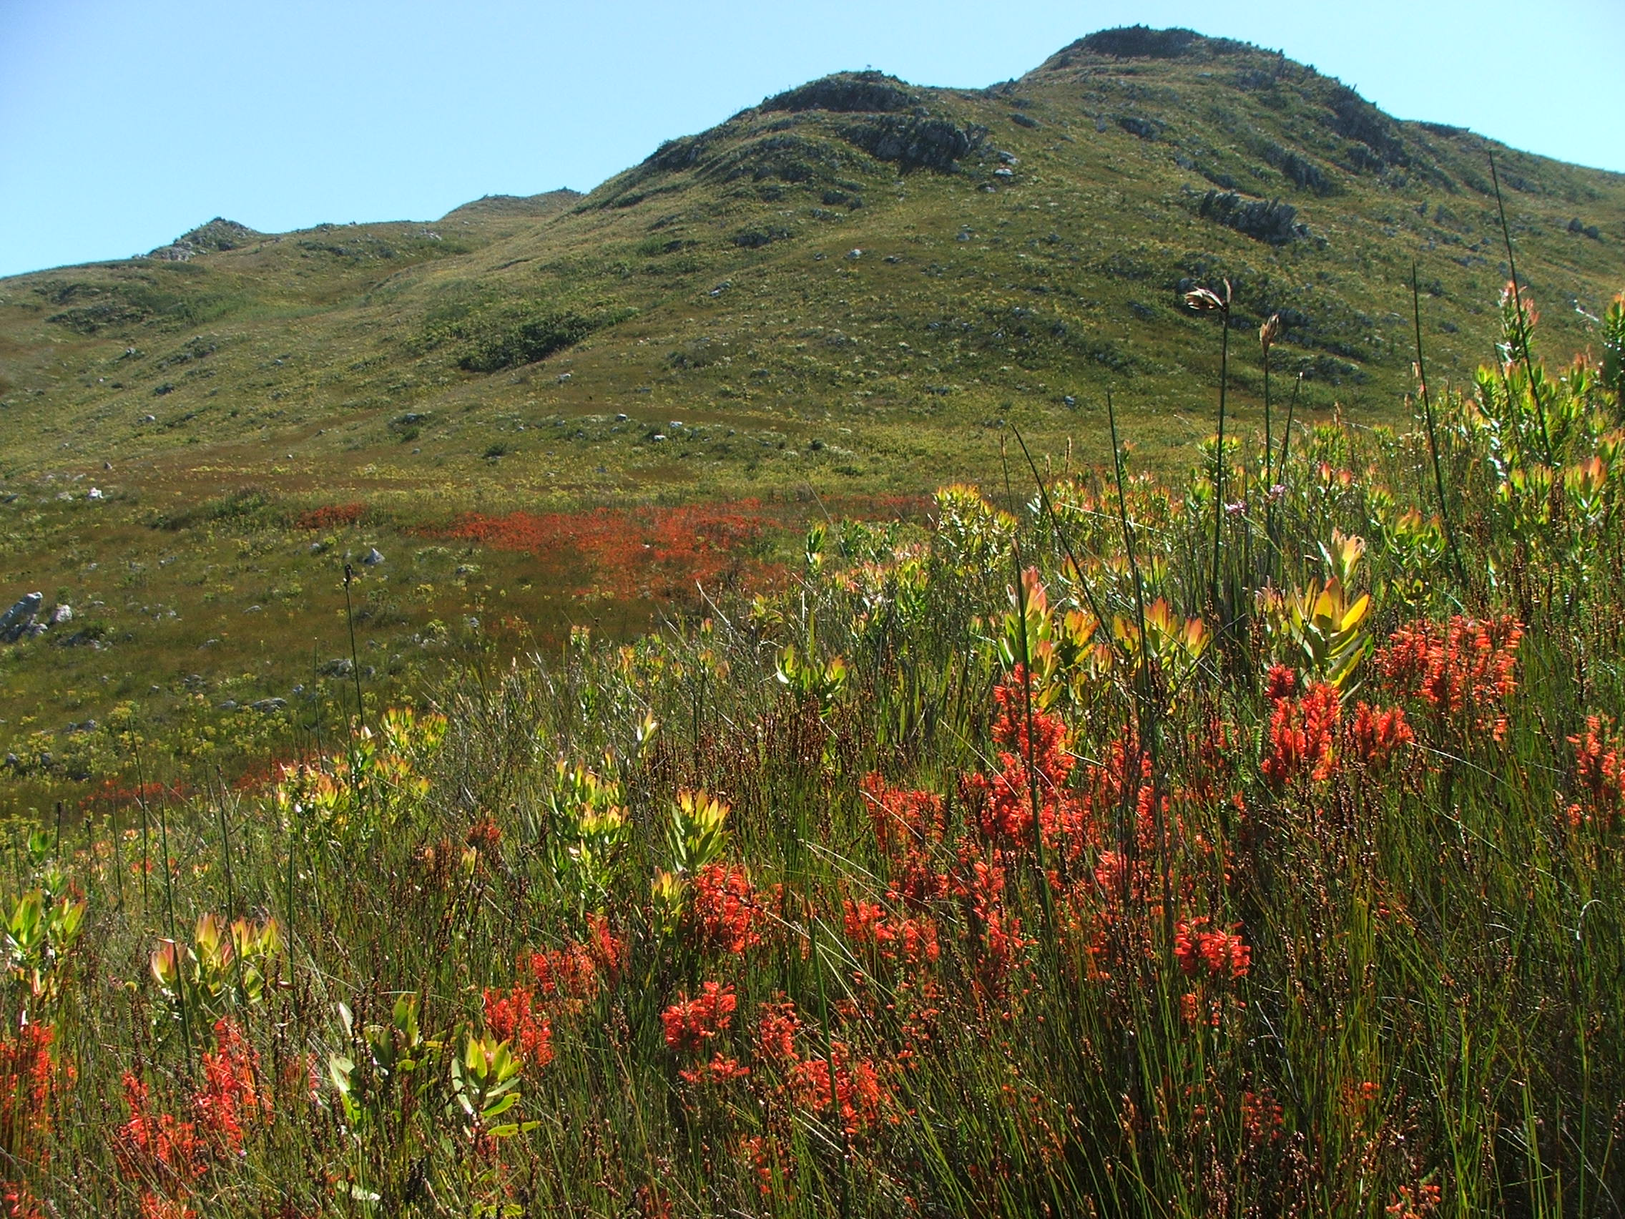
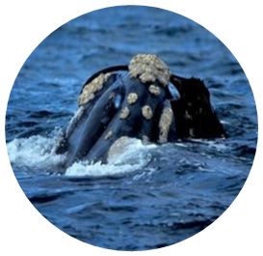
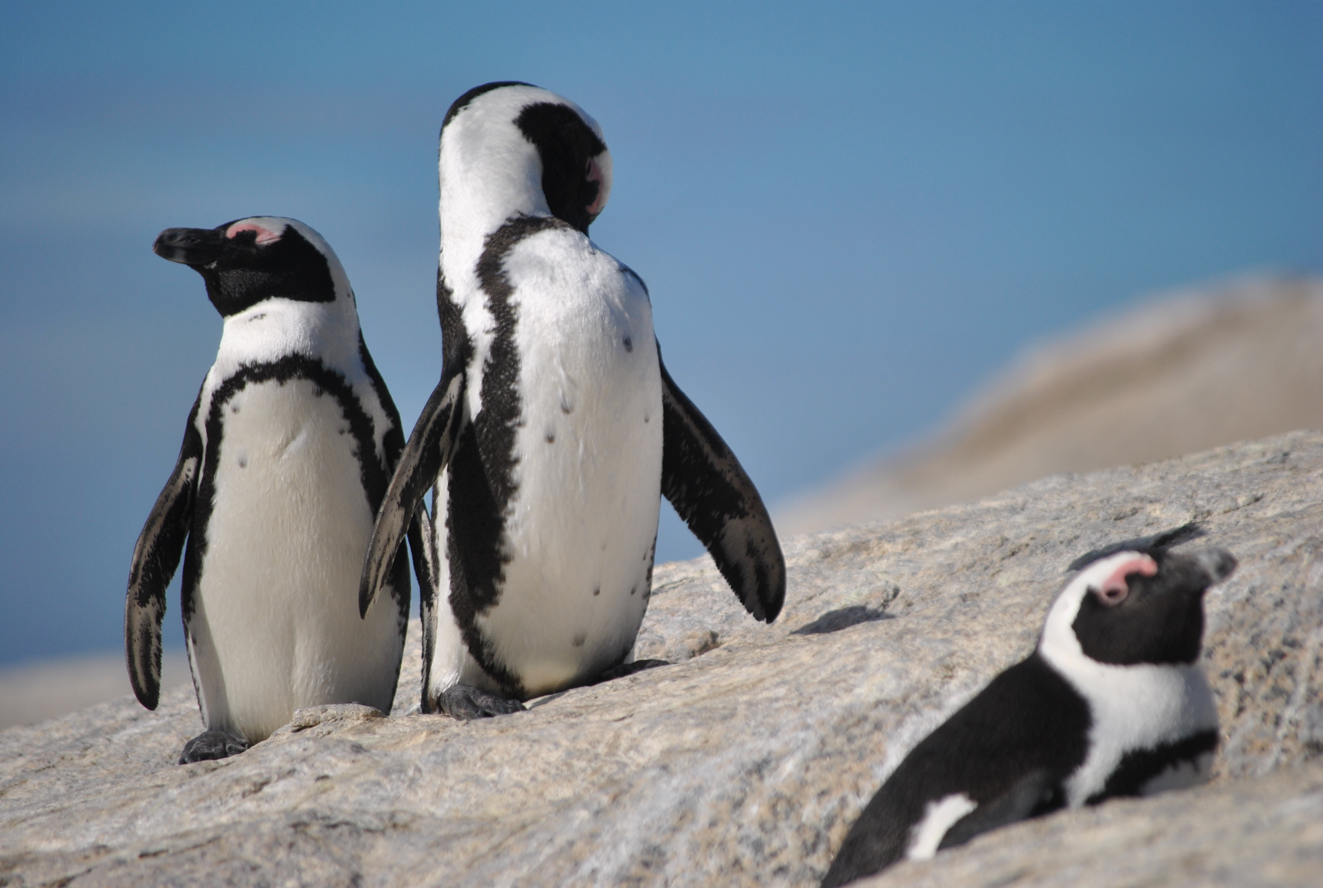
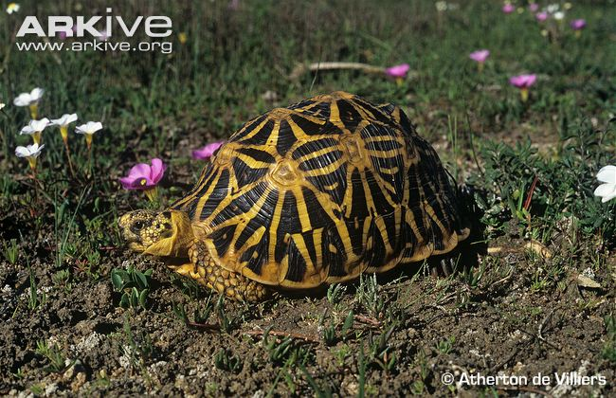
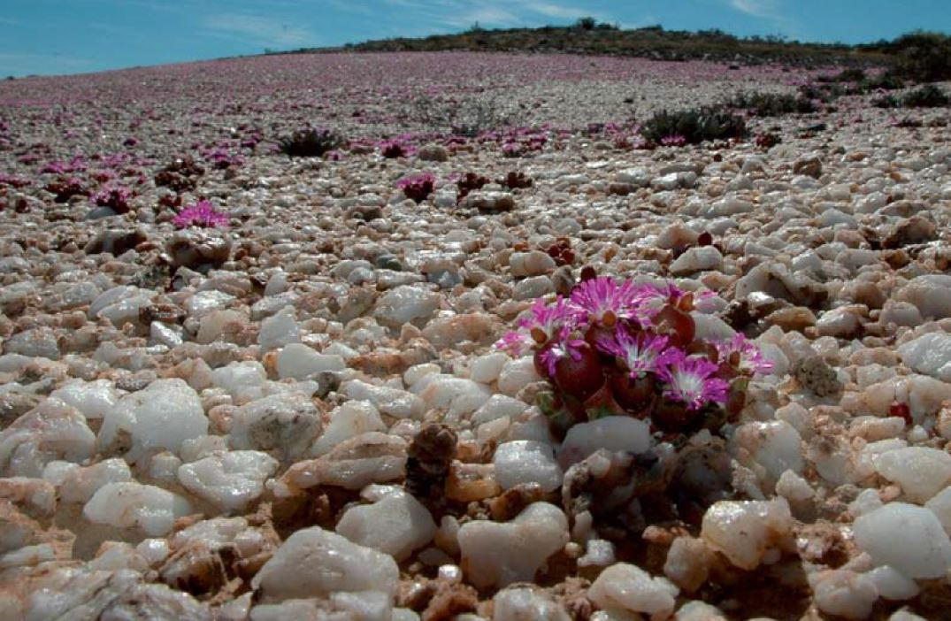
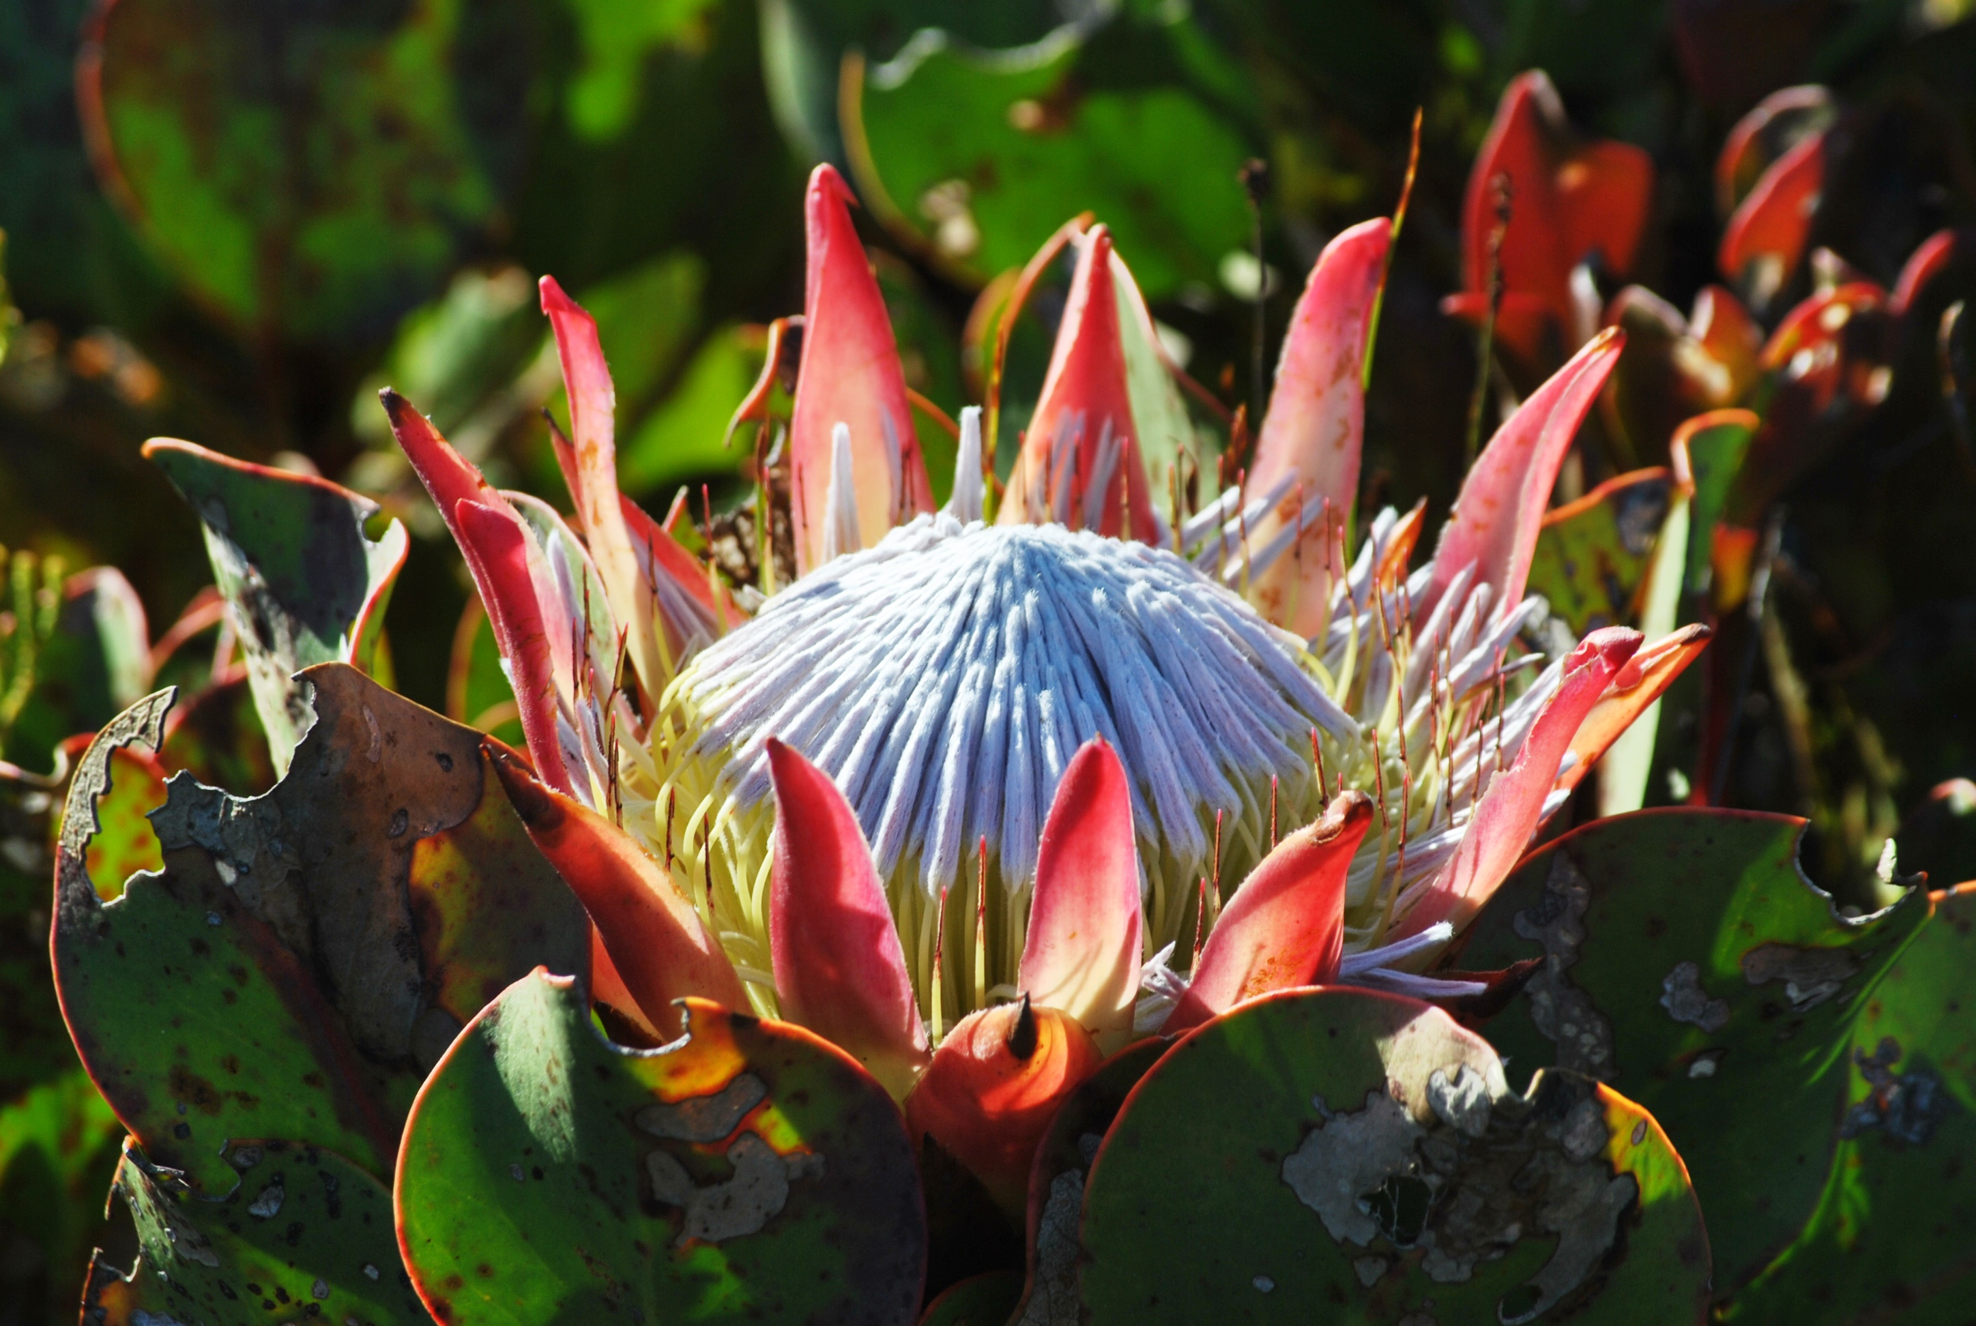
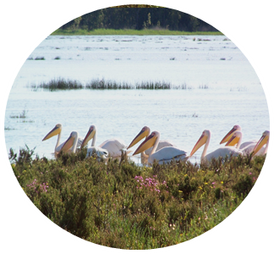
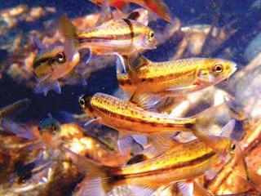
Primary focus, let’s talk about species (Species in need of protection or posing threat to environment)

Slide 17
Primary focus for this session of stakeholder engagements
The regulation of what species do you feel can be less restrictive?
The regulation for what species do you feel should be more restrictive?
What permitted activities do you feel should be lessened
or even exempted?
Do you feel there is room in your industry to be more
self-regulated?

Slide 18
For queries & feedback:
wcbaregulations@capenature.co.za

