Slide 1


Worms on a mission
11 June – ages 8 – 12
14h00 Session
Natasja warnick
Stakeholder Engagement Officer

Slide 2
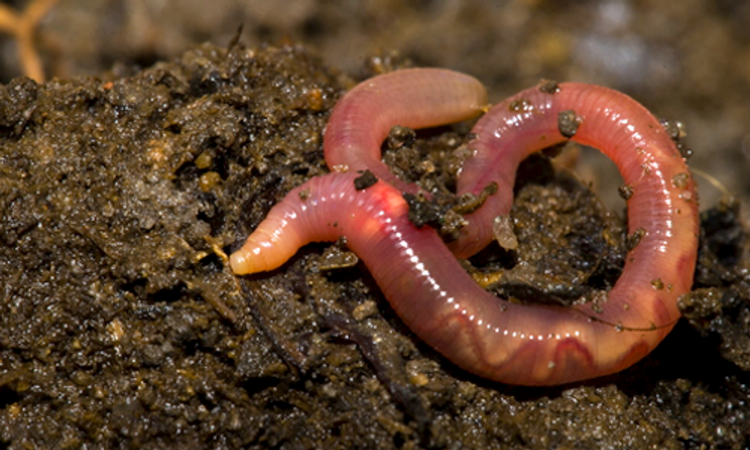
Introduction

Slide 3
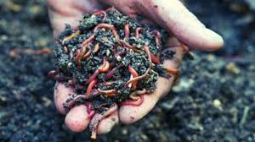
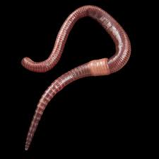
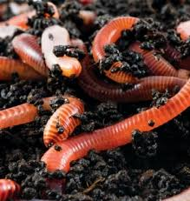
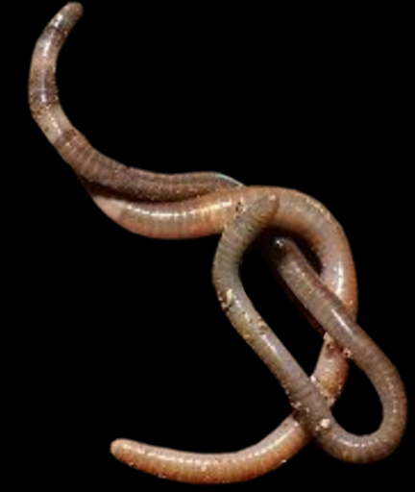
How much do you know about earthworms?
Earthworms move by…
Earthworms breathes through…
Earthworms like…
Earthworms eat…

Slide 4
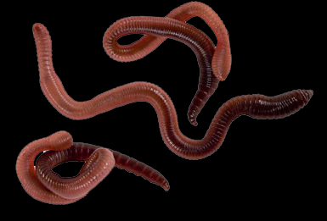
All about earthworms

Slide 5
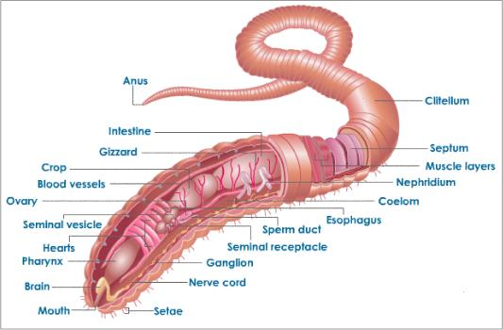
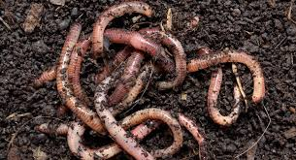
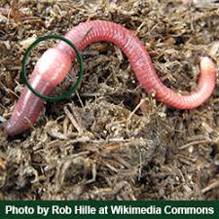
Anatomy of the earthworm
Worms are invertebrates: they do not have a backbone. They wiggle, crawl and slide.
Earthworms have no eyes or ears. They breathe through their skin.
They like dark, moist places.
Clitellum (stores eggs)

Slide 6
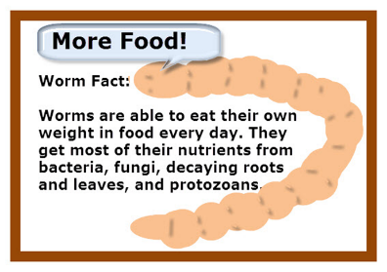

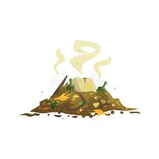
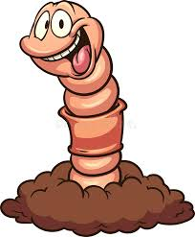
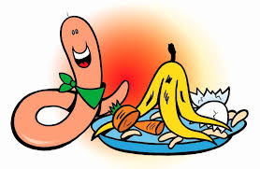
What worms eat

Slide 7
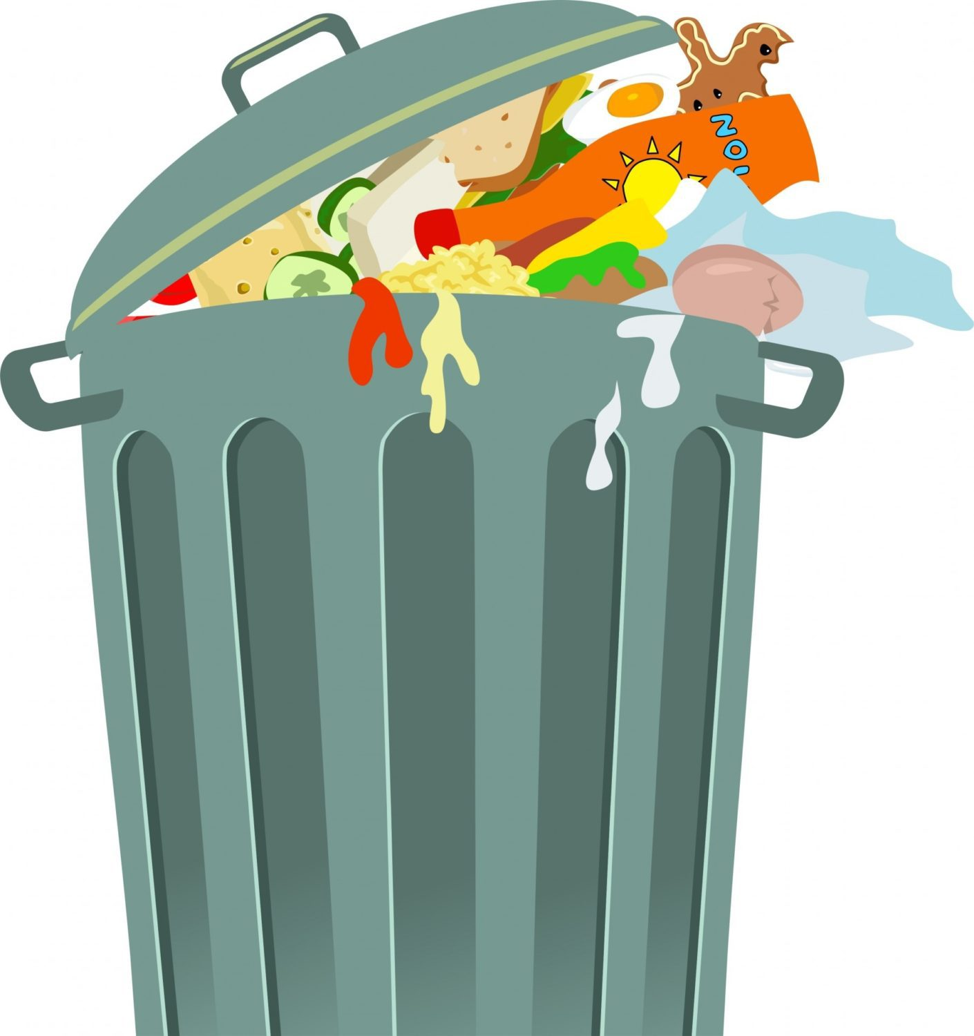
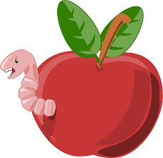
EARTHWorms loves our waste.
AN APPLE AWAY KEEPS THE WORM OK.

Slide 8
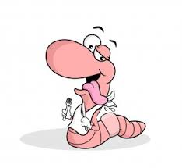


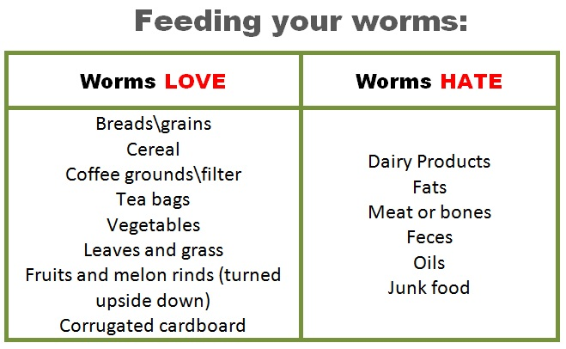
What do worms like to eat and what not?

Slide 9
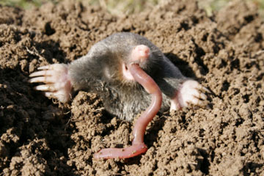
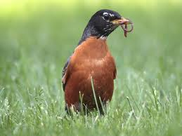
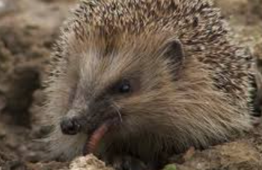
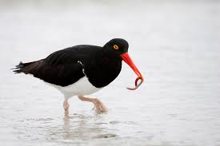
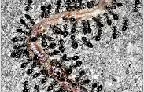
Worms as food
Who eats the earth worm?
Earthworms have to hide from plenty of natural predators during their lives.
Birds, moles, foxes, hedgehogs, turtles, slugs, beetles, snakes and leeches, are all happy to feed on them.

Slide 10
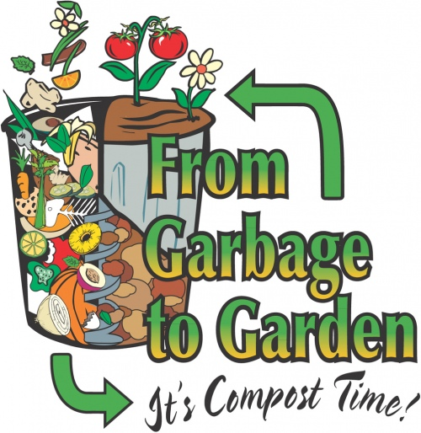
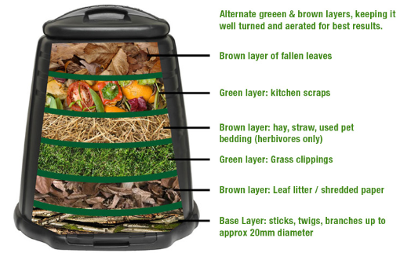
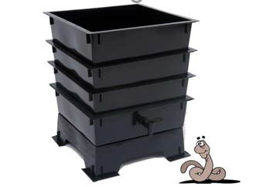
What is a worm farm?
Composting with worms is also called vermicomposting. Vermi means worm in Latin.
Vermicomposting helps reduce the amount of waste going to the landfills.
Vermicomposting can be done inside or outside; it is odourless (no smell) if done correctly.

Slide 11
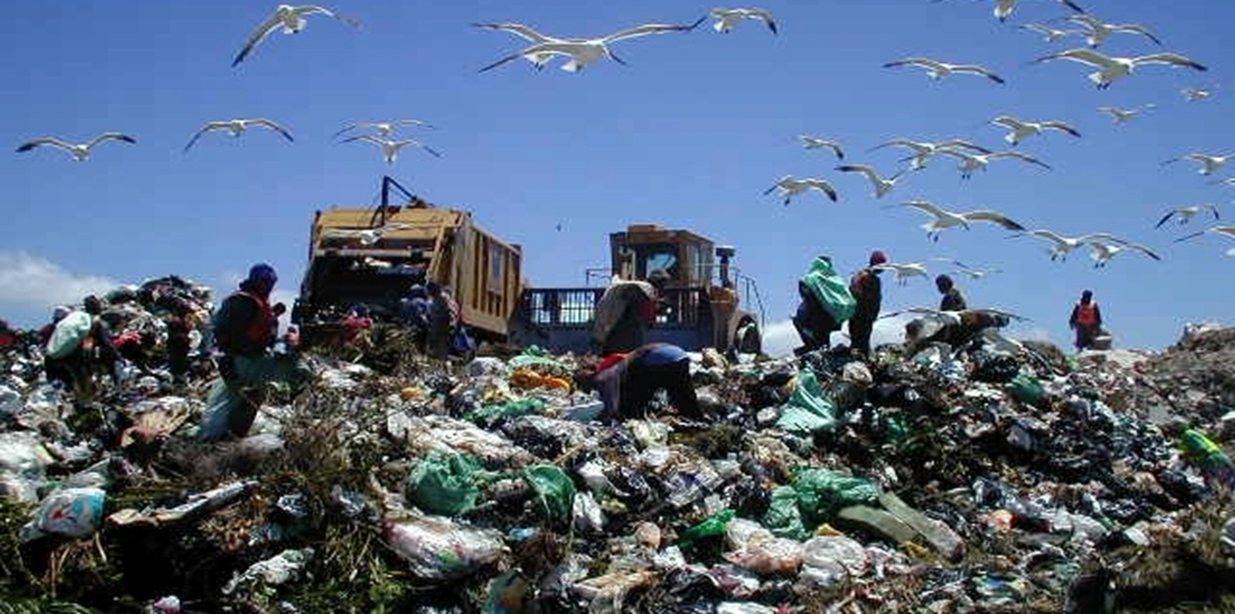
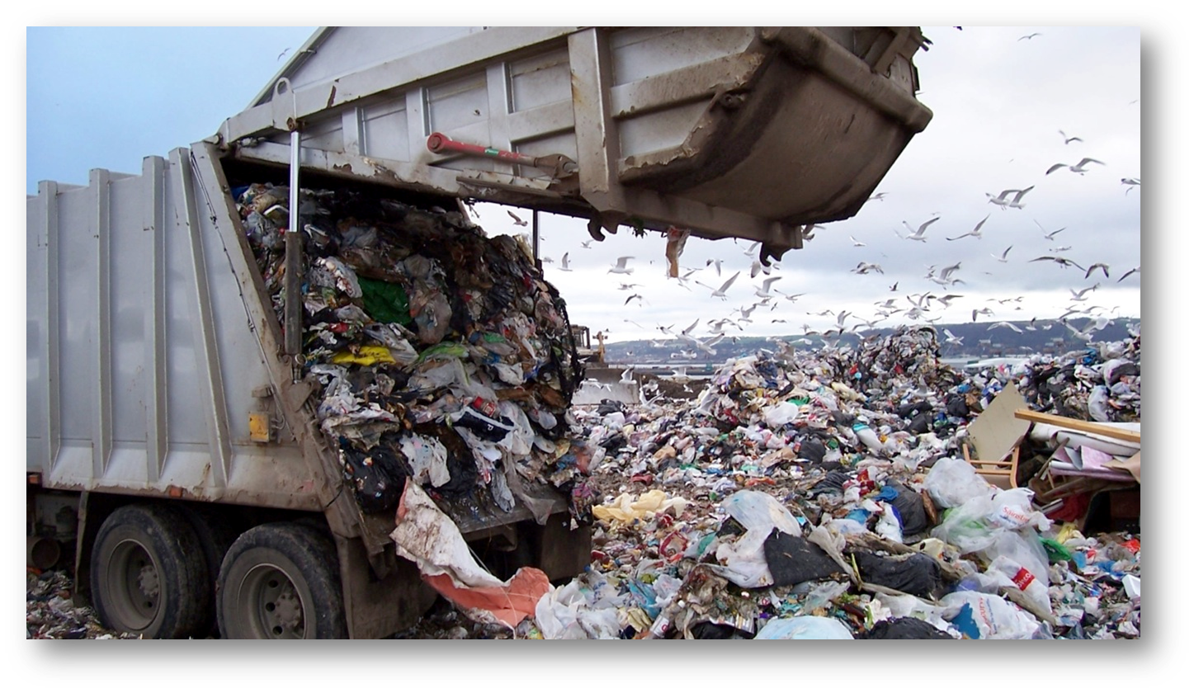
What happens to our rubbish?
Landfill sites facts
  A big hole in the ground where garbage is buried.
  Trash is crushed to make space for more trash.
  Garbage in landfills stays there for a very long time.
  When food is composted, it breaks down much faster and recycles itself into new life.

Slide 12
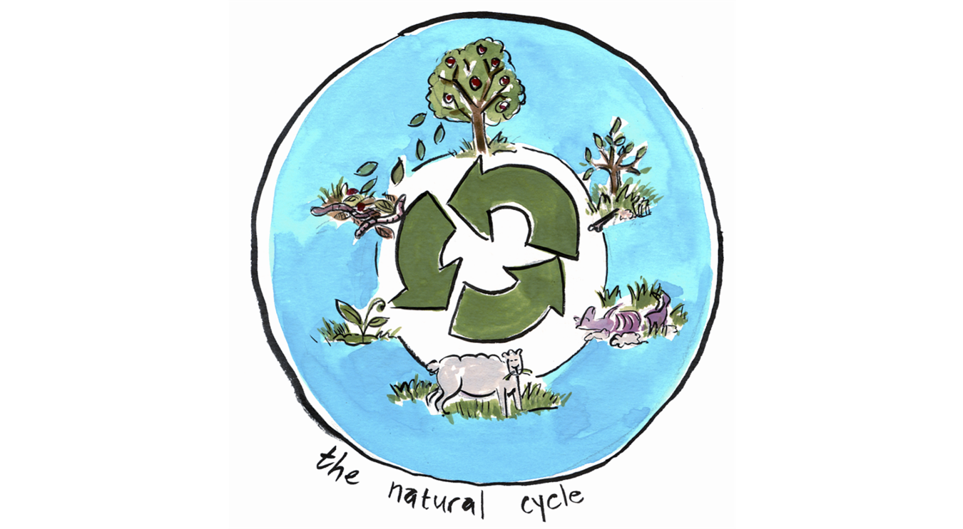
Nature knows no waste.
What is a worm farm?
Vermicomposting:
Composting with worms is also called Vermicomposting. Vermi means worm in Latin.
Vermicomposting helps reduce the amount of waste going to the landfills.
Vermicomposting can be done inside or outside; it is odourless if done correctly

Slide 13

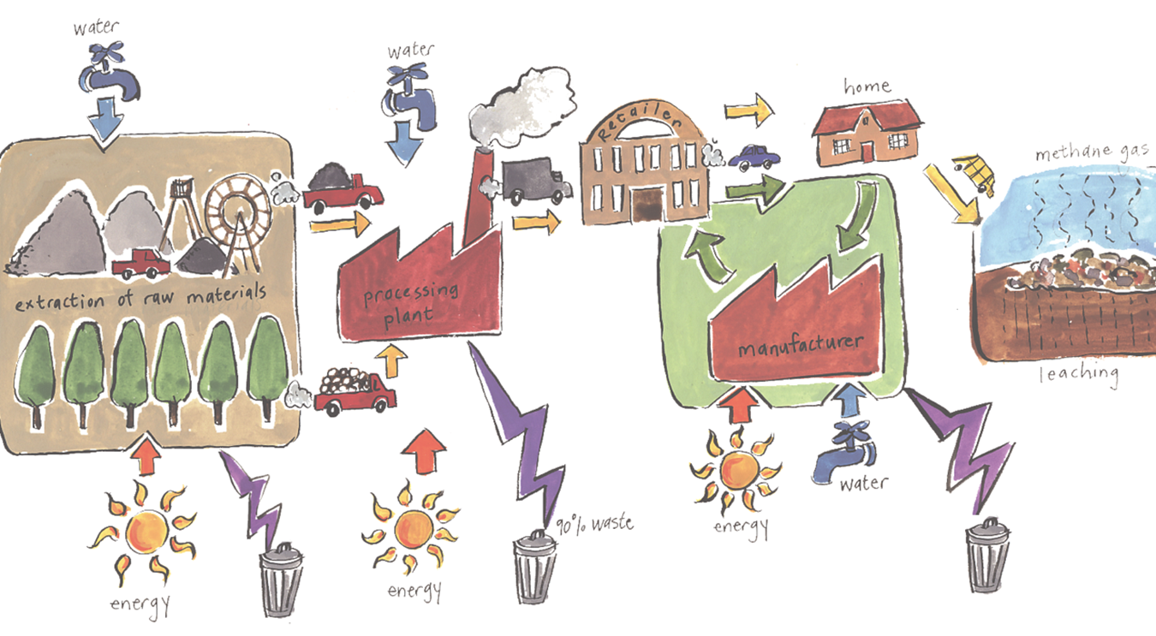
90% of the things we use become waste.
What is a worm farm?
Vermicomposting:
Composting with worms is also called Vermicomposting. Vermi means worm in Latin.
Vermicomposting helps reduce the amount of waste going to the landfills.
Vermicomposting can be done inside or outside; it is odourless if done correctly

Slide 14
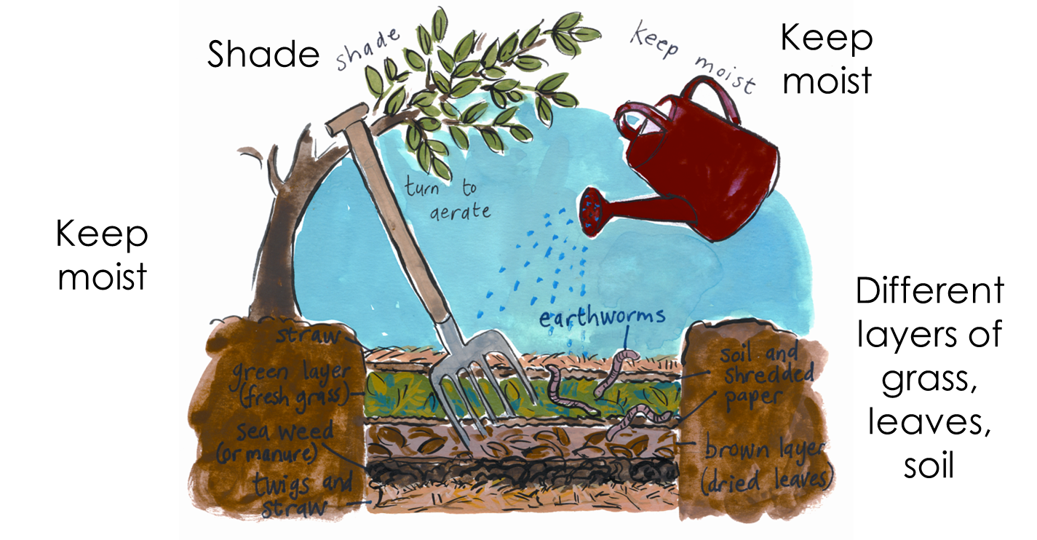
Let’s put our waste to better use

Slide 15
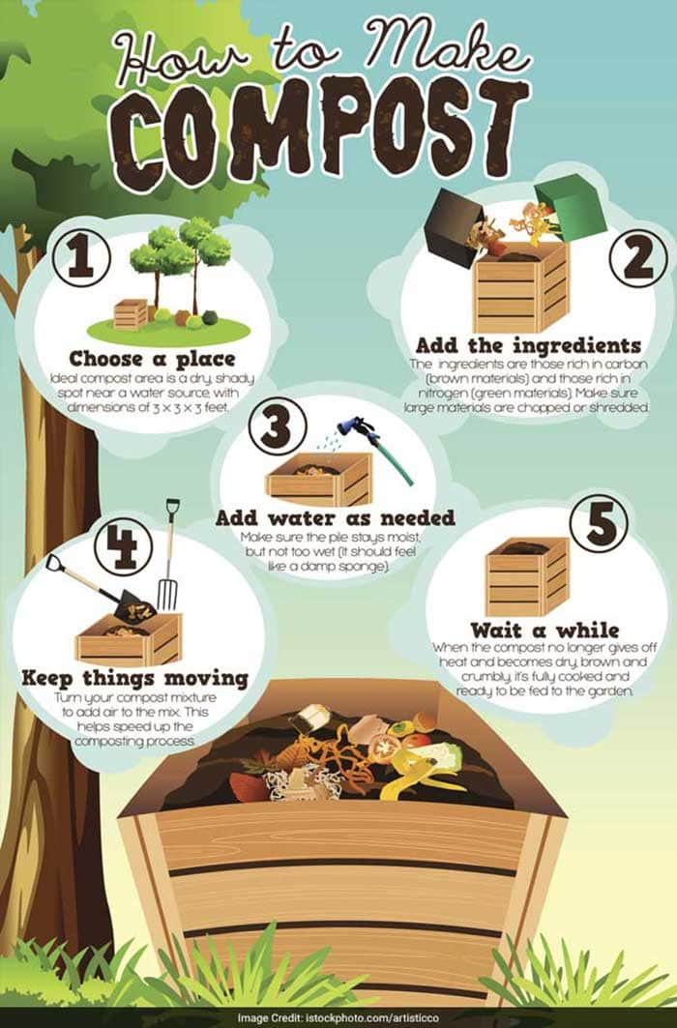
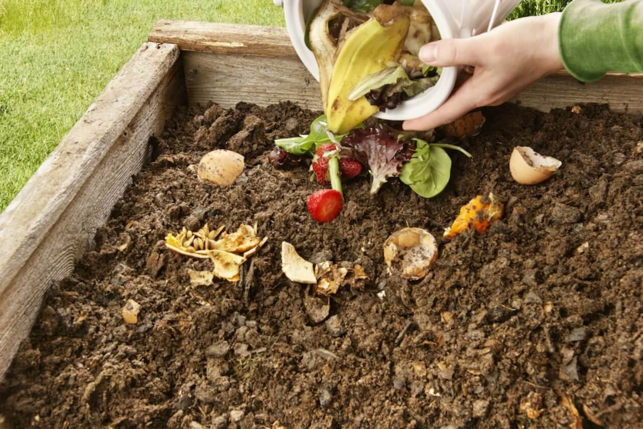
Steps to make compost:
What is a worm farm?
  Identify a place
  Add waste
  Add just enough water
  Keeps things moving
  Be patient
Vermicomposting:
Follow these easy steps
Composting with worms is also called Vermicomposting. Vermi means worm in Latin.
Vermicomposting helps reduce the amount of waste going to the landfills.
Vermicomposting can be done inside or outside; it is odourless if done correctly

Slide 16
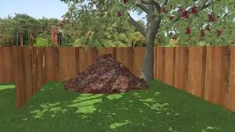
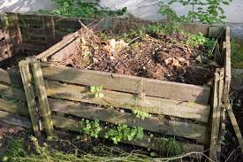
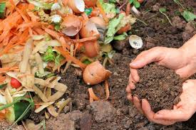
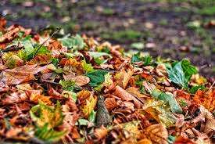
Step 1: Choose a place
What is a worm farm?
  Shady & dry.
Vermicomposting:
Step 2: Add waste
  Brown material & green material.

Slide 17
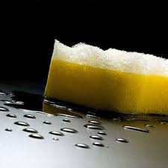
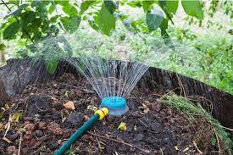
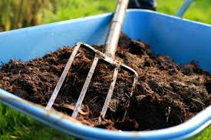
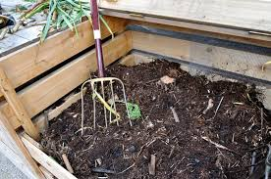
Step 3: Add water as needed
What is a worm farm?
  Moist, but not too wet, like a sponge.
Vermicomposting:
Step 4: Keep things moving
  Turn to add to the mix.

Slide 18

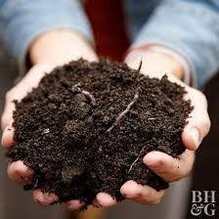
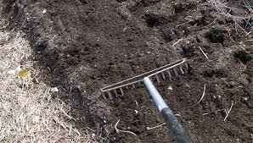
Step 4: Be patient
What is a worm farm?
Vermicomposting:
  No heat & dry and brown = ready to use in your garden.

Slide 19
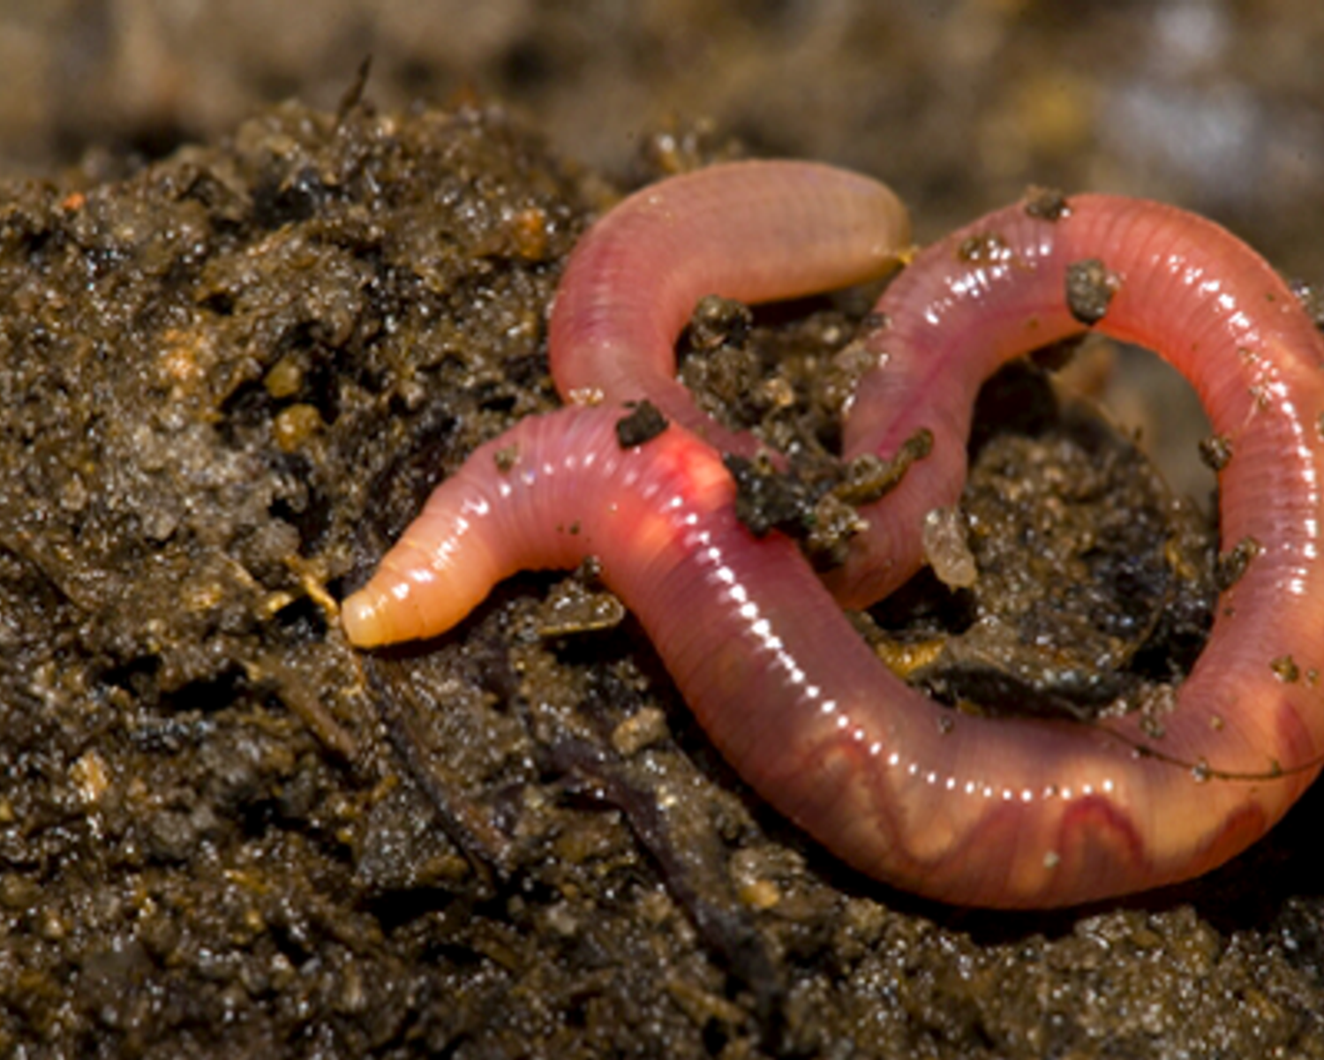
Earthworms are good

Slide 20

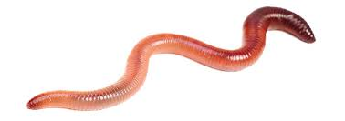

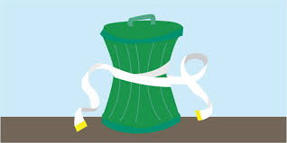
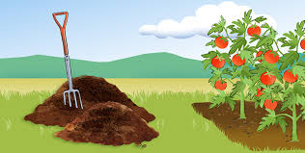
  Earthworms are good for our environment.
  Earthworms helps to reduce waste.
  Earthworms help to make compost for our plants to grow.
Vermicomposting:
Follow these easy steps

Slide 21
